Slide 1





GI Pedagogy
Innovative Pedagogies for Teaching with Geoinformation
Michaela Lindner-Fally
Secondary Geography,
BORG Oberndorf, AT
EUROGEO researcher
lindner.michaela@borgoberndorf.at
Sophie Wilson
Senior Lecturer Secondary Geography,
Institute of Education,St Mary’s University,
Twickenham, London. TW1 4SX.
sophie.wilson@stmarys.ac.uk

Slide 2
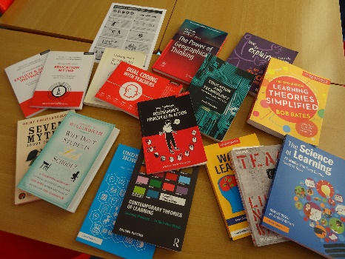
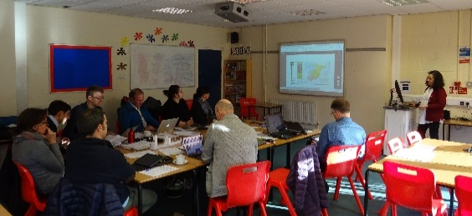
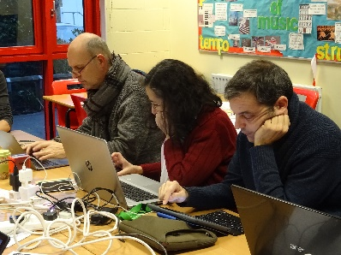
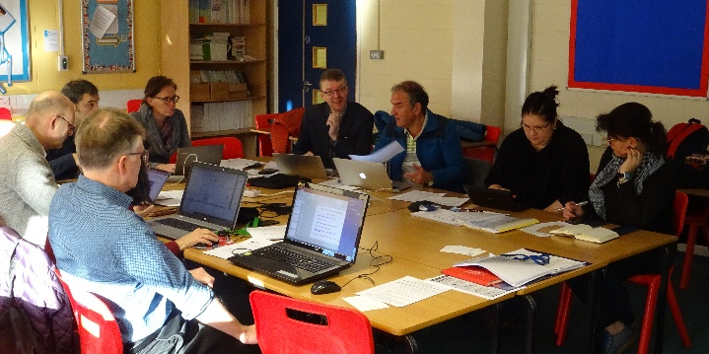
Contents
About the project
Innovative Pedagogical Model for Teaching with GIS
Toolkit of innovative pedagogical approaches to teaching with GIS
Teacher training course with innovative pedagogical approaches to teaching with GIS
Case studies and digital exhibition of outcomes and findings
Further discussion
Notes:
Michaela

Slide 3
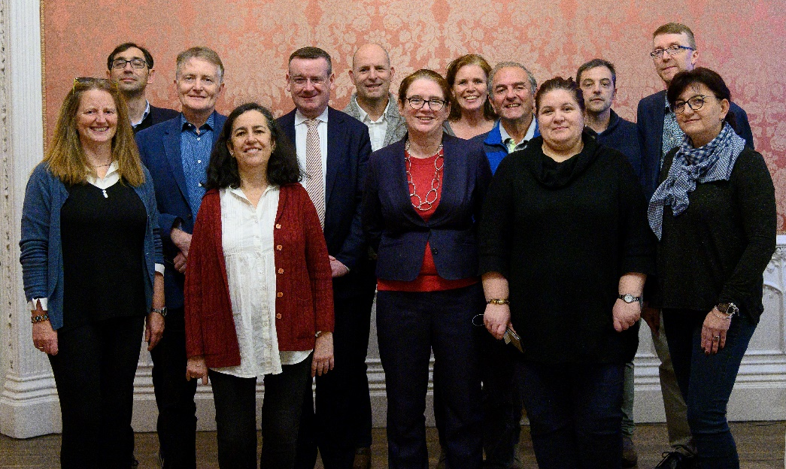

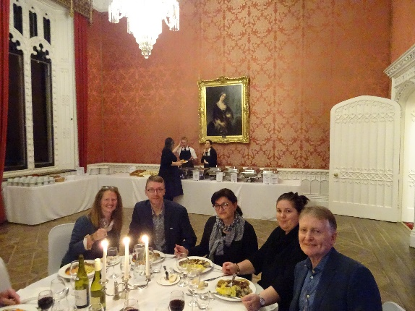

About the Project
Builds on GI-Learner E+ project (2015-2018)
Project aim: Development of Pedagogies and Teacher Training materials for Early Career and Trainee Teachers
E+ project 2019-2022
6 Partner institutions including
experts from Belgium, Spain,
Romania, Austria, UK
3 Universities:
  St Mary’s University
  Ugent,
  UNED (Madrid)
2 Secondary schools
  Liceul Teoretic "Dimitrie Cantemir" Iasi
  The Kings School, Ely
Professional Subject Association
  EUROGEO
Kick-off meeting at St Mary’s University
Notes:
Michaela
GI-Learner - innovative pedagogies for learning with geoinformation; K7-K12
Research on learning with GI, curriculum review, learning line, 10 competencies at 3 levels, self evaluation test , LEARNING MATERIALS! - find it on the GI Pedagogy website

Slide 4
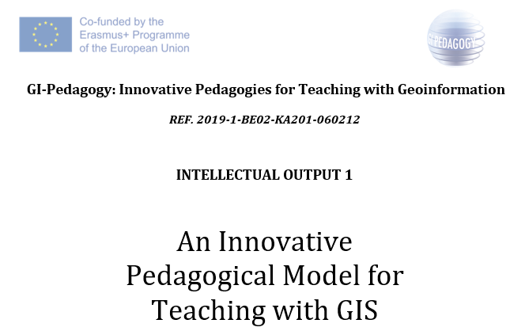
An Innovative Pedagogical Model for Teaching with GIS
Literature review
Teaching with GIS
Approaches to teaching with GIS
Innovative Pedagogies
Training teachers for GIS
Recommendations for teacher professional development
… for planning of teacher training courses (real needs, curriculum, involve teachers, Rosenshine...)
… approaches for teacher training courses (various active learning approaches, authentic learning contexts, enquiry driven…)
… pedagogies (critical thinking, spatial citizenship)
… practical recommendations based on student learning and tools
... and networking (communities of practice, support)
Notes:
Michaela (Abstract/Summary)
This output consists of a literature review, analysis and evaluation of existing teaching practices that incorporate GI(S)cience/Services in schools.
As a result of the review and analysis of findings, a series of recommendations are provided to inform the development of the teacher professional development course and toolkit of innovative pedagogical approaches to teaching with GIS and connect to the case studies of outcomes
There was very little research linking innovative pedagogies LINKED to GIS!!! GI-Pedagogy could fill this gap.
Teaching with GIS, innovative pedagogies

Slide 5

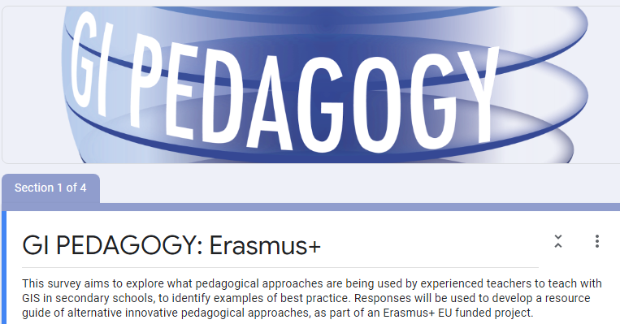
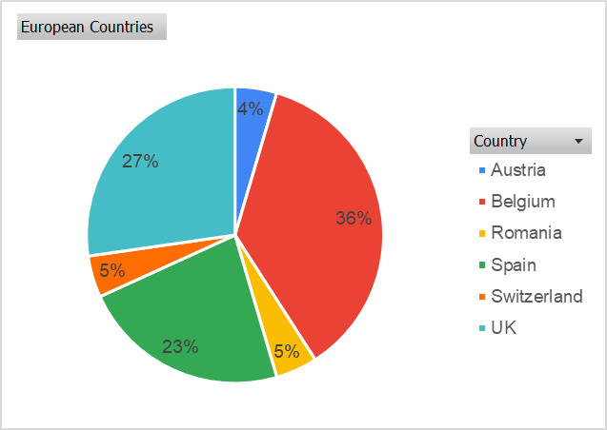
An Innovative Pedagogical Model for Teaching with GIS
2. Small-scale survey of expert teachers
Notes:
Sophie

Slide 6
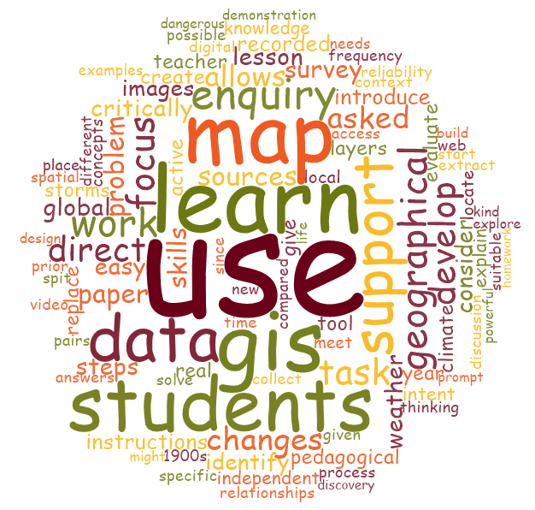
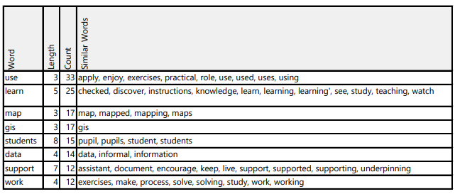
2. Small-scale survey of expert teachers
Notes:
sophie

Slide 7
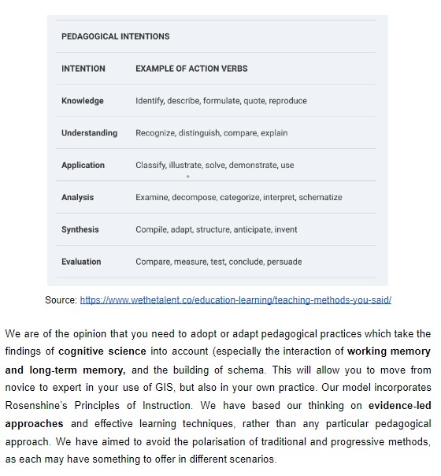
Toolkit of innovative pedagogical approaches to teaching with GIS
GI Pedagogy- project summary
What does this toolkit contain?
What is the power of GIS?
Setting out your pedagogical intent
Notes:
Sophie

Slide 8
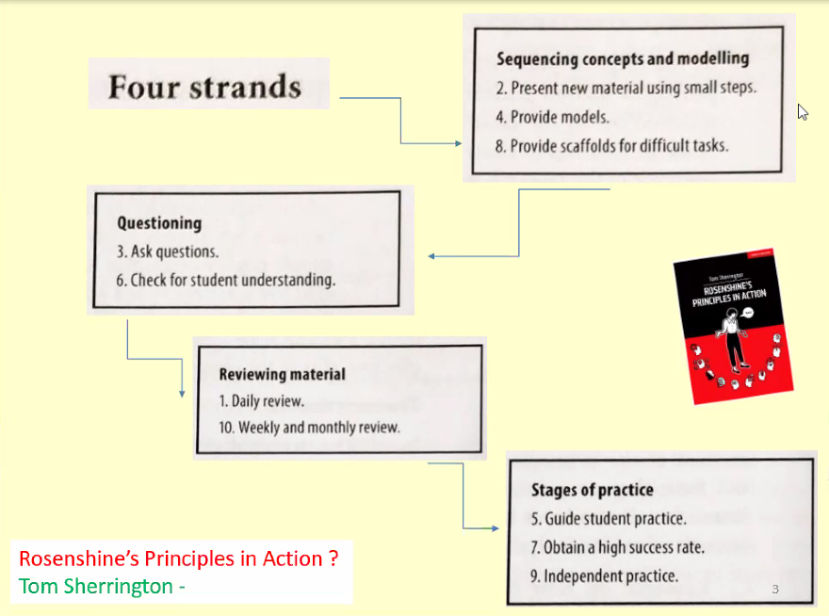
5. Adapting Rosenshine’s 10 principles
6. Our model for GIS Pedagogy - next steps
Notes:
Sophie
How can successful GIS lessons be created in your classroom?

Slide 9

A teacher training course with innovative pedagogical approaches to teaching with GIS
Draft module
Review experiences of partner schools in trialling new approaches to teaching with GIS (face to face?)
Develop implementation plan for MOOC creation
Design and develop MOOC content and implementation
What impact will online vs face to face teaching have on the use of these innovative pedagogies??
How to organise? How many schools - test group vs normal school group?
Notes:
Michaela IO 3

Slide 10
Case studies and digital exhibition of outcomes and findings
a project conference to communicate, review, and evaluate different approaches to teaching with GIS
online 'exhibition' of teachers' findings
share findings through journal publications
use case studies to develop quality indicators
What impact will online vs face to face teaching have on the use of these innovative pedagogies??
Notes:
Sophie: IO 4

Slide 11
What next?
? How will the pandemic influence teaching/GI pedagogies?
? What will the ‘new normal’ look like?
Any suggestions?
Thank you!
Michaela Lindner-Fally
Secondary Geography,
BORG Oberndorf, AT
EUROGEO researcher
lindner.michaela@borgoberndorf.at
Sophie Wilson
Senior Lecturer Secondary Geography,
Institute of Education,St Mary’s University,
Twickenham, London. TW1 4SX.
sophie.wilson@stmarys.ac.uk
Notes:
both

