Slide 1





Karl Donert
Vice President, EUROGEO.
Sophie Wilson
Senior Lecturer Secondary Geography, Course Lead,
St Mary’s University, Twickenham.
Brendan Conway
Geography Tutor, St Mary’s University, Twickenham.
Luc Zwartjes
Head of Geography, Sint-Lodewijkscollege, Belgium,
‘GI-Pedagogy’
Innovative Pedagogies for Teaching
with GIS
Download materials:
https://bit.ly/3KuVIMi
Notes:
The aim of this session is to share with you some of the resources developed as part of this Erasmus+ funded project which includes the development of a *toolkit of innovative approaches to teaching with GIS, which is designed to help teachers to develop the skills required to use GIS to teach geography in a more effective way, and provide them with the confidence to embed it in their classroom practice.
This will be done by presenting:
the framework used for the toolkit, together with
a case-study example and resources
which have been brought together by drawing on *evidence from educational research, as well as *practical examples of teachers’ best practice.
The project aims to provide trainee and early career teachers, with the skills and resources they need. Feedback on this presentation would be welcomed from delegates.

Slide 2
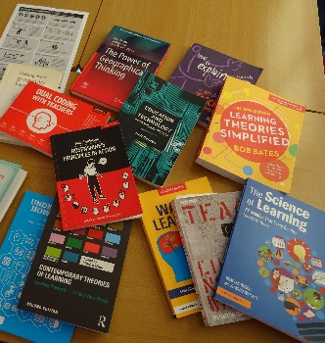
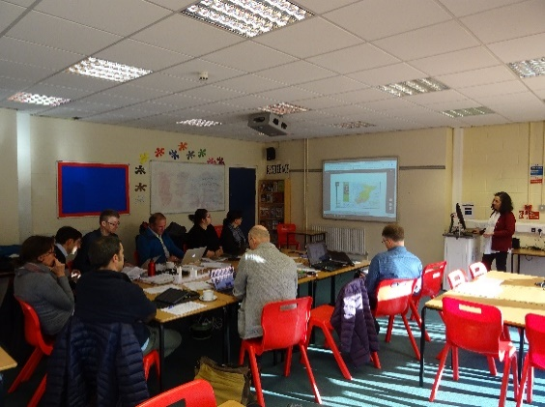
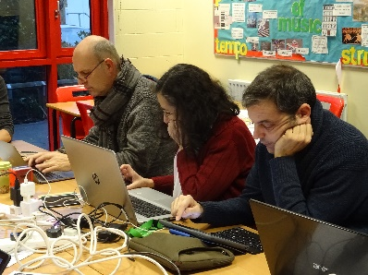
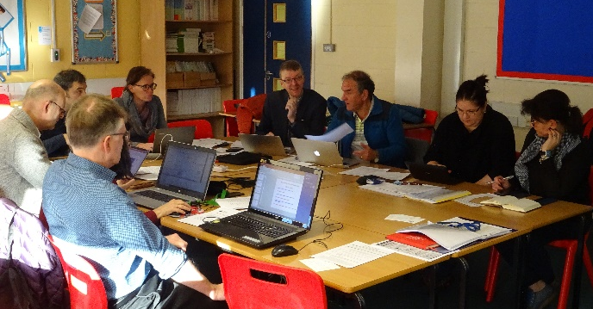
Innovative Pedagogies for Teaching with GIS
Contents
  About the project
  Innovative Pedagogical model for Teaching with GIS
  Toolkit of innovative pedagogical approaches
  Teacher training course
  Case studies and a digital exhibition of the findings
Notes:
By researching innovative methods for teaching with GIS ….….
the aim is to provide teachers with the pedagogical skills and resources they need to embed the use of digital mapping into their everyday geography teaching …….. Last year -
Share today an outline of the
How we developed the toolkit based on 10 Rosenshine’s Principles of Instruction

Slide 3


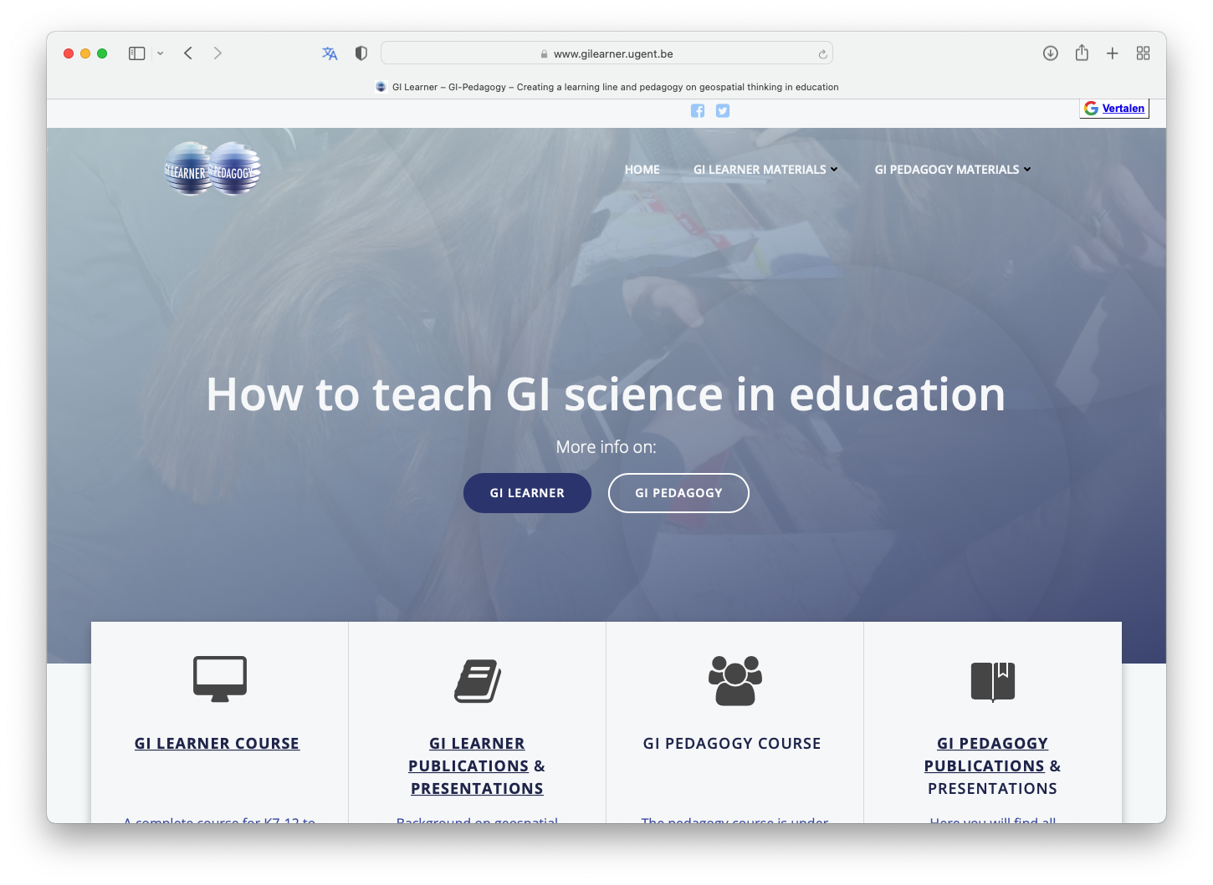
Website
@GIPedagogy
www.gilearner.eu
www.gi-pedagogy.eu

Slide 4
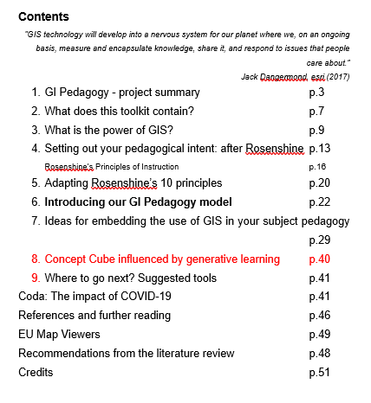

Toolkit
Notes:
About the project:
It is a

Slide 5
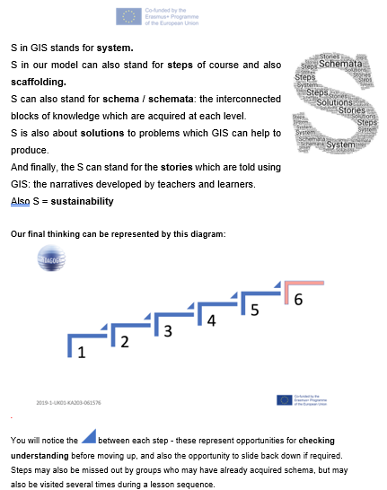
Creating
vignettes

Slide 6
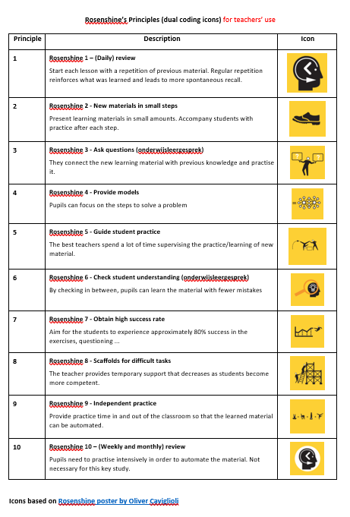

Slide 7
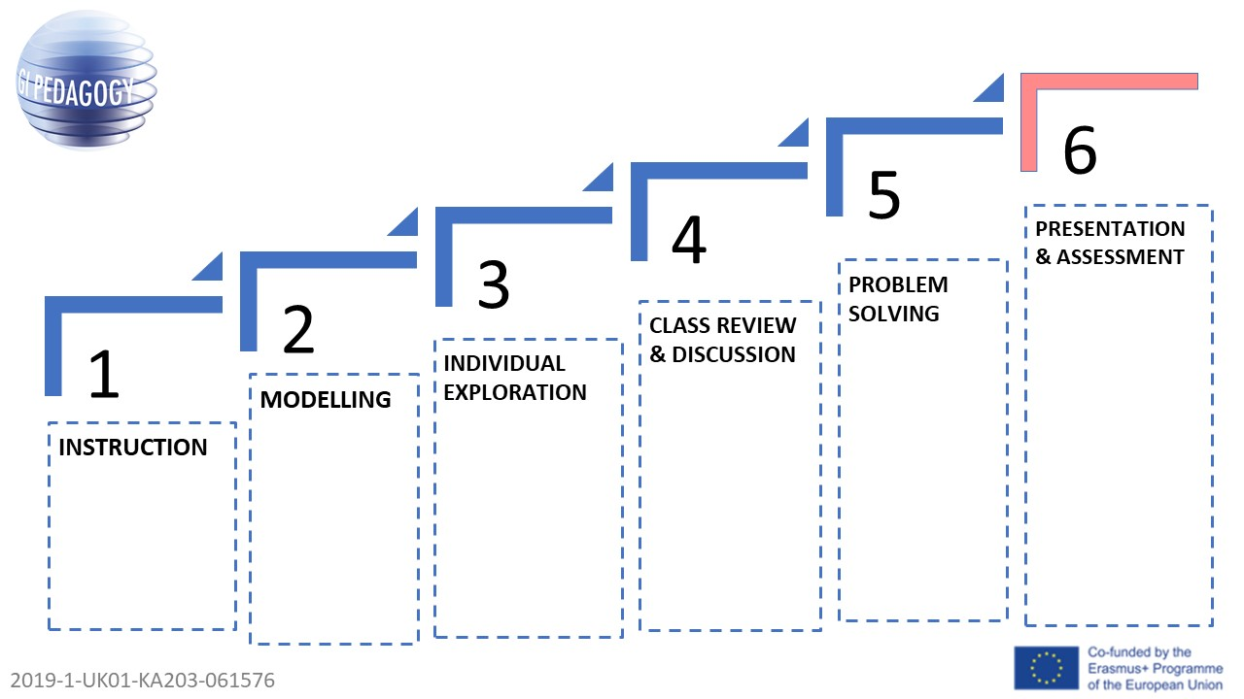

Step 1: Direct instruction / teacher facilitated stage - this is where schema building begins. Present new material.
Step 2: Modelling / Scaffolding, with review and questioning – what data are needed?
Step 3: Individual exploration
Step 4: Review - discussion
Step 5: Problem-solving
Step 6: Presentation/Assessment (Peer assessment possible too) and sharing of outcomes. This will also be the stage where students may feel secure enough to start their own exploration.

Slide 8
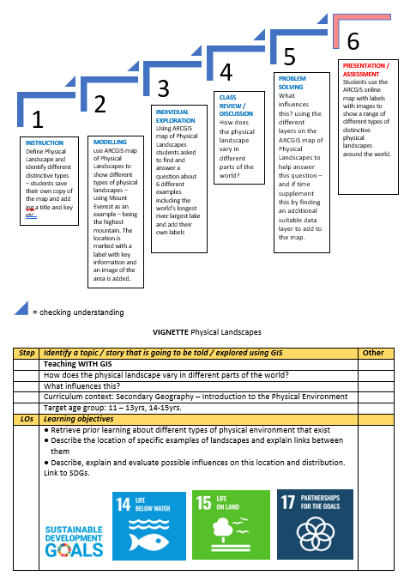
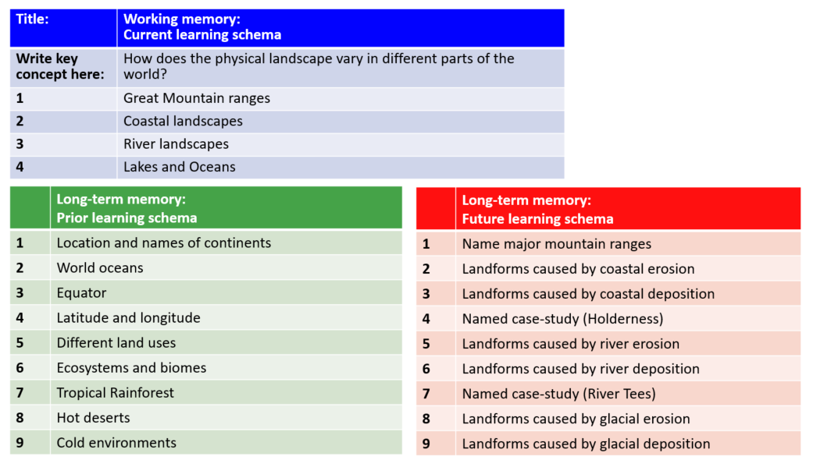
Example 1
Physical landscapes
Age group 11-14 y

Slide 9
Working memory:
Current learning schema
Great Mountain ranges
Lakes and Oceans
Coastal landscapes
River landscapes
How does the physical landscape vary in different parts of the world?

Slide 10
Great Mountain ranges
Lakes and Oceans
Coastal landscapes
Working memory:
Current learning schema
River landscapes
Location and names of continents
World oceans
Name major mountain ranges
Landforms caused by coastal erosion
Landforms caused by coastal deposition
Equator
How does the physical landscape vary in different parts of the world?
Latitude and longitude
Different land uses
Named case-study (Holderness)
Landforms caused by river erosion
Landforms caused by river deposition
Ecosystems and biomes
Tropical Rainforest
Hot deserts
Named case-study (River Tees)
Landforms caused by glacial erosion
Landforms caused by glacial deposition
Cold environments
Long-term memory:
Prior learning schema
Long-term memory:
Future learning schema

Slide 11
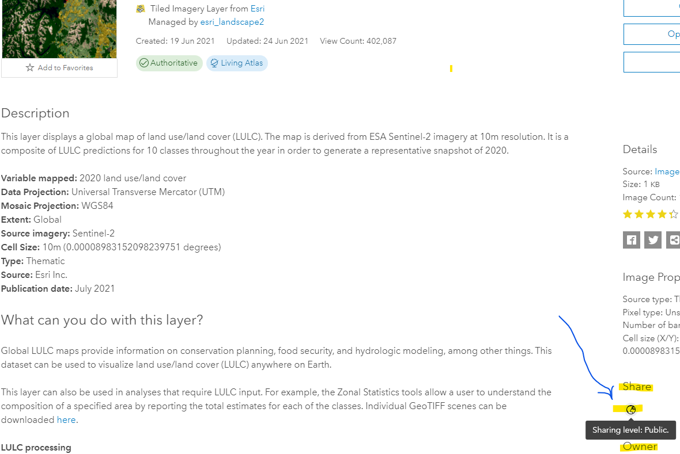
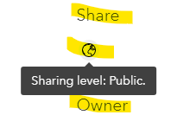

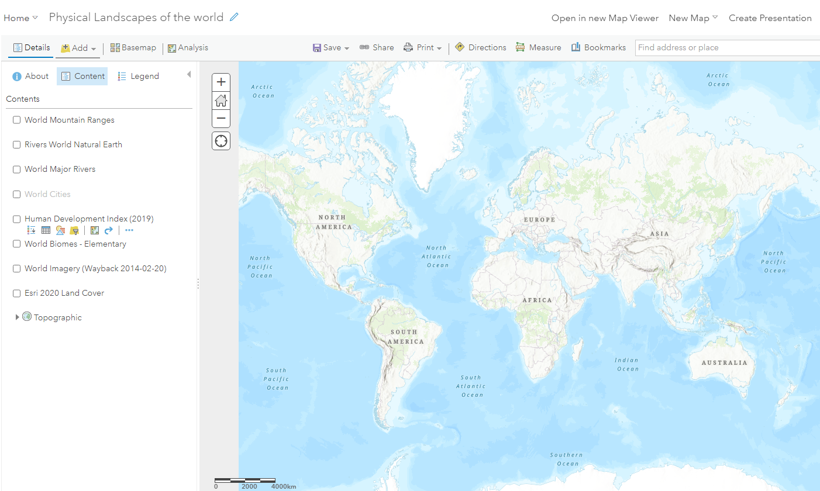
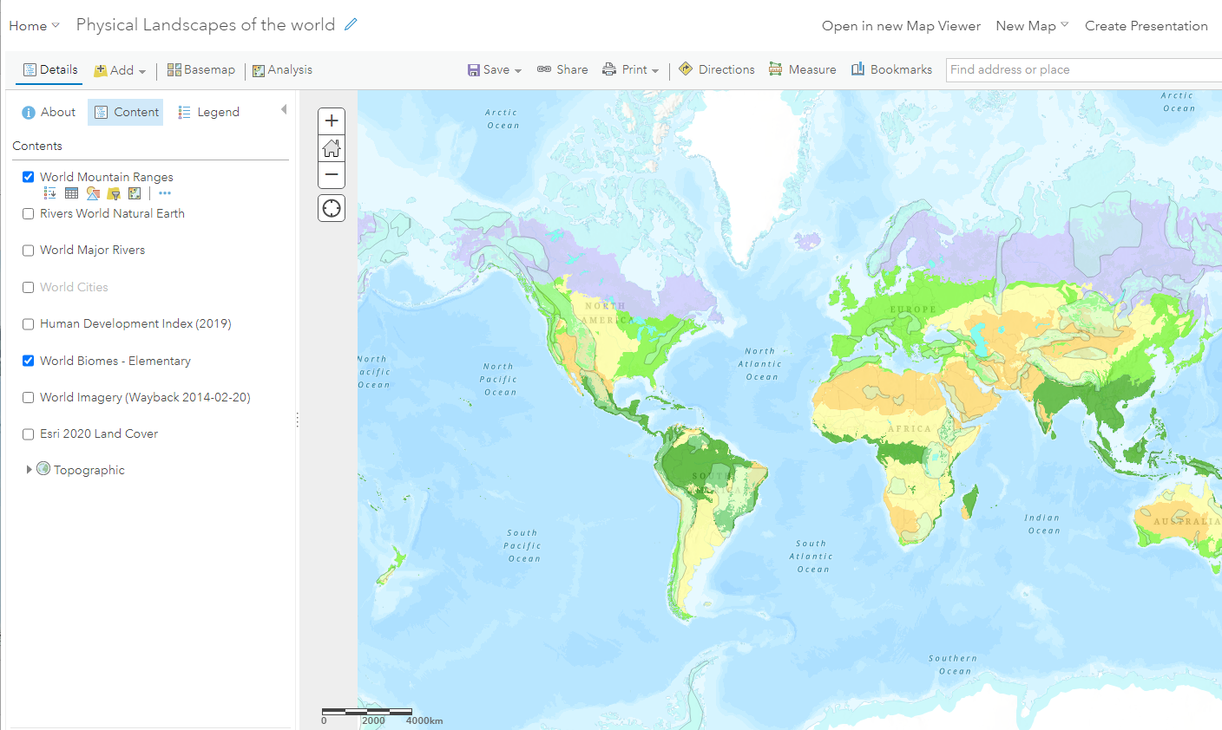
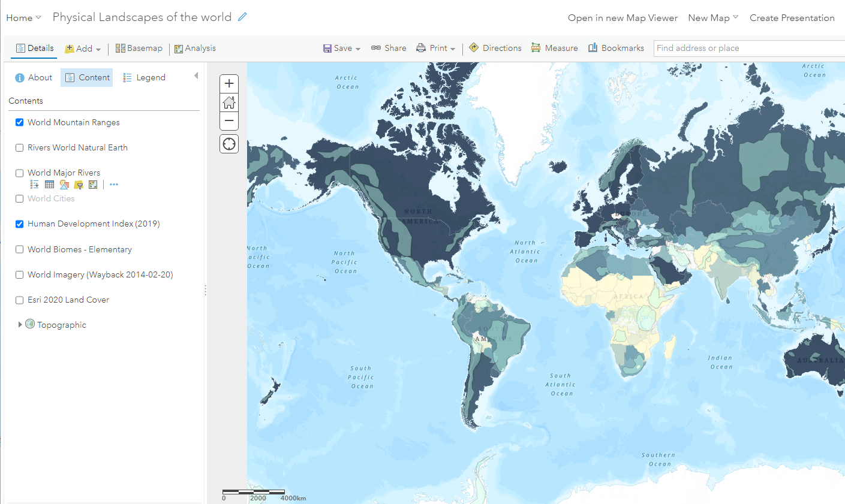
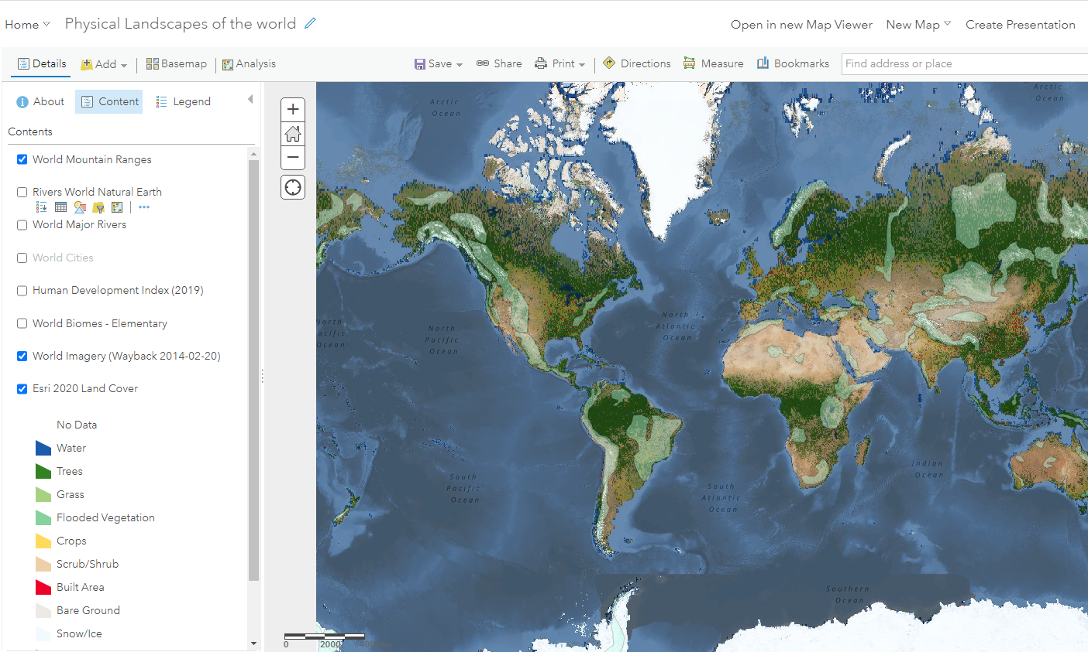
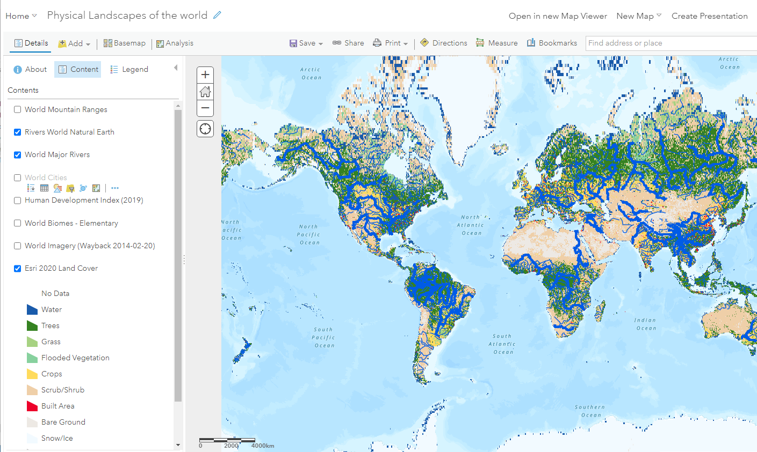
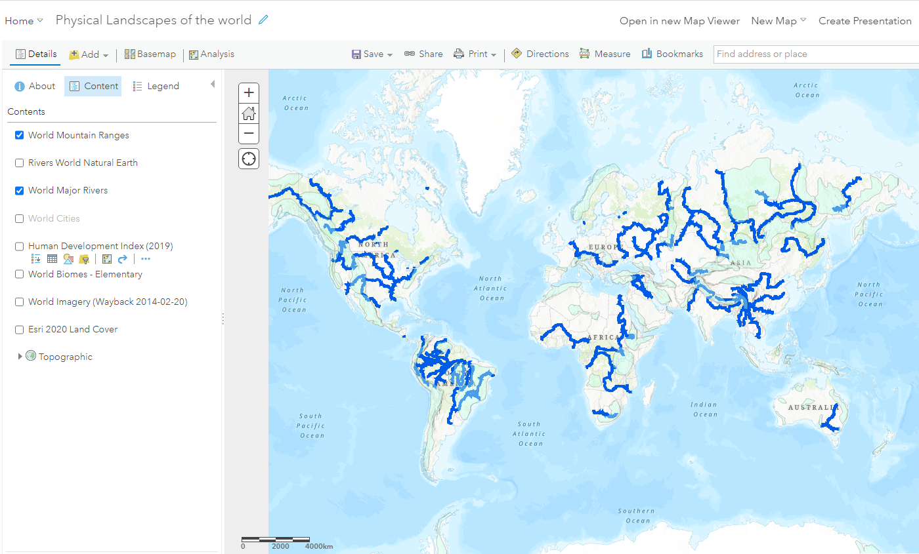
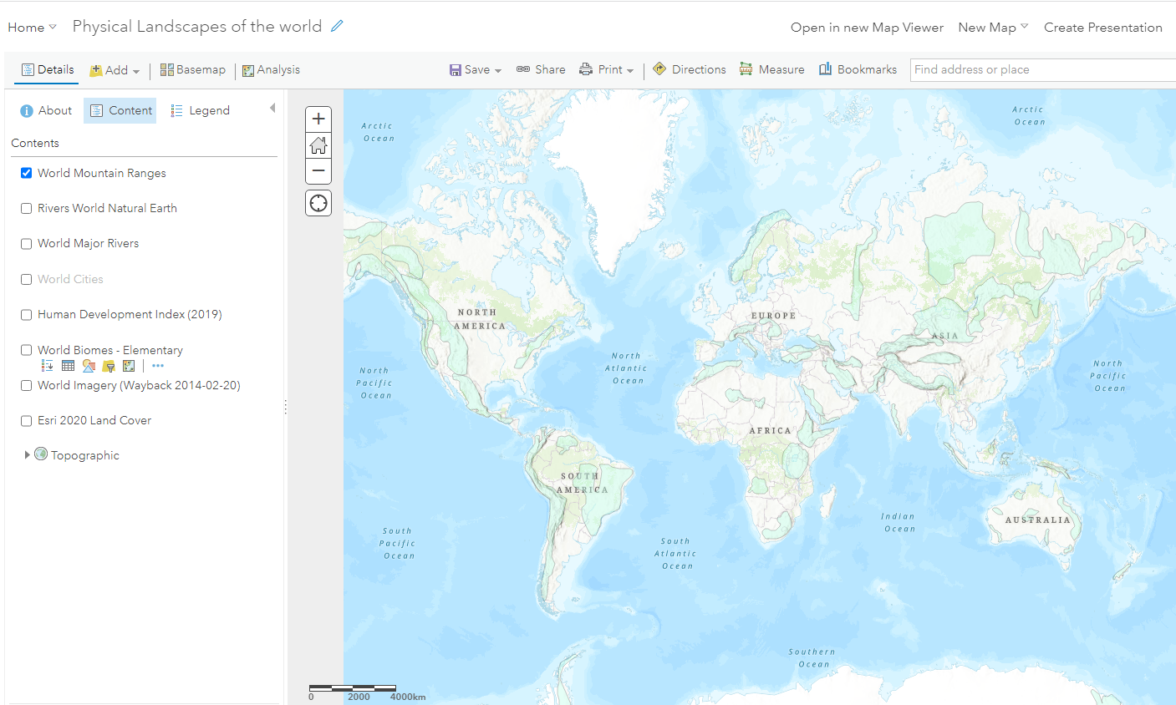
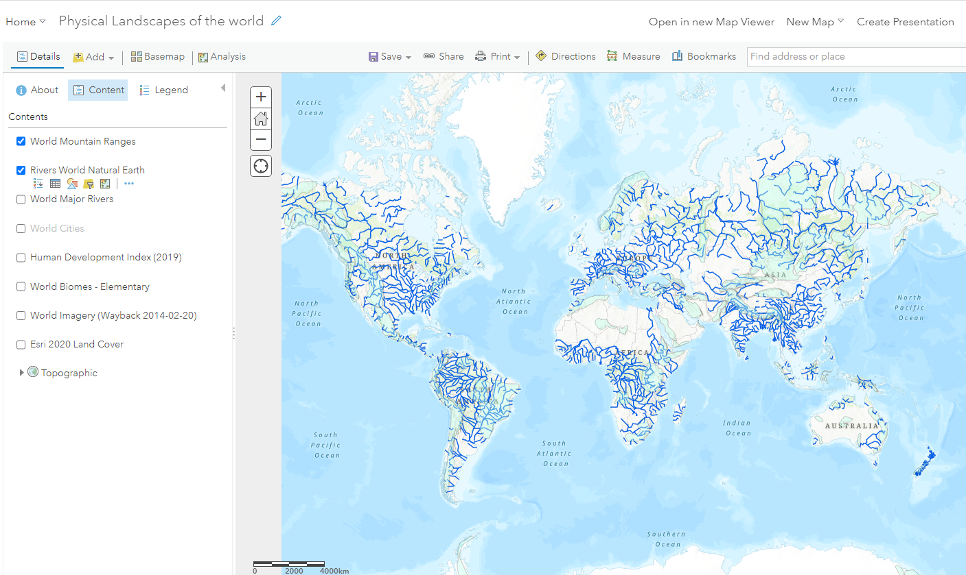
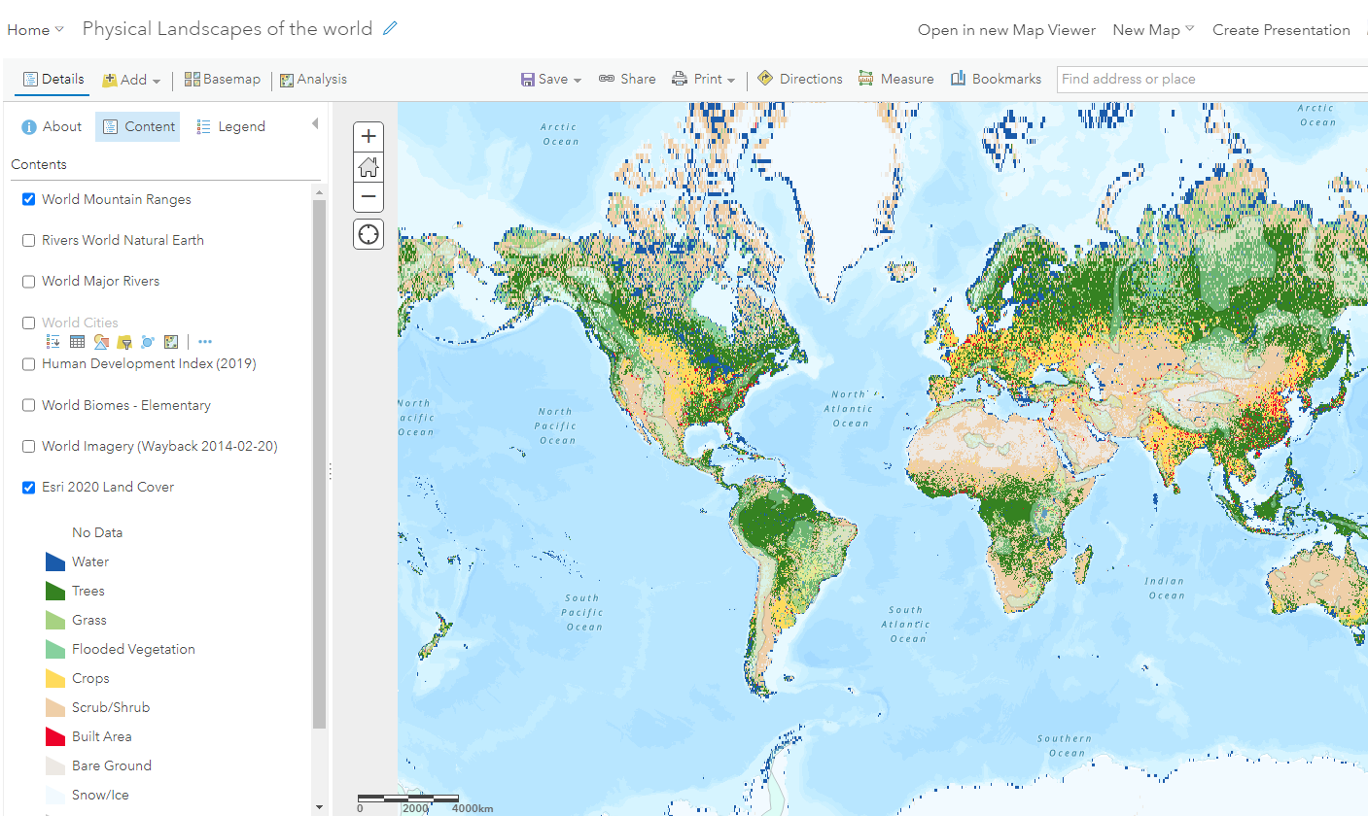
Notes:
SW –each layer of the map is a click

Slide 12
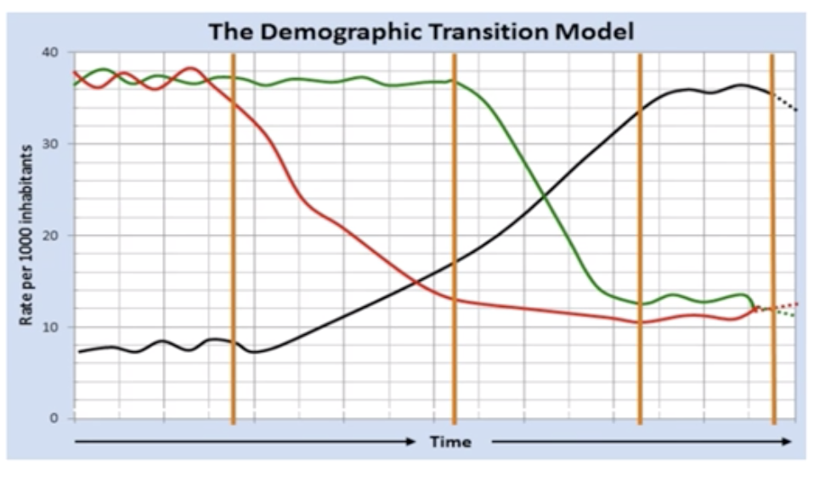
Example 2
Demographic transition
Age group 11-18 yrs

Slide 13
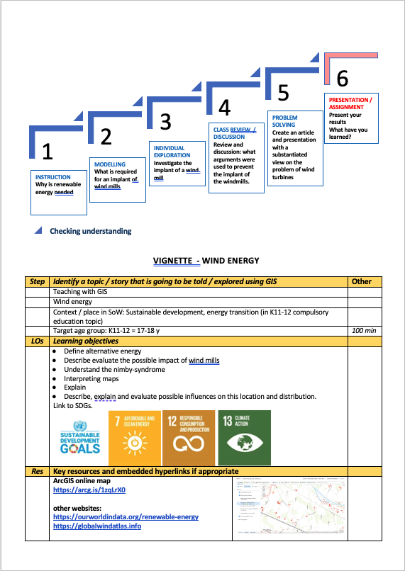
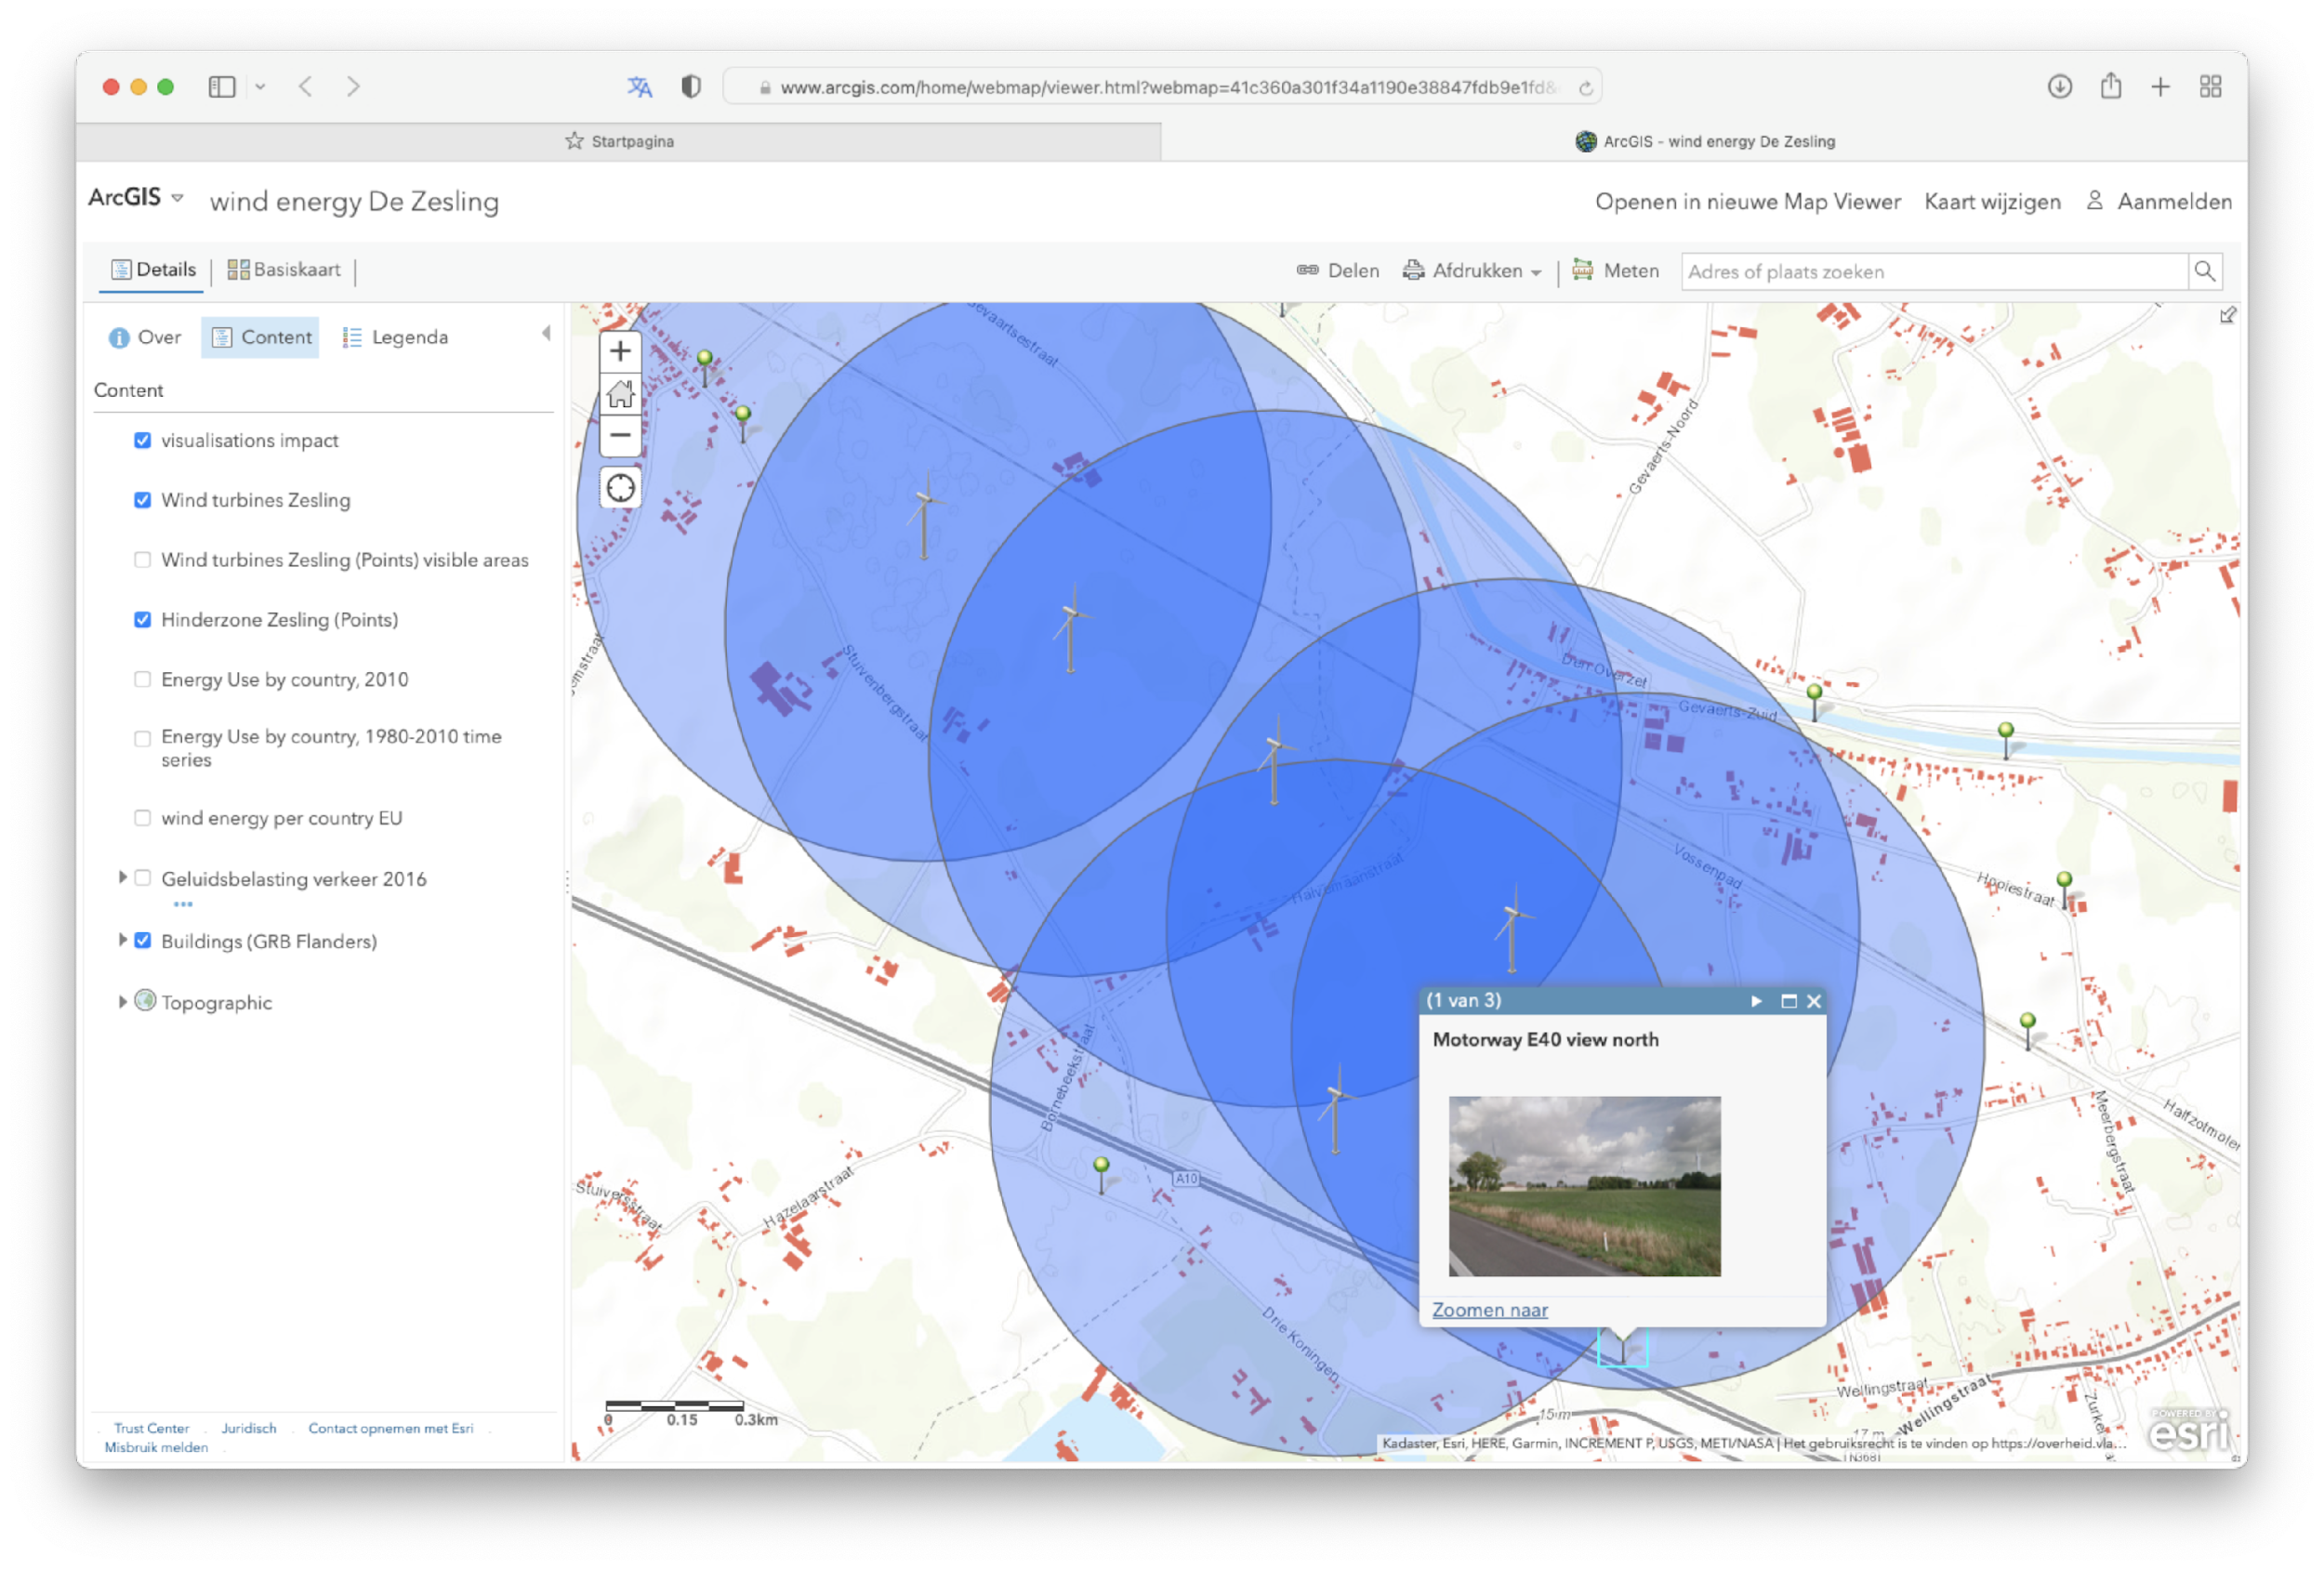
Example 3
Locating windmills
Age group 17-18 yrs
demo
Notes:
Luc

Slide 14
Looking forward…
What next?
? Developing an online course for Teachers
? Case-study examples?
? Multiplier events
? Digital exhibition of findings
  Any questions?

Slide 15


Further presentions and training:
EUROGEO Conference University of the Aegean, Mytilene (Lesbos, Greece)
🡪 5-6 May
https://www.eurogeography.eu/conferences/lesvos-2022/
Multiplier Teacher Training events
St Mary’s University 🡪 22 June 2022
sophie.wilson@stmary.ac.uk
Kings School, Ely 🡪
alanparkinson@kingsely.org
Madrid International Training - Summer Course 🡪 4-6 July 2022
  https://bit.ly/3JoRUe3
Join us for more

Slide 16
Karl Donert
Vice President, EUROGEO.
Sophie Wilson
Senior Lecturer Secondary Geography, Course Lead,
St Mary’s University, Twickenham.
Brendan Conway
Geography Tutor, St Mary’s University, Twickenham.
Luc Zwartjes
Head of Geography, Sint-Lodewijkscollege, Belgium,
‘GI-Pedagogy’
Innovative Pedagogies for Teaching
with GIS
Download materials:
https://bit.ly/3KuVIMi
Notes:
The aim of this session is to share with you some of the resources developed as part of this Erasmus+ funded project which includes the development of a *toolkit of innovative approaches to teaching with GIS, which is designed to help teachers to develop the skills required to use GIS to teach geography in a more effective way, and provide them with the confidence to embed it in their classroom practice.
This will be done by presenting:
the framework used for the toolkit, together with
a case-study example and resources
which have been brought together by drawing on *evidence from educational research, as well as *practical examples of teachers’ best practice.
The project aims to provide trainee and early career teachers, with the skills and resources they need. Feedback on this presentation would be welcomed from delegates.

