Slide 1

GI-Pedagogy
Innovative Pedagogies for Teaching witg GIS
Luc Zwartjes
Geography Department Ghent University, Belgium

Slide 2

Aim of the project
The goal of this project is to provide teachers with the skills and resources they need to embed Geographic Information System technology for spatial thinking into their geography teaching.
GIS technology exists and is freely available to many schools, but implementing effective pedagogical methods requires communication between universities, teacher training institutions, and teachers themselves.

Slide 3

Back to the future …
GI LEARNER

Slide 4
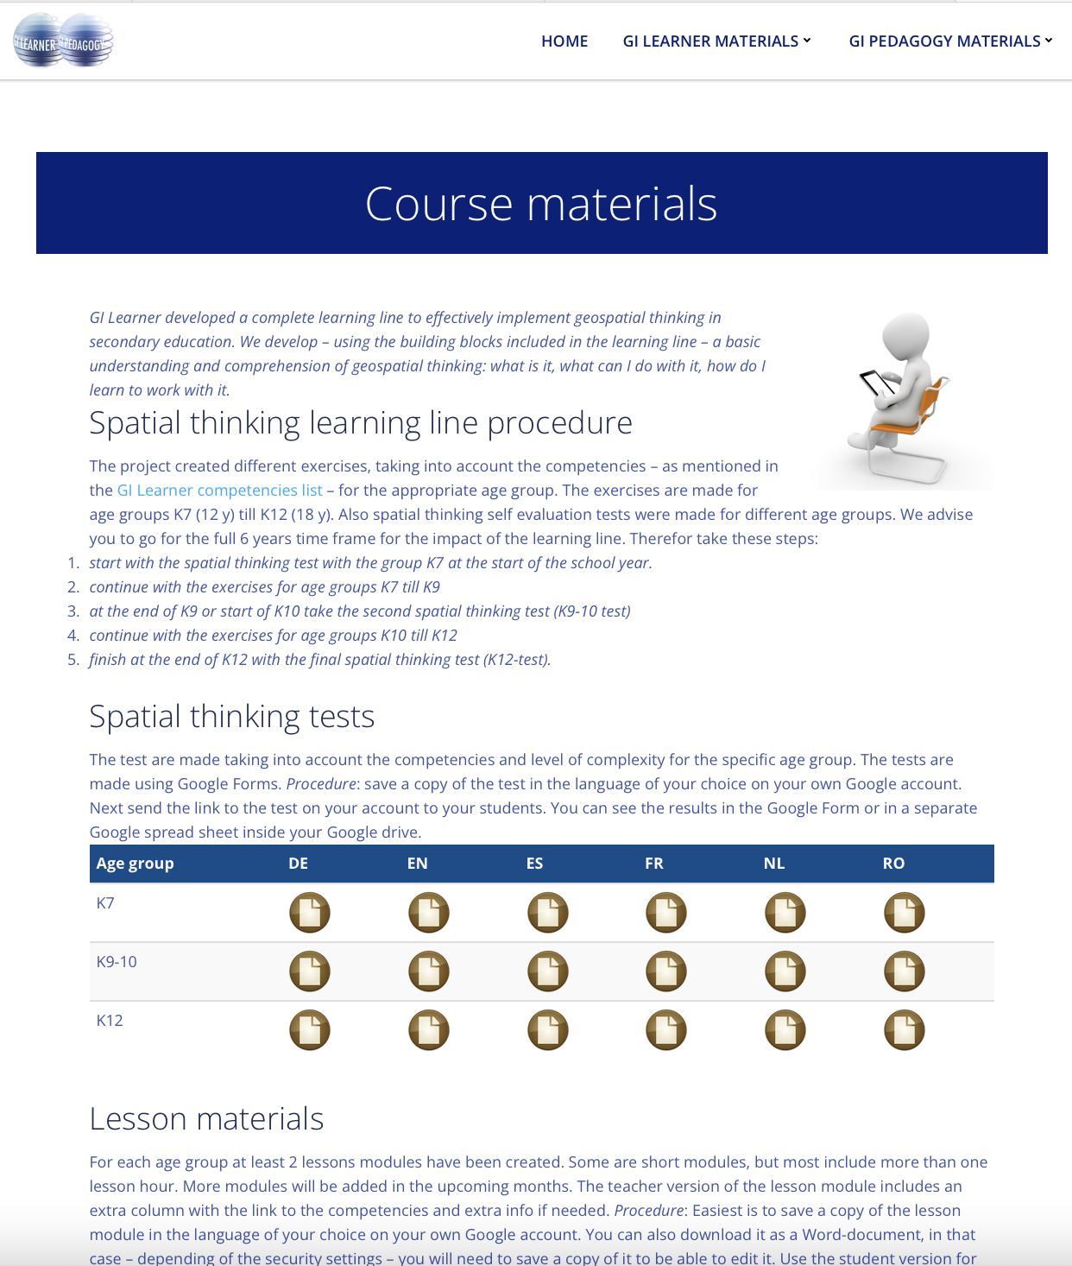

Learning outcomes
Course materials on
www.gilearner.eu

Slide 5
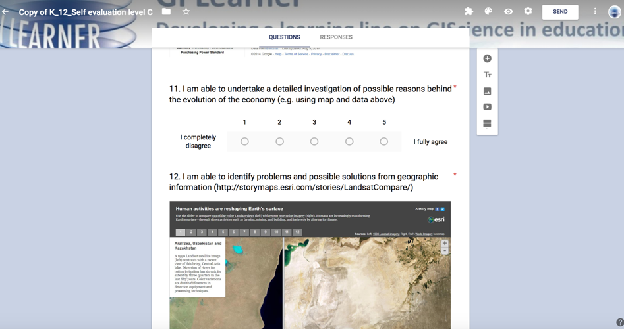
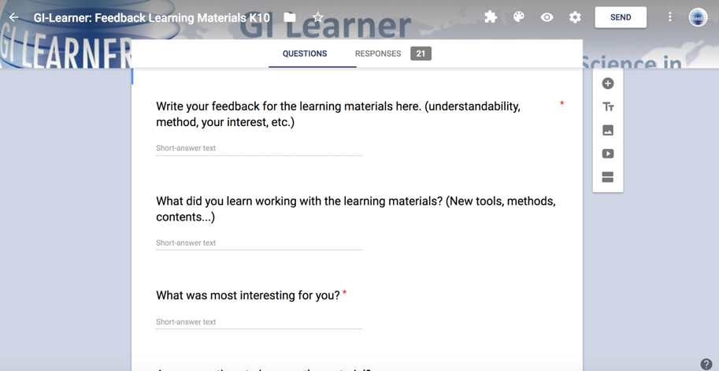
Pupils feedback & self evaluation
Evaluation tool

Slide 6
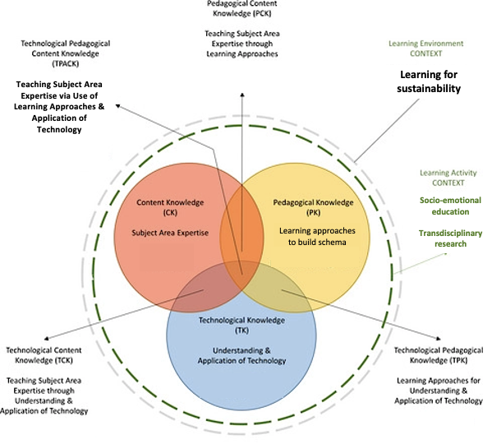

Slide 7
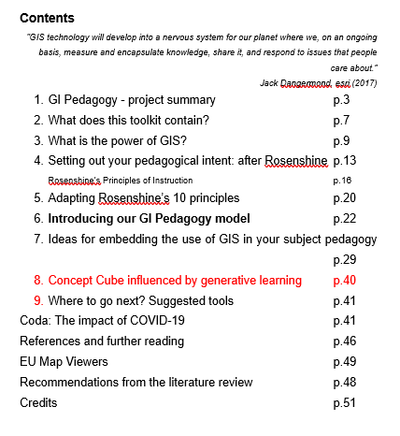

Toolkit
Notes:
About the project:
It is a

Slide 8
Notes:
We will be focusing on the PK in the TPACK model

Slide 9
GI Pedagogy
A review, analysis and evaluation of existing, prevailing teaching practices that incorporate GIS in schools
An exploration of evidence related to alternative, innovative, pedagogical approaches to teaching with GIS.
A series of recommendations to inform the development of the teacher professional development course
A toolkit of innovative pedagogical approaches

Slide 10
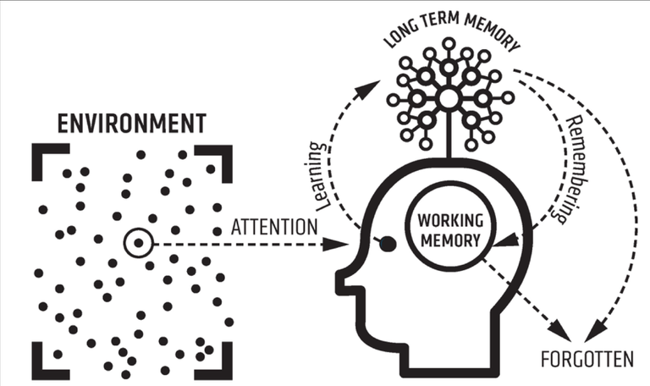
Cognitive Load Theory: What is it?
Existing schema
Schema building
Cognitive Load Theory (CLT)
targets improvements in
long-term memory
in order to ‘free up’
working memory
Developed in the 1980s by John Sweller, an Australian Educational Psychologist
Need for retrieval
Notes:
Cognitive Load Theory …
targets improvements in
long-term memory in order to ‘free up’
working memory.
It was developed in the 1980s by an Australian educational psychologist called John Sweller.
His idea was that you have to long-term memory and working memory connected and the long-term memory has within it
…. existing schema. But as we go through life and especially as we’re learning ...
… we’re getting various stimuli and ideas which come to our attention.
And in lessons at school for example learning will occur.
That learning will hopefully help us to build new schema or adapt existing schema.
We remember these things in these existing schema.
But sadly sometimes we forget things.
I say sadly, but it’s completely normal. So what do we have to do to try and make sure that our remembering of things in our long-term memory deals with that?
We need to retrieve things. This a key idea in Cognitive Load Theory – the importance of retrieval

Slide 11
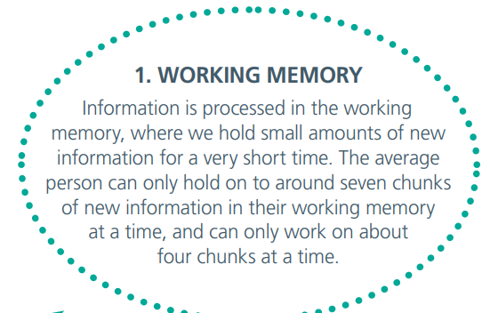
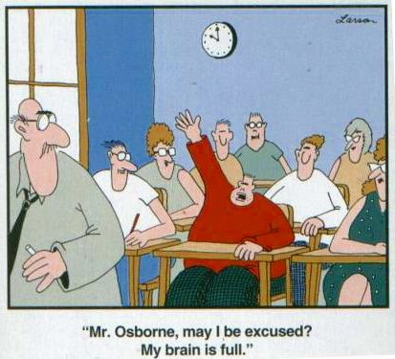
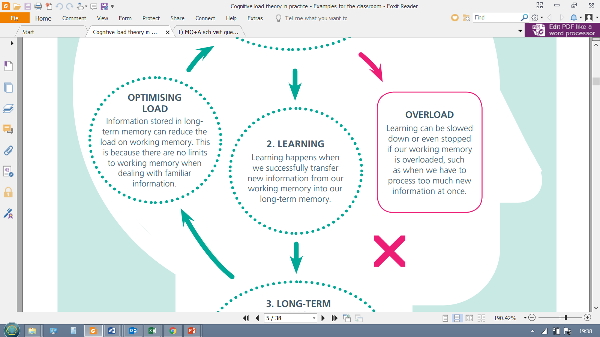
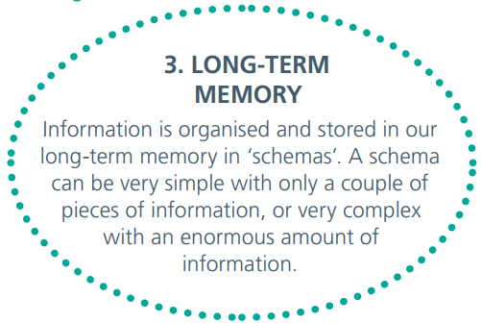
Cognitive Load Theory
What is it?
X
‘Extraneous load’
Source: Cognitive load theory in practice: Examples for the classroom
Notes:
Let’s look at Cognitive Load Theory in a little more detail
It concerns the working memory which can hold about seven things – or about seven pieces of information ... But can only work on about 4 maybe 5 at a time.
So as we learn, we try and get new information from our ... working memory to include in someway or other in our long time memory.
In the long-term memory the information is stored in schema. Schema can be quite random or well-organized. And as teachers we try to make sure students have strong robust correct schema. The problem with this is that the working memory, because of its limitations can suffer…
… what we call ‘overload’. This famous cartoon by Gary Larson shows this ... ‘Mr Osborne’ the boys is saying ‘may I be excused my brain is full’.
This is because he's experiencing overload.
It's also known as extraneous load. This means that the working memory has too much ... information going into it at one time ... And is struggling to cope. Learning is not going to be very effective when that happens.
So our role as teaches is to try to optimise that load to make sure that we’re ... Producing information students that students need in such a way ... that they’re not going to be overloaded. But also that they're going to receive the correct amount challenge in ... order to make sure they can use their working memory to ... store things in the long-term memory in robust schema.

Slide 12
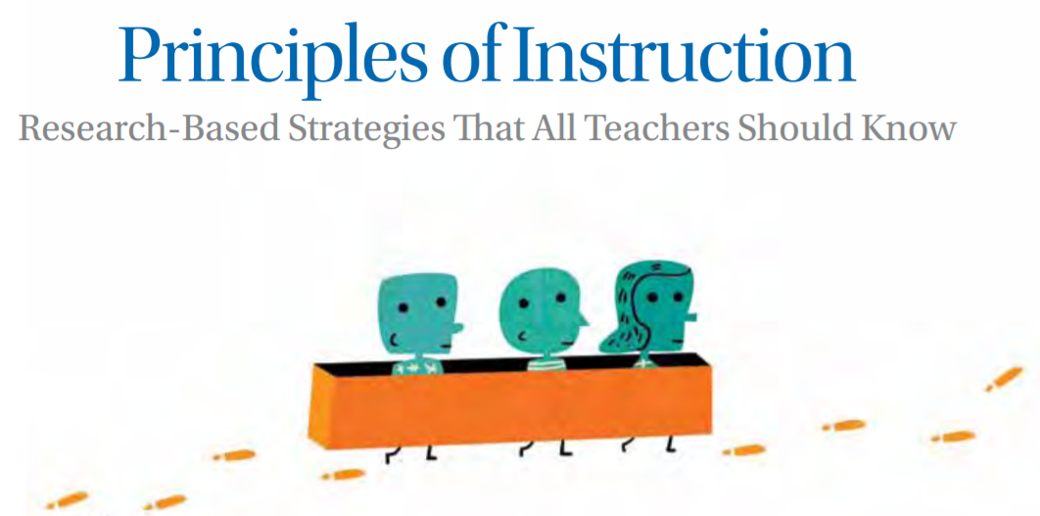
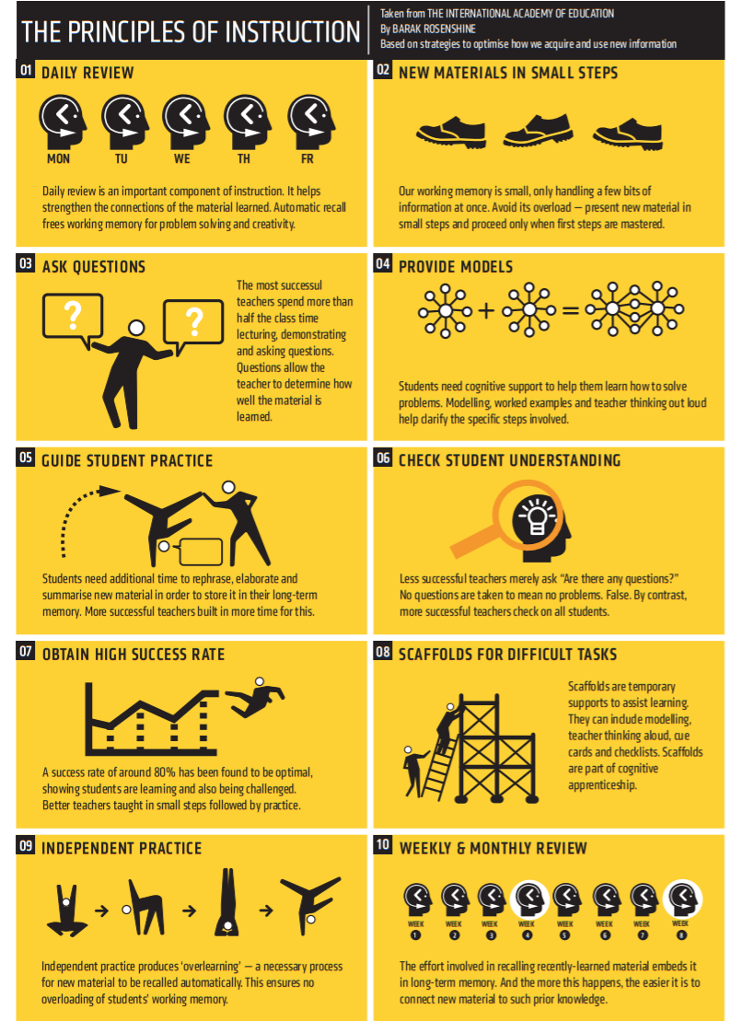
Schema and Cognitive Load Theory: How can it be used? – Rosenshine’s Principles of Instruction
Download as pdf:
https://www.aft.org/sites/default/files/periodicals/Rosenshine.pdf
‘we connect our understanding of the new information to our existing concepts or “schema” ’
Concept of ‘novice’ and ‘expert’
‘The best way to become an expert is through practice…’
e.g. ‘deliberate practice’
Use retrieval practice to build schematic strength
Rosenshine's Principles of Instruction (yellow poster)
Notes:
One of the the most popular ways of putting Cognitive Load Theory ...
into to practice these Rosenshine’s Principles of Instruction...
Principles of Instruction. So Barack Rosenshine came up with these principles so years ago to distill some of the key points of Cognitive Load Theory ...
and to link it with what would have been observed to be the most effective teaching.
It’s portrayed in a very helpful poster created by an educationalist called Oliver Caviglioli and what he's done is put the 10 elements into kind of cartoon images or icon images which we can look at more closely in a moment. Just a few key points to start off with – it does bring out this idea of ...
how we connect what we understand in new information (what we’ve learned now with our working memory) to existing comments or ‘schema’. That's key to the whole idea.
It also introduces us to the idea of ‘novice’ and ‘expert’ the idea that teachers are the experts and our students are to some extent or to a greater extent going to be novices. So, how we going to get them from being novices towards being experts?
We have to share models with them; we have to scaffold the learning; we have to break it down into chunks.
And then we have to enable them to practice what they’ve learned
so one key idea there that is that using retrieval practice to build schematic strength but also ‘deliberate practice’ to make sure that the skills and schema are properly embedded.

Slide 13










Schema and Cognitive Load Theory: How can it be used? – Rosenshine’s Principles
Rosenshine 1 - Daily review | Rosenshine 2 - New materials in small steps | Rosenshine 3 - Ask questions | Rosenshine 4 - Provide models | Rosenshine 5 - Guide student practice
Rosenshine 6 - Check student understanding | Rosenshine 7 - Obtain high success rate | Rosenshine 8 - Scaffolds for difficult tasks | Rosenshine 9 - Independent practice | Rosenshine 10 Weekly and monthly review
Notes:
Here's a closer look at those ideas - those 10 principles in ... this table
and they've been associated with these icons ...
so that they can be adopted and perhaps used in lesson ... planning and also in schemes of work so you can very ... quickly identify what kind of things are going on.
The idea isn’t that you would try and do all of these things in all of your lessons - there's no point in considering this to be a ... sort of slavish model that we have to adhere to but it's ... very important we consider ... how we use these elements for quite a bit of the time from ... various stages of the learning process. So, for example when ... we’re sharing new material, are we sharing it in lots of small chunks or steps? Are we asking plenty of questions to make sure ... students are really understanding what they’ve learned? Are providing coherent models for them to follow?
Let’s first recap Rosenshine’s ten principles. Below is the name Sherrington gives to each principle, followed by the way Rosenshine expresses each principle in ‘Principles of Instruction’ (all page references are to that article):
1. Daily review
‘Begin each lesson with a short review of previous learning: Daily review can strengthen previous learning and can lead to fluent recall’ (p. 13).
2. Present new material using small steps
‘Present new material in small steps with student practice after each step: Only present small amounts of new material at any time, and then assist students as they practice this material’ (p. 13).
3. Ask questions
‘Ask a large number of questions and check the responses of all students: Questions help students practice new information and connect new material to their prior learning’ (p. 14).
4. Provide models
‘Providing students with models and worked examples can help them learn to solve problems faster’ (p. 15).
5. Guide student practice
‘Successful teachers spend more time guiding students’ practice of new material’ (p. 16).
6. Check for student understanding
‘Checking for student understanding at each point can help students learn the material with fewer errors’ (p. 16).
7. Obtain a high success rate
‘It is important for students to achieve a high success rate during classroom instruction’ (p. 17).
8. Provide scaffolds for difficult tasks
‘The teacher provides students with temporary supports and scaffolds to assist them when they learn difficult tasks’ (p. 18).
9. Independent practice
‘Require and monitor independent practice: Students need extensive, successful, independent practice in order for skills and knowledge to become automatic’ (p. 18).
10. Weekly and monthly review
‘Engage students in weekly and monthly review: Students need to be involved in extensive practice in order to develop well-connected and automatic knowledge’ (p. 19).

Slide 14
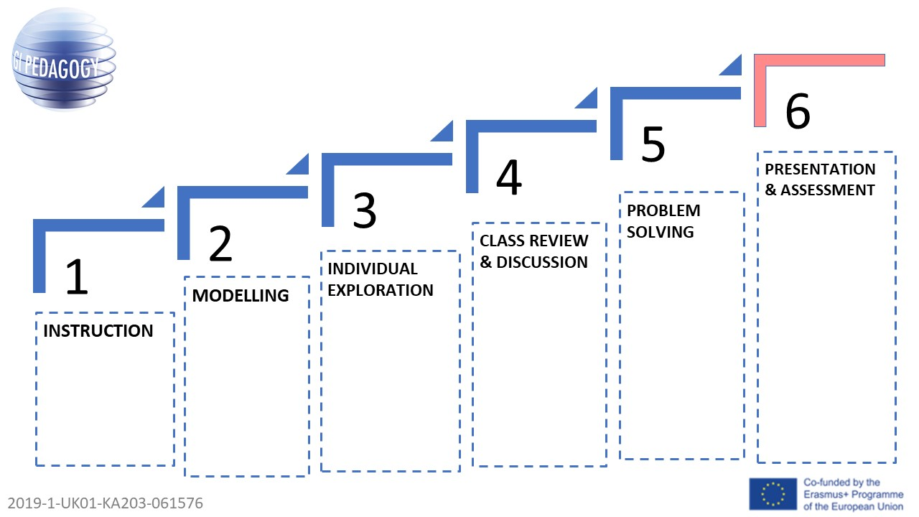
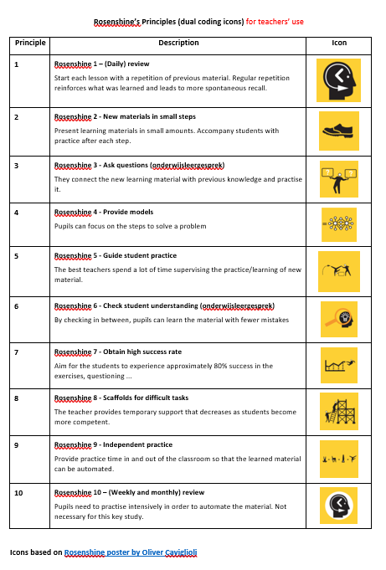
Creating vignettes
+
Step 1: Direct instruction / teacher facilitated stage
Step 2: Modelling / Scaffolding,
Step 3: Individual exploration
Step 4: Review - discussion
Step 5: Problem-solving
Step 6: Presentation/Assessment
Notes:
Step 1: Direct instruction / teacher facilitated stage - this is where schema building begins. Present new material.
Step 2: Modelling / Scaffolding, with review and questioning – what data are needed?
Step 3: Individual exploration
Step 4: Review - discussion
Step 5: Problem-solving
Step 6: Presentation/Assessment (Peer assessment possible too) and sharing of outcomes. This will also be the stage where students may feel secure enough to start their own exploration.

Slide 15
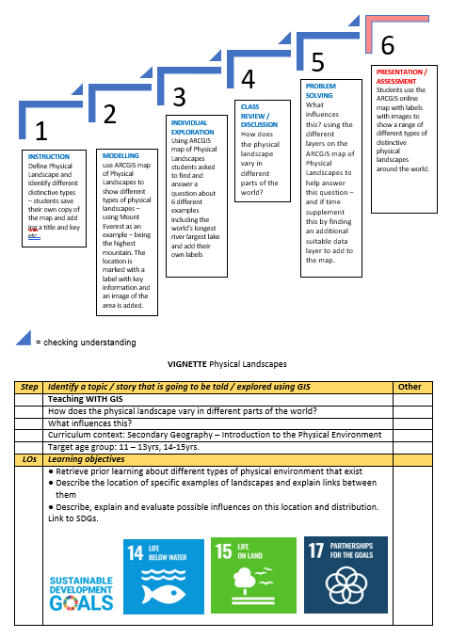
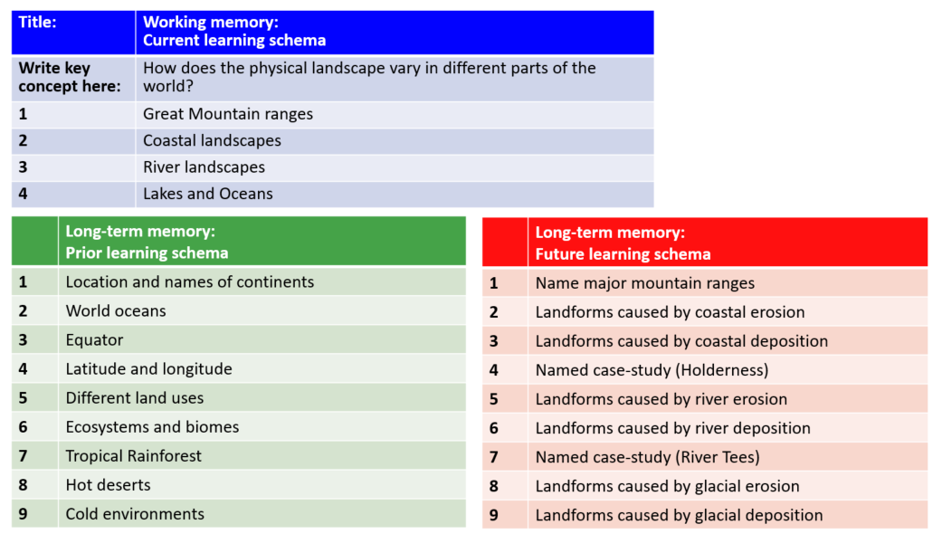
Example 1
Physical landscapes
Age group 11-14 y

Slide 16
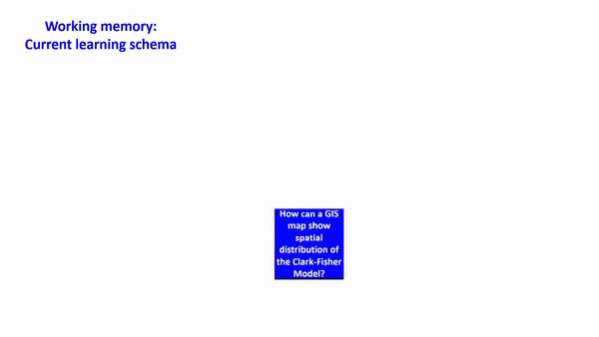
Notes:
Cube

Slide 17
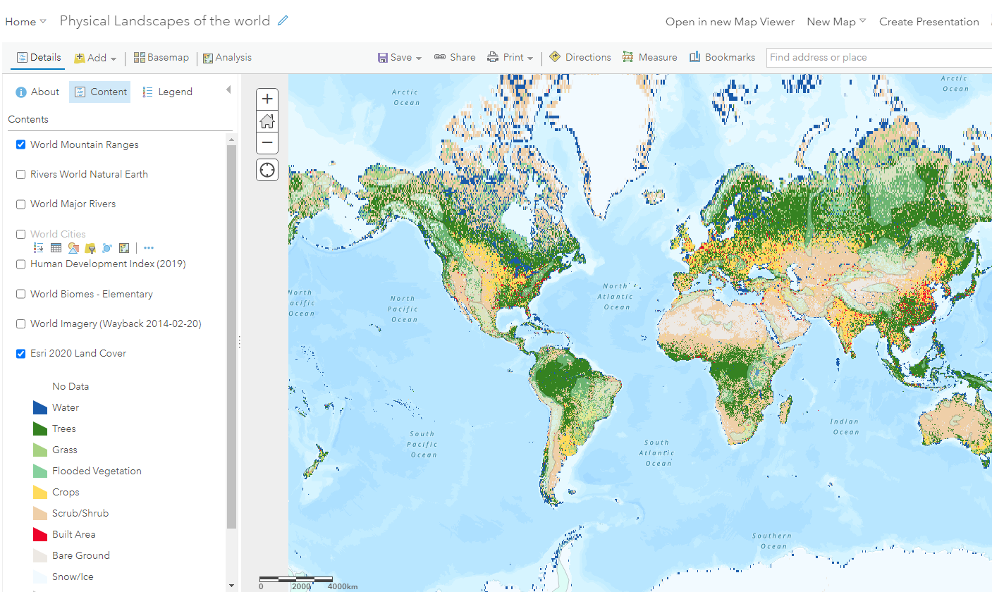
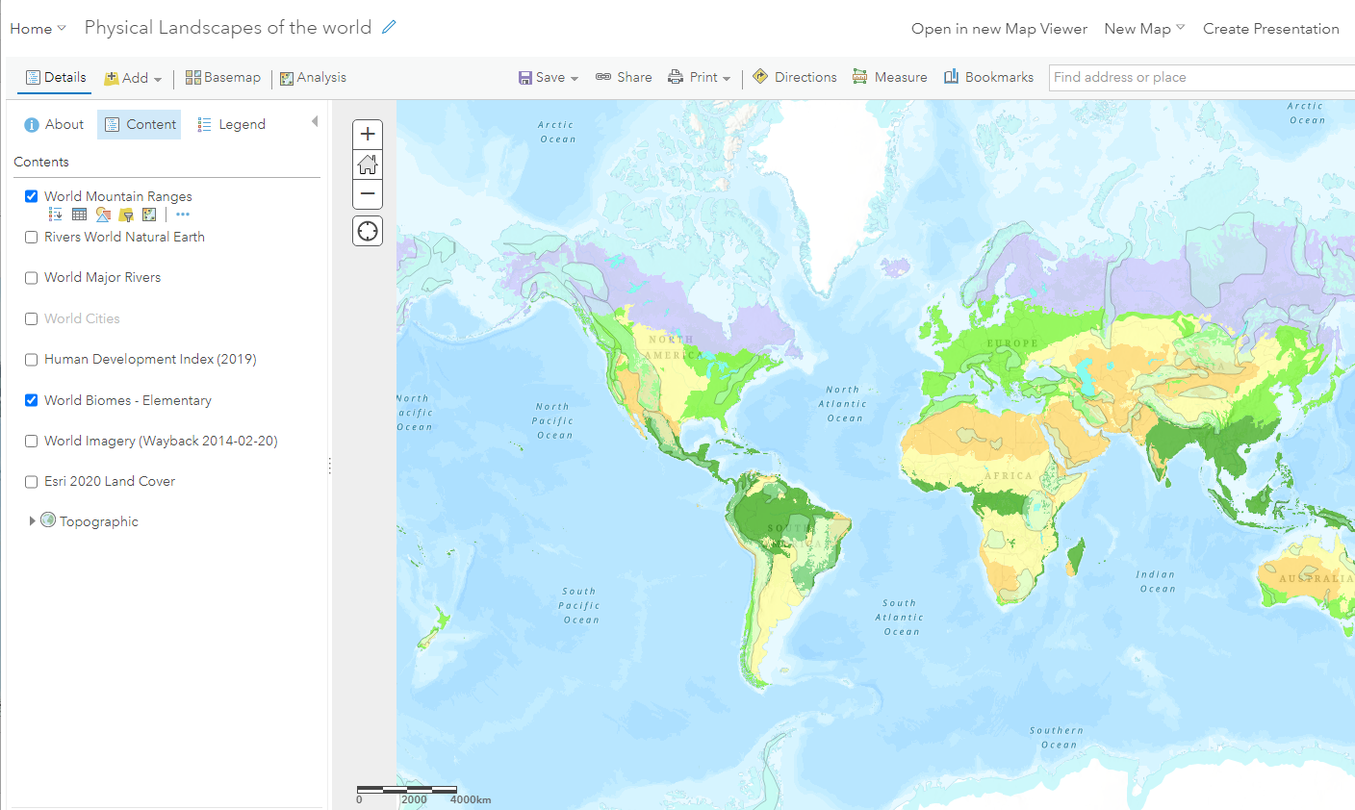
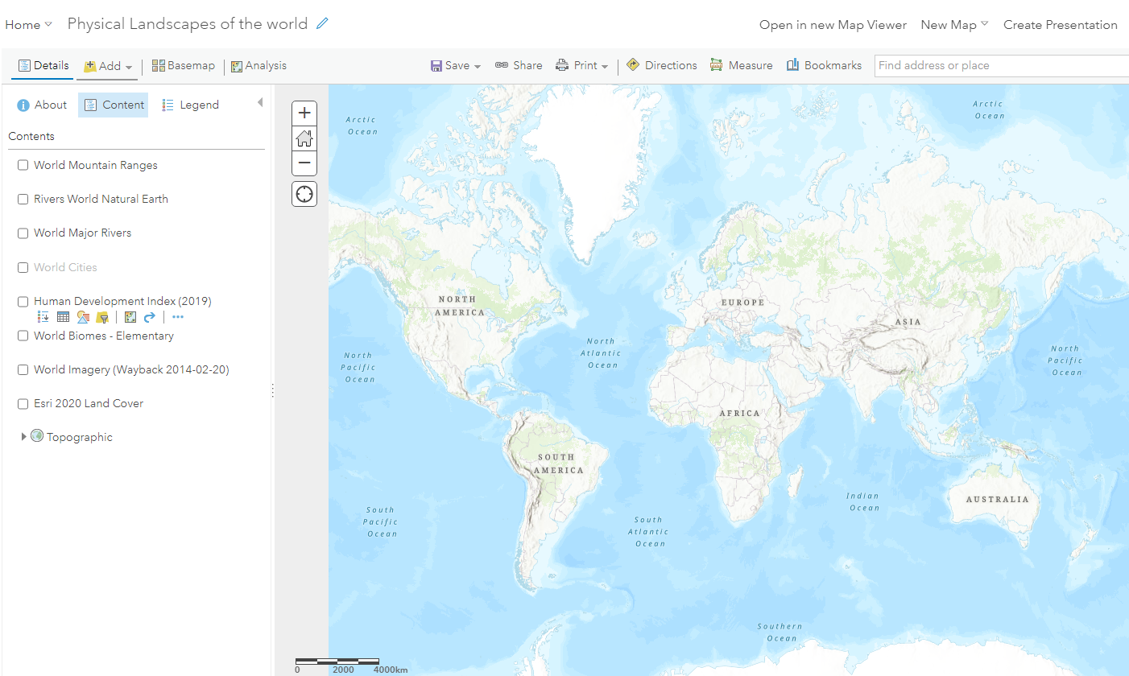
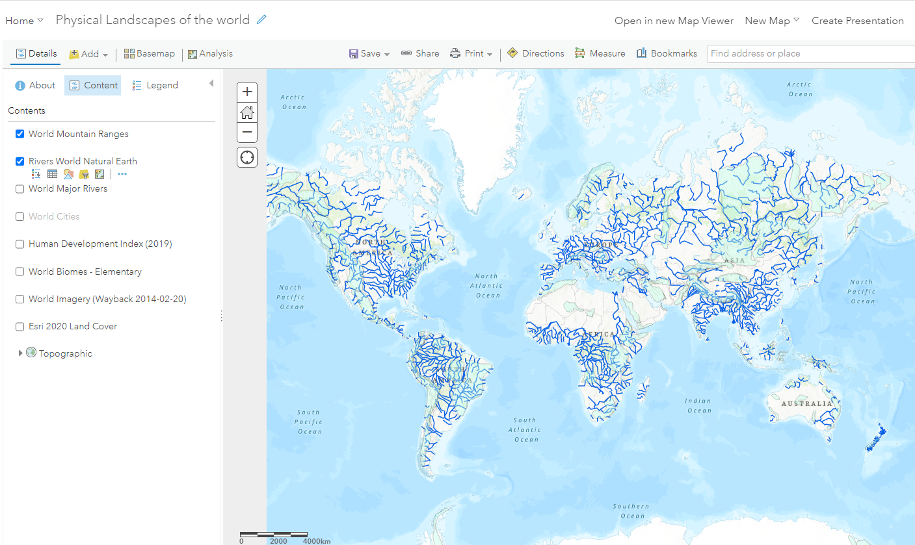
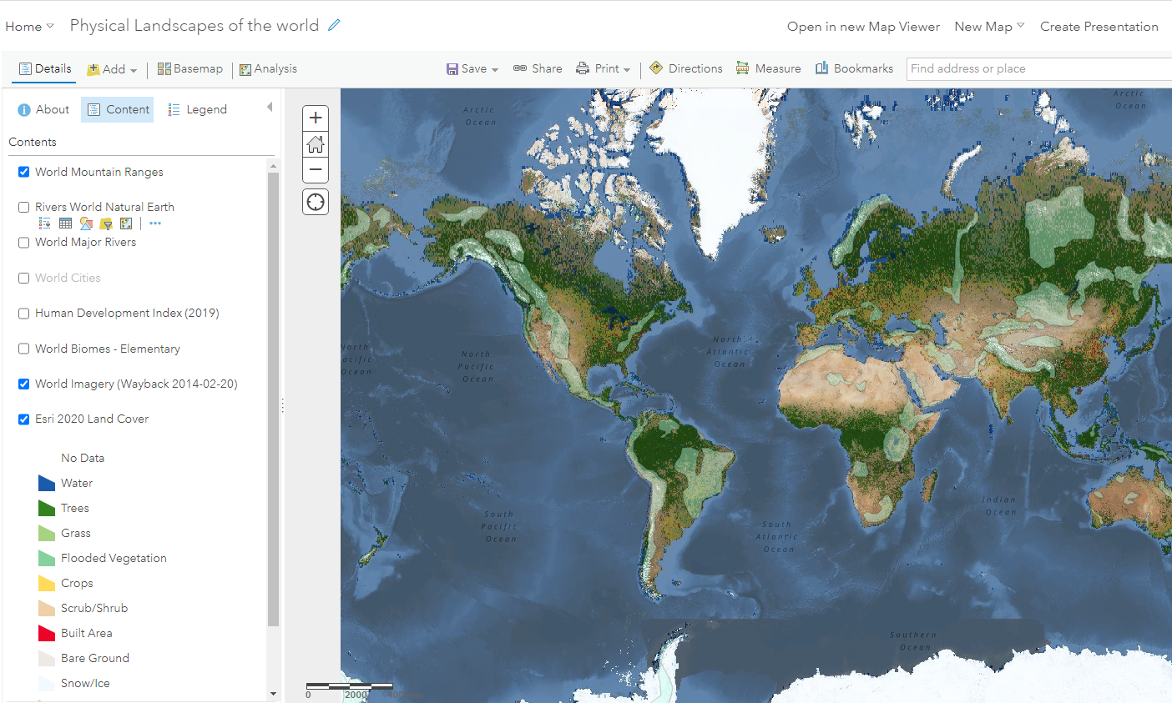
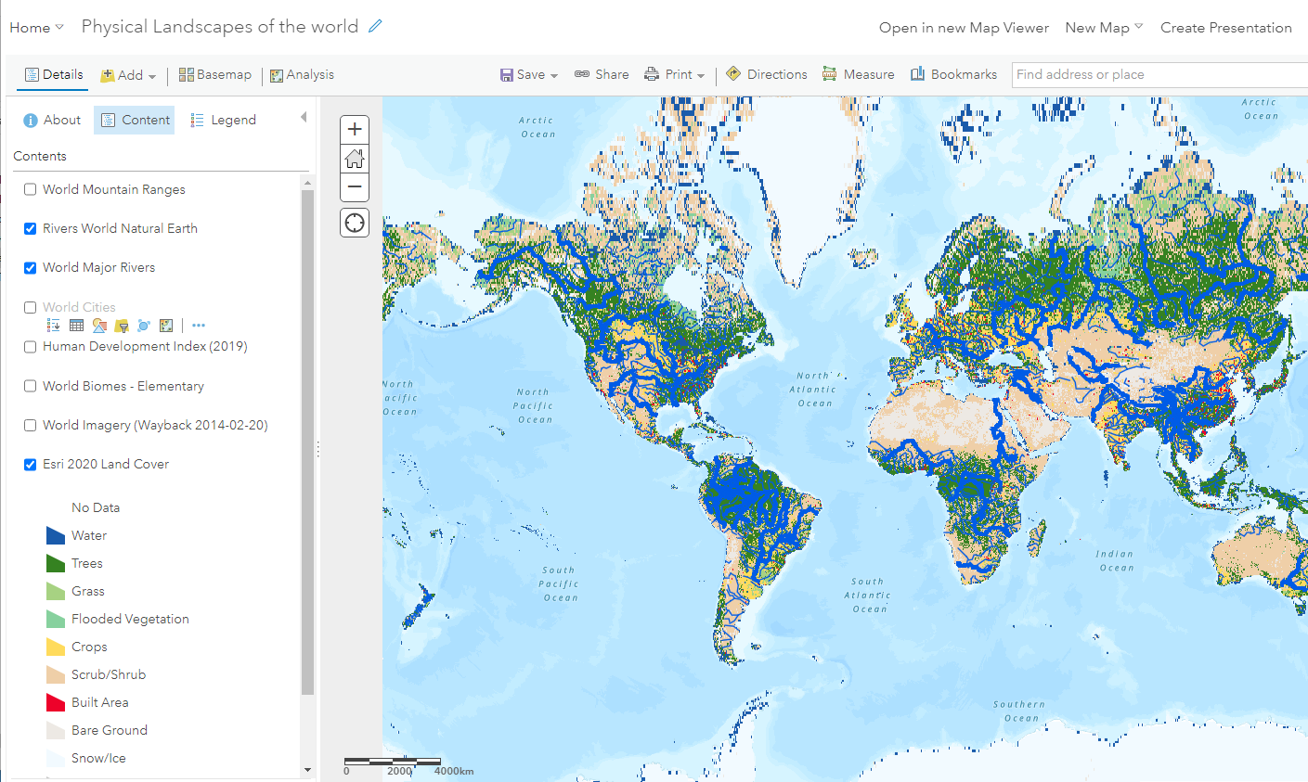
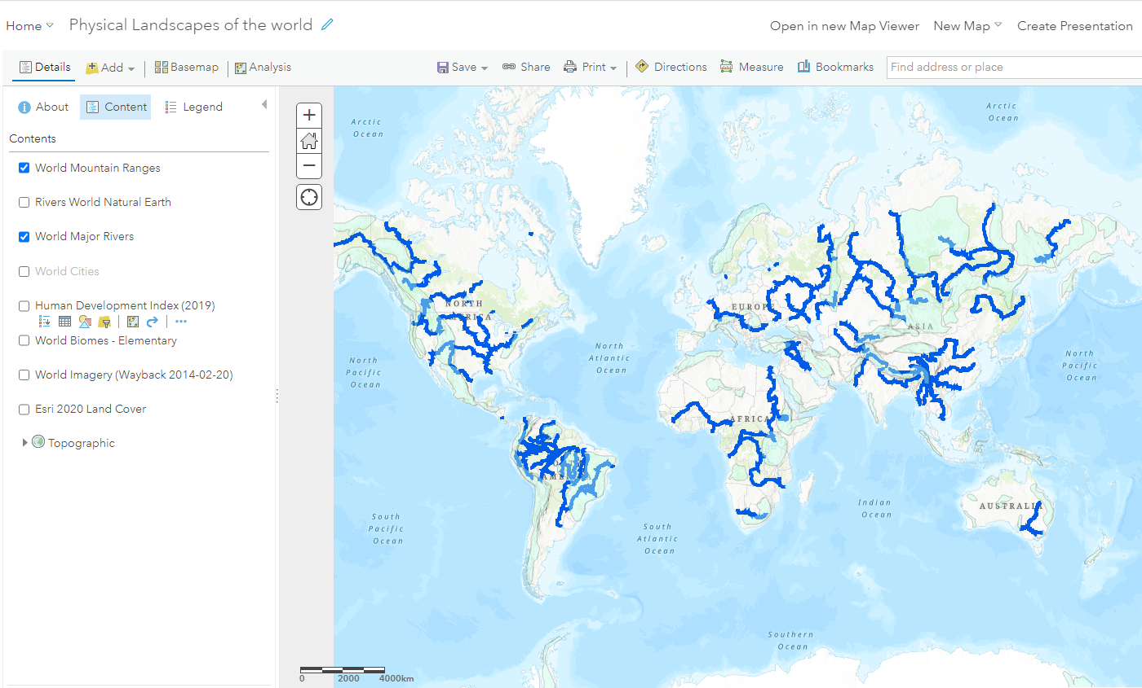
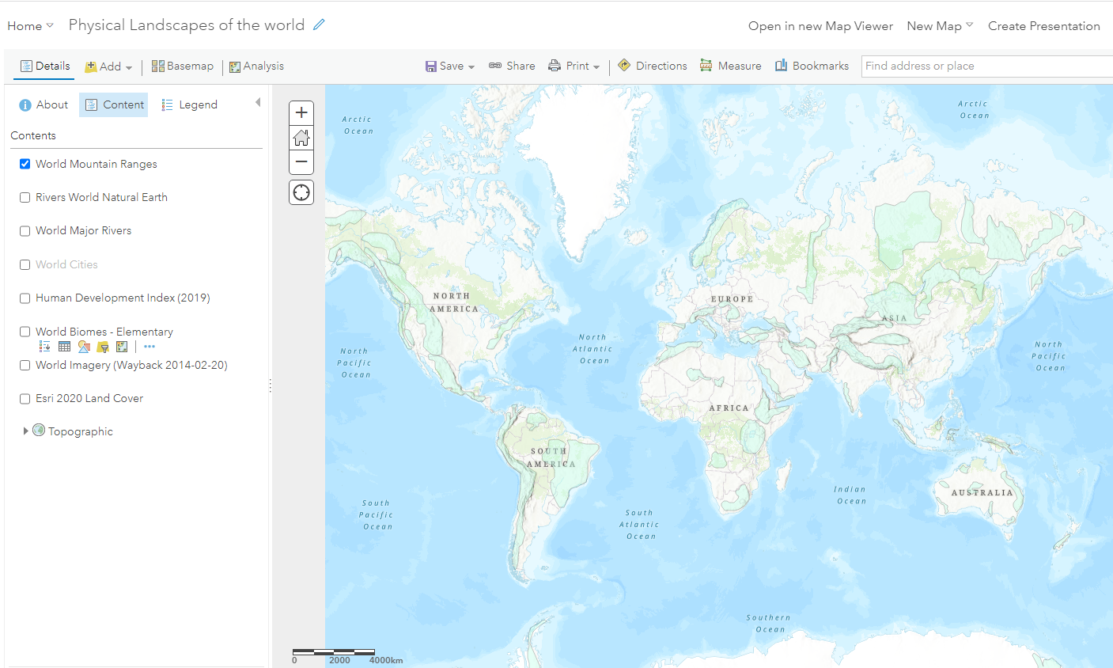
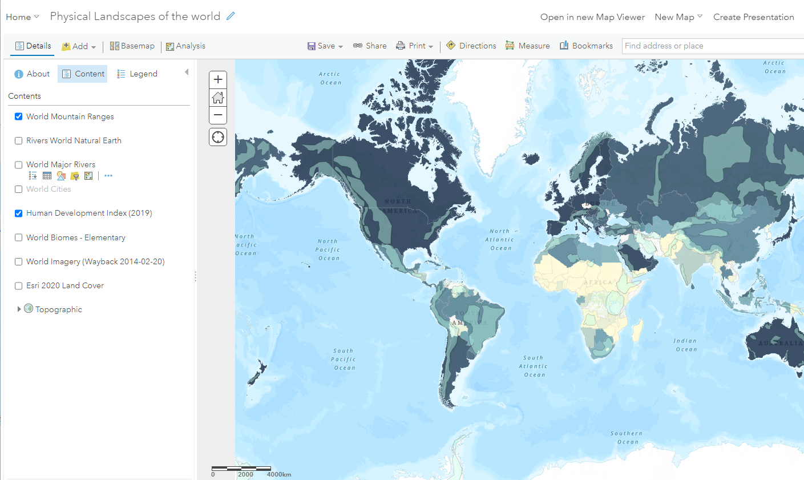
Notes:
SW –each layer of the map is a click

Slide 18
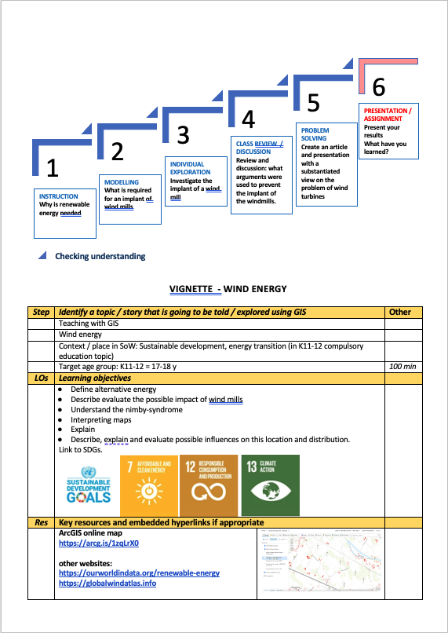
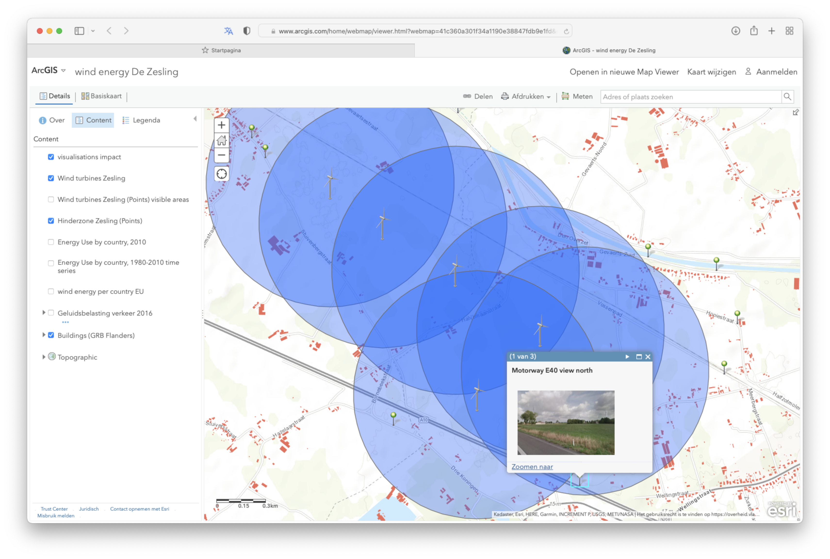
Example 2
Widmills
Age group 17-18 y
demo
Notes:
Luc

Slide 19


Website
www.gilearner.eu
www.gi-pedagogy.eu
@GIPedagogy

Slide 20
Any questions?

