Slide 1
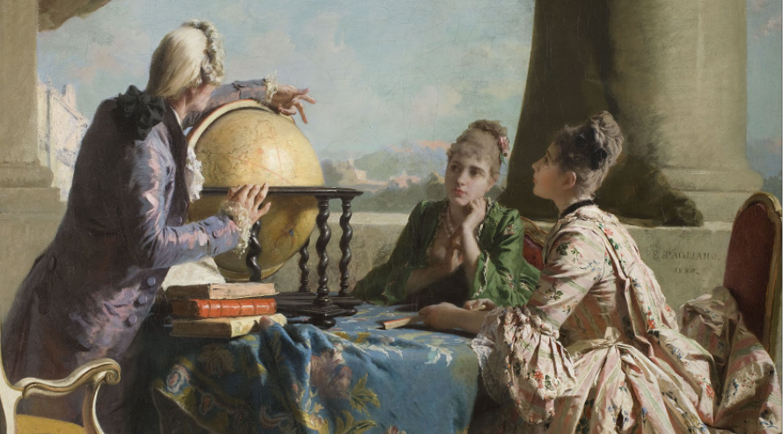



GI Education in Geography
Luc Zwartjes
Teaching assistant Ghent University
Pedagogic counsellor Katholiek Onderwijs Vlaanderen
BeGeo2021 – 26 November 2021
The Geography Lesson Eleuterio Pagliano 1880

Slide 2


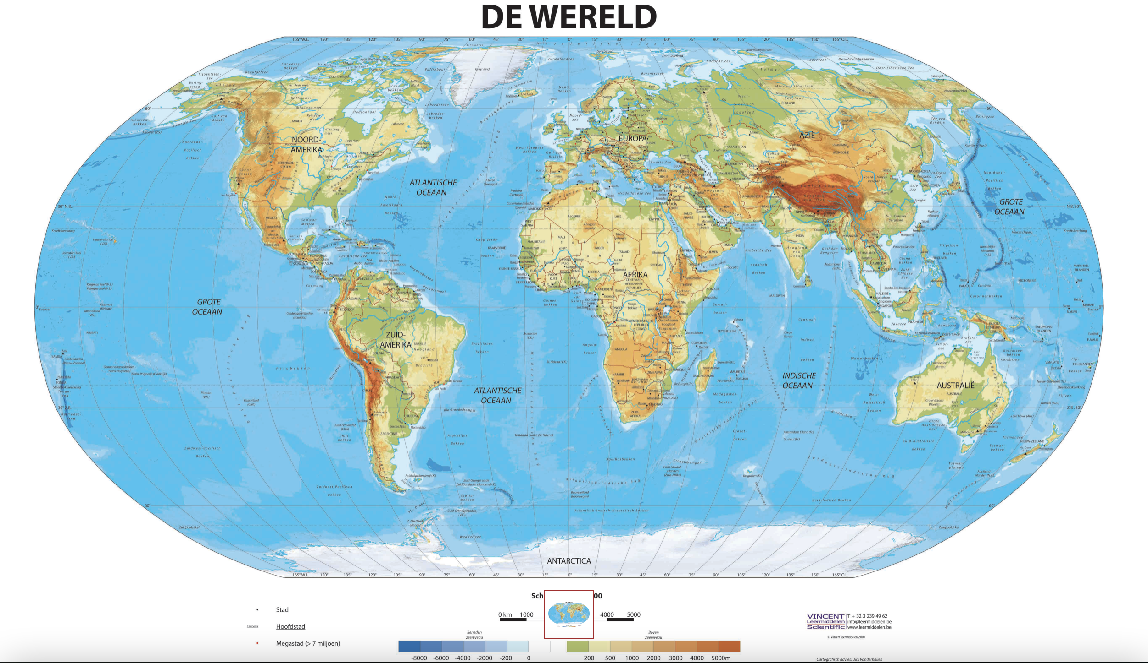
SPATIAL THINKING IN EDUCATION
Atlas
Globe
Wall maps

Slide 3

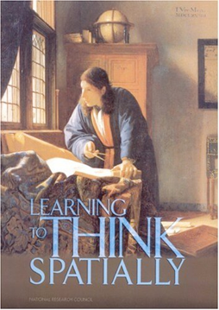
GIS → SPATIAL THINKING
a distinct form of thinking that helps people visualise relationships between spatial phenomena
(NRC, 2006) "a set of cognitive skills consisting of knowing concepts of space, using representational tools and reasoning processes".
https://www.nap.edu/catalog/11019/learning-to-think-spatially
Notes:
enables knowing about
- Space – e.g. different ways of calculating distance, coordinate system
- Representation – e.g. effect of projections, principles of graphic design (semiology)
- Reasoning – e.g. different ways of thinking about shortest distances, estimate the slope of a hill fom a map of contour lines

Slide 4
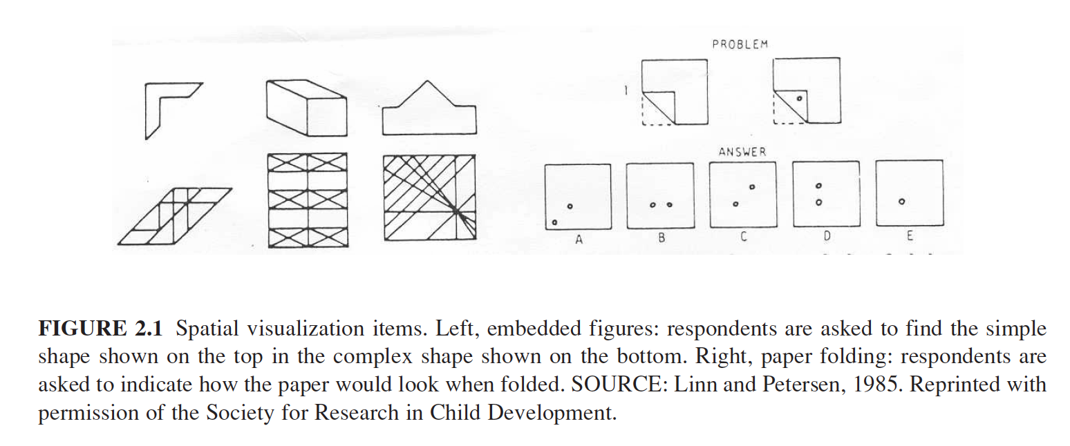
SPATIAL THINKING IS ...
traditionally linked to spatial visualisation, orientation, spatial perception and mental rotation

Slide 5
GEOSPATIAL THINKINS IS EVEN MORE…
Geospatial is not only about visualisation and relationships (Wang et al. 2014), it implies manipulation, interpretation and explanation of information (Baker et al. (2015) .... at different geographical scales
The ability to study the characteristics and interconnected processes of nature and human impact over time and on an appropriate scale (Kerski 2008)
Baker, T.R., Battersby, S., Bednarz, S.W., Bodzin, A.M., Kolvoord, B., Moore, S., Sinton, D. and Uttal, D., 2015. A research agenda for geospatial technologies and learning. Journal of Geography, 114(3), pp.118-130.
Kerski, J.J., 2008. The role of GIS in Digital Earth education. International Journal of Digital Earth, 1(4), pp.326-346.

Slide 6
GEOSPATIAL THINKING IS EVEN MORE…
The ability to study the characteristics and interconnected processes of nature and human impact over time and on an appropriate scale (Kerski 2008)
Enable students to realise and interpret patterns, associations and spatial order (National Geography Standard, 2012)
equip students with skills to respond to crucial scientific and social questions of the 21st century (Tsou and Yanow, 2010).
Kerski, J.J., 2008. The role of GIS in Digital Earth education. International Journal of Digital Earth, 1(4), pp.326-346.
Geography Education Standards Project, 2012, Geography for Life – National Geography Standards, Second edition, National Geographic Society, Washington D.C., 272 p.
Tsou, M.H. and Yanow, K., 2010. Enhancing general education with geographic information science and spatial literacy. URISA Journal, 22(2), 45-54
Notes:
Bednarz and Lee (2011) conclude in their spatial thinking ability test (STAT) that spatial thinking is not a single ability but comprised of a collection of different skills, whereby following spatial thinking components emerge: map visualization and overlay, identification and classification of map symbols (point, line, area), use of Boolean operations, map navigation and recognition of spatial correlation

Slide 7
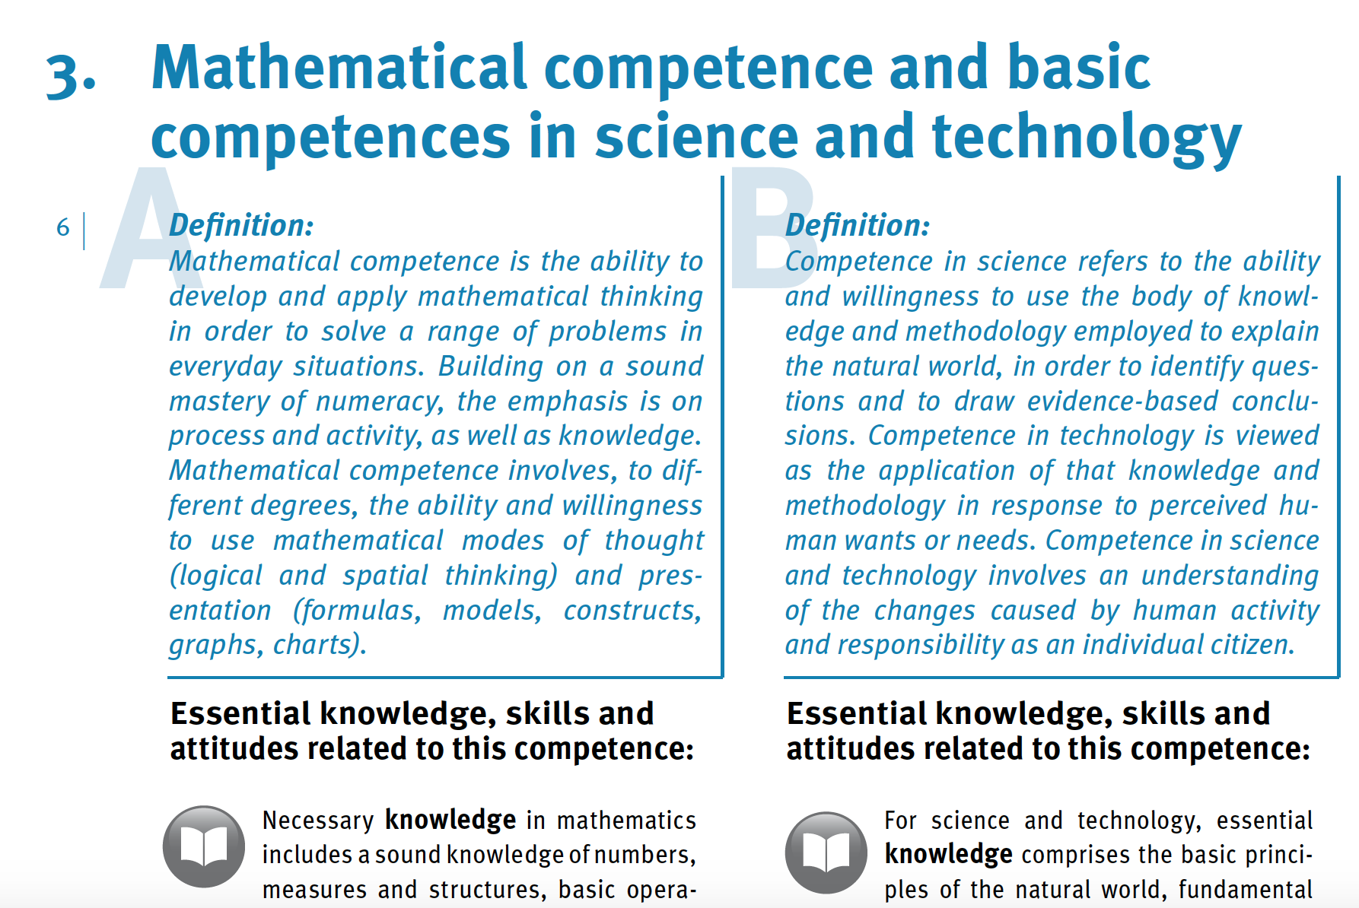

https://publications.europa.eu/en/publication-detail/-/publication/5719a044-b659-46de-b58b-606bc5b084c1/language-en/format-PDF/source-71624064

Slide 8

Learning outcomes in function of 16 key competences
Competences in the field of physical, mental and emotional awareness and in the field of physical, mental and emotional health | Competences with regard to spatial awareness
Competences in Dutch | Competences regarding sustainability
Competences in other languages | Economic and financial competences
Digital competence and media literacy | Legal competences
Social relational competences | Learning competences including research competencies, innovation thinking, creativity, problem solving and critical thinking, system thinking, information processing and collaboration
Competences in mathematics, exact sciences and technology | Self-awareness and self-expression, self-management and maneuverability
Citizenship competences, including competences in living together | Development of initiative, ambition, entrepreneurial spirit and career competencies
Competences with regard to historical awareness | Cultural awareness and cultural expression
VLAAMSE REGERING
Notes:
GIS is opgenomen in het referentiekader met de competenties m.b.t. ruimtelijk bewustzijn.

Slide 9
Eindtermen i.f.v. 16 sleutelcompetenties
Competenties op het vlak van lichamelijk, geestelijk en emotioneel bewustzijn en op vlak van lichamelijke, geestelijke en emotionele gezondheid | Competenties m.b.t. ruimtelijk bewustzijn
Competenties in het Nederlands | Competenties inzake duurzaamheid
Competenties in andere talen | Economische en financiële competenties
Digitale competentie en mediawijsheid | Juridische competenties
Sociaal-relationele competenties | Leercompetenties met inbegrip van onderzoekscompetenties, innovatiedenken, creativiteit, probleemoplossend en kritisch denken, systeemdenken, informatie- verwerking en samenwerken
Competenties inzake wiskunde, exacte wetenschappen en technologie | Zelfbewustzijn en zelfexpressie, zelfsturing en wendbaarheid
Burgerschapscompetenties met inbegrip van competenties in zake samenleven | Ontwikkeling van initiatief, ambitie, ondernemingszin en loopbaancompetenties
Competenties m.b.t. historisch bewustzijn | Cultureel bewustzijn en culturele expressie
VLAAMSE REGERING
Notes:
GIS is opgenomen in het referentiekader met de competenties m.b.t. ruimtelijk bewustzijn.

Slide 10
To explain spatial patterns and processes on the earth's surface as the result of interactions between natural processes
between human processes and between natural and human processes.
Notes:
Daarin staat letterlijk:
“Ruimtelijk bewustzijn ontwikkelen heeft te maken met vaardig worden in ruimtelijk relationeel denken en bewust ruimtelijk handelen”

Slide 11
Ruimtelijke patronen en processen aan het aardoppervlak verklaren als het resultaat van interacties tussen natuurlijke processen onderling,
tussen menselijke processen onderling en tussen natuurlijke en menselijke processen.
Notes:
En “Ruimtelijke patronen en processen aan het aardoppervlak verklaren als het resultaat van interacties tussen natuurlijke processen onderling, tussen menselijke processen onderling en tussen natuurlijke en menselijke processen.”

Slide 12
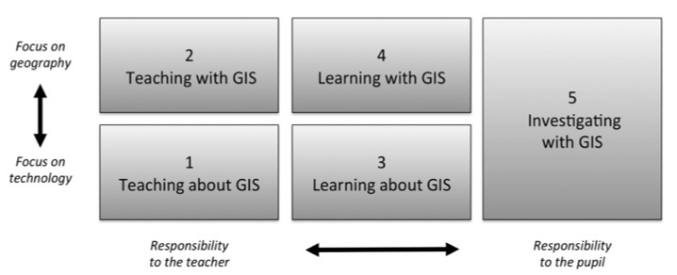
HOW TO IMPLEMENT GI?
Five ways of integrating GIS in geography education (Favier, 2013)
Favier, T.M., 2011, Geographic Information Systems in inquiry-based secondary geography education, Vrije Universiteit Amsterdam, 287 pp.

Slide 13


GIS-viewers and GIS-software
GIS viewers allow you to view those layers and see simple connections
Example: Geopunt
GIS software (online & off-line): view layers and see simple connections + add, manage, edit, visualise, analyse (filtering, buffering ...)
Example: ArcGIS Online, QGis

Slide 14
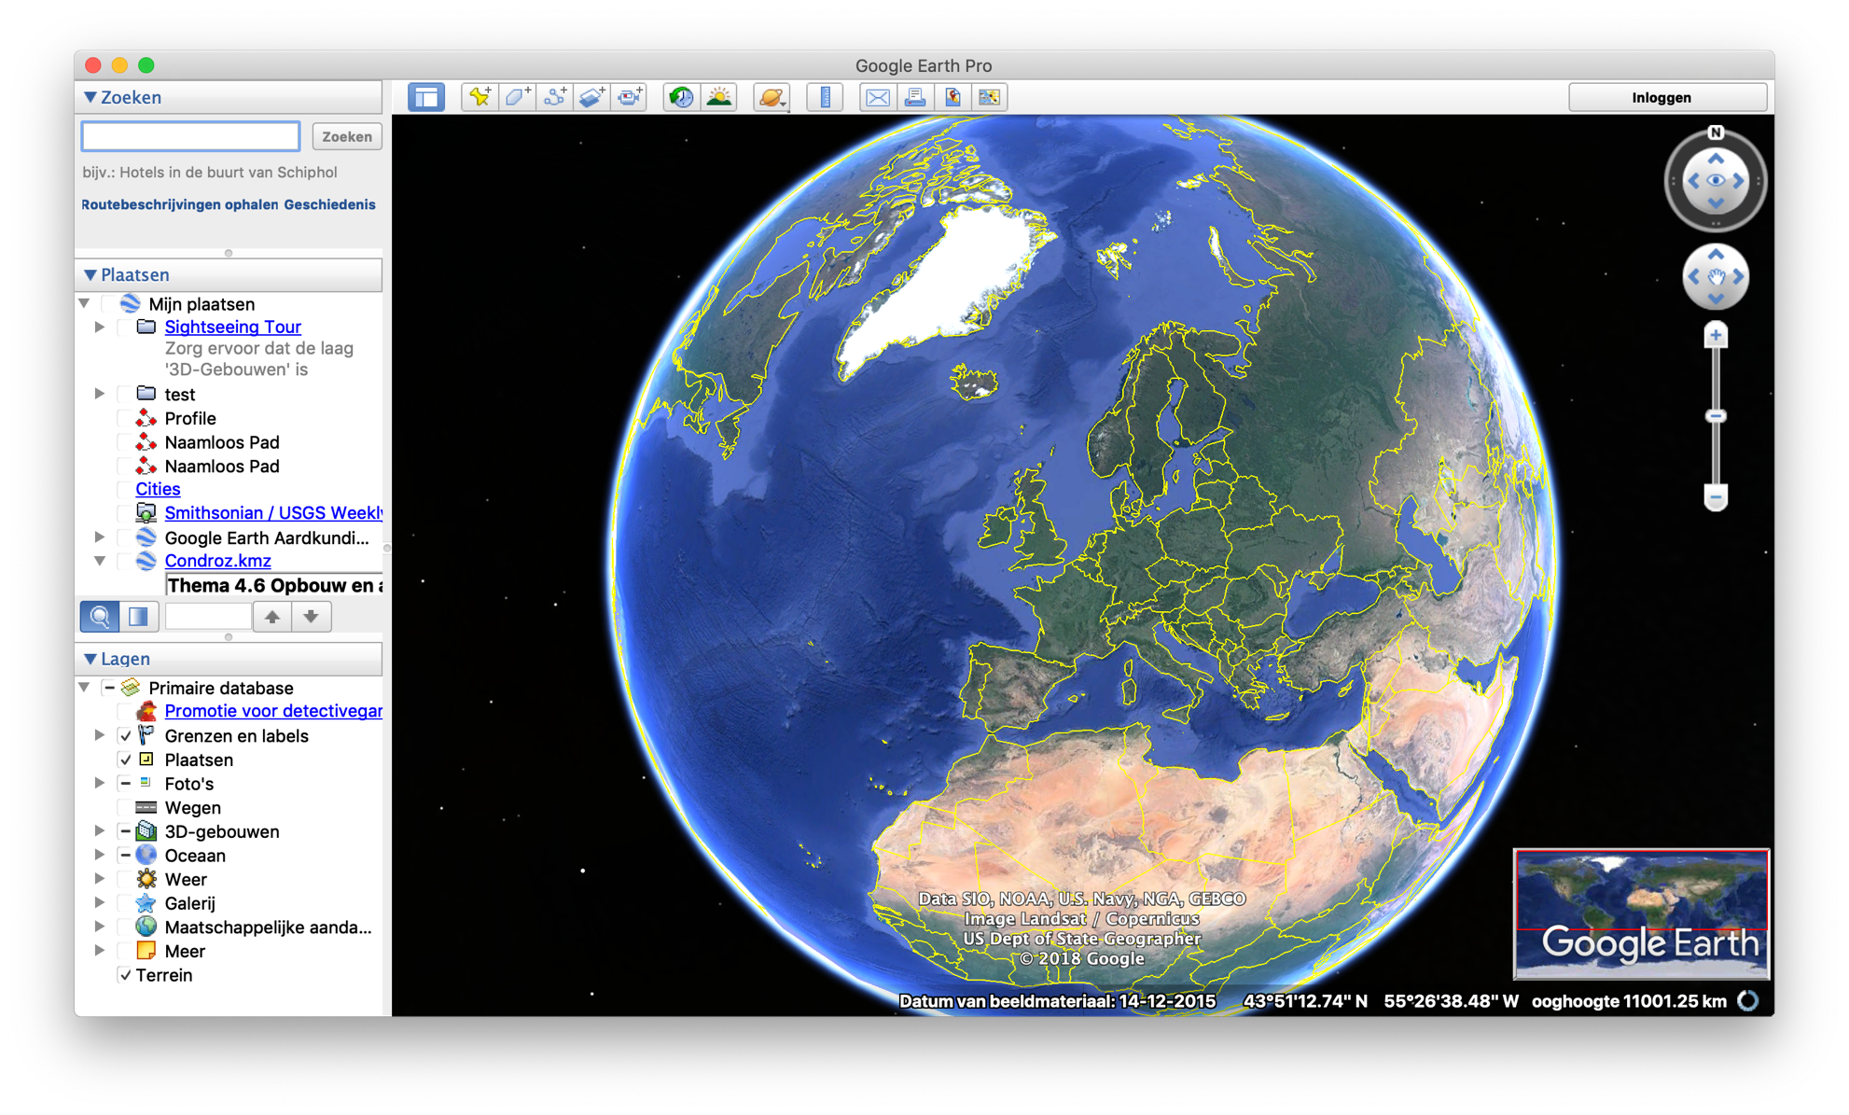
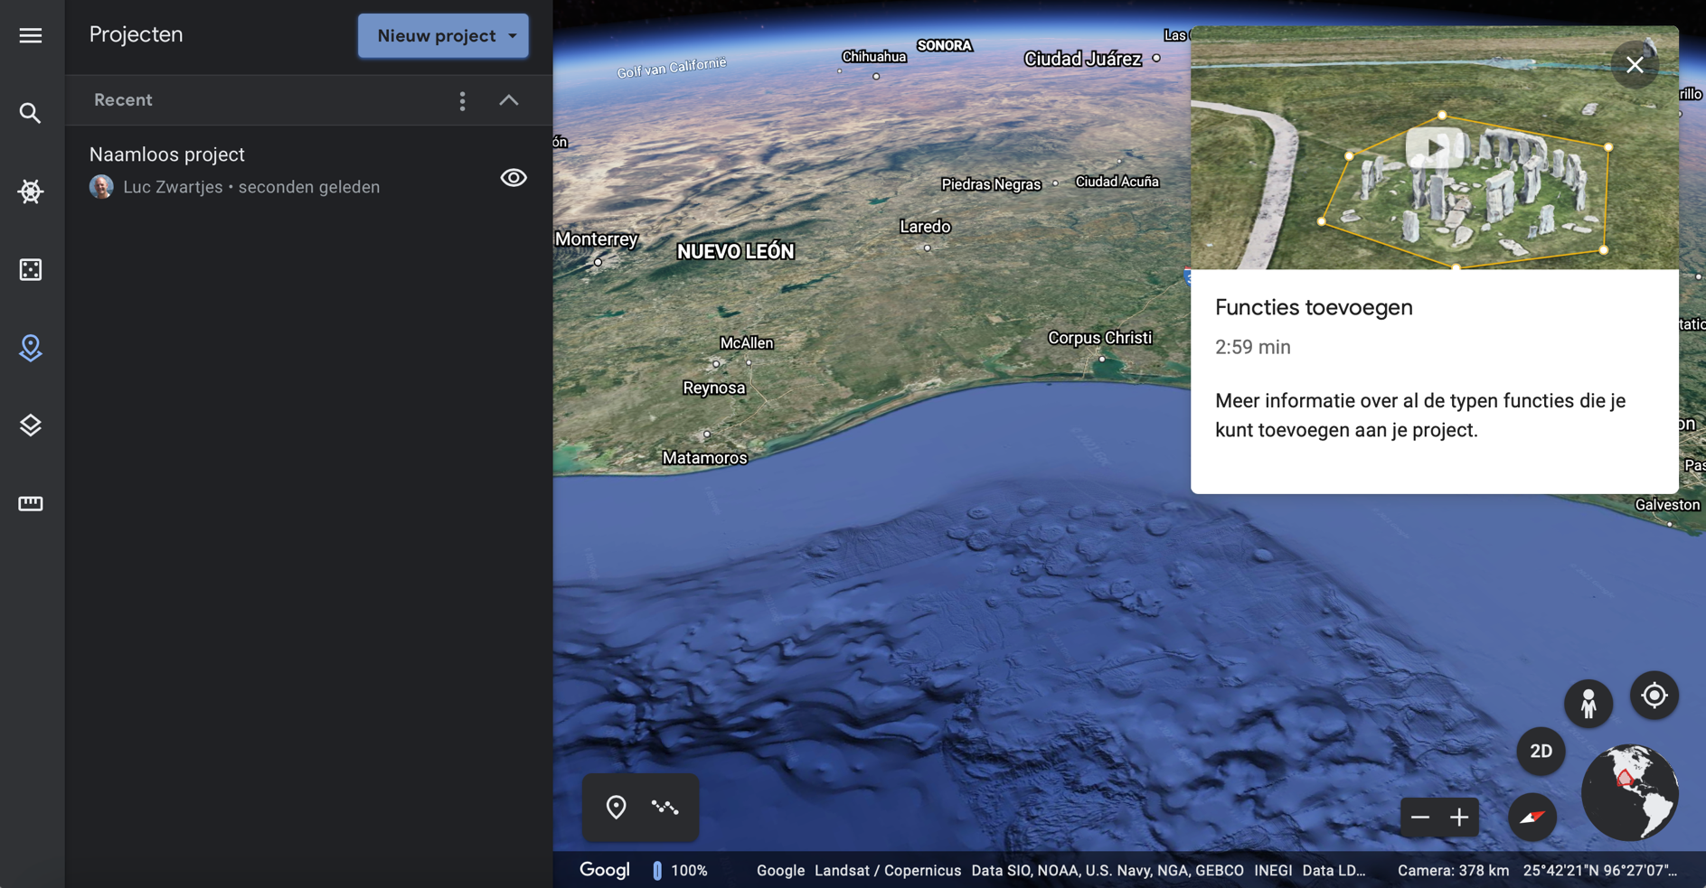
And virtual globes?
Best known: Google Earth
Pro:
Simple and fast visual results
Realistic view of the world
Easy to draw on + add kmz layers
Contra:
Not really GIS
Connections between layers
(relationships) more difficult
https://earth.google.com/web/

Slide 15
LEARNING LINE

Slide 16
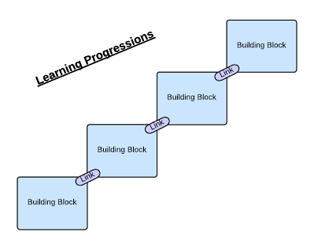
LEARNING PROGRESSION LINE
construction of knowledge and skills throughout the whole curriculum
reflect a growing level of complexity, ranging from easy to difficult

Slide 17
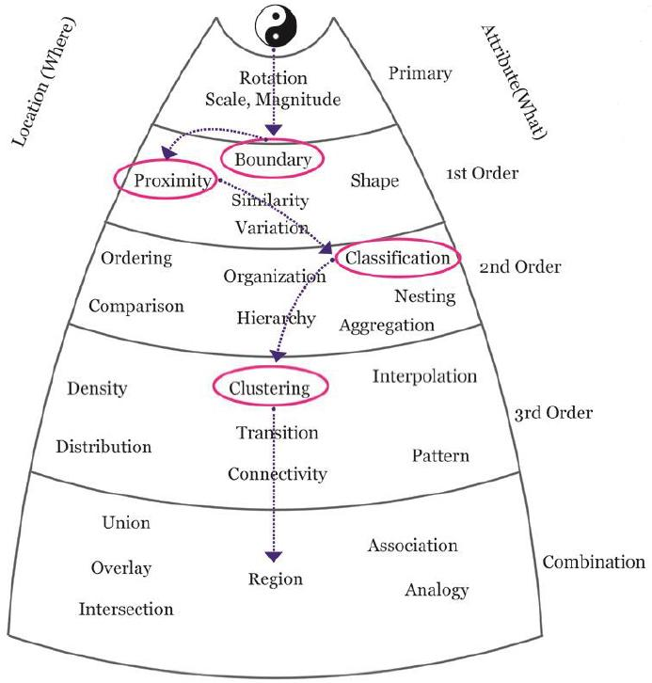
LEARNING PROGRESSION LINE
Certain spatial thinking skills are higher order than others and build upon previous, less complex skills

Slide 18
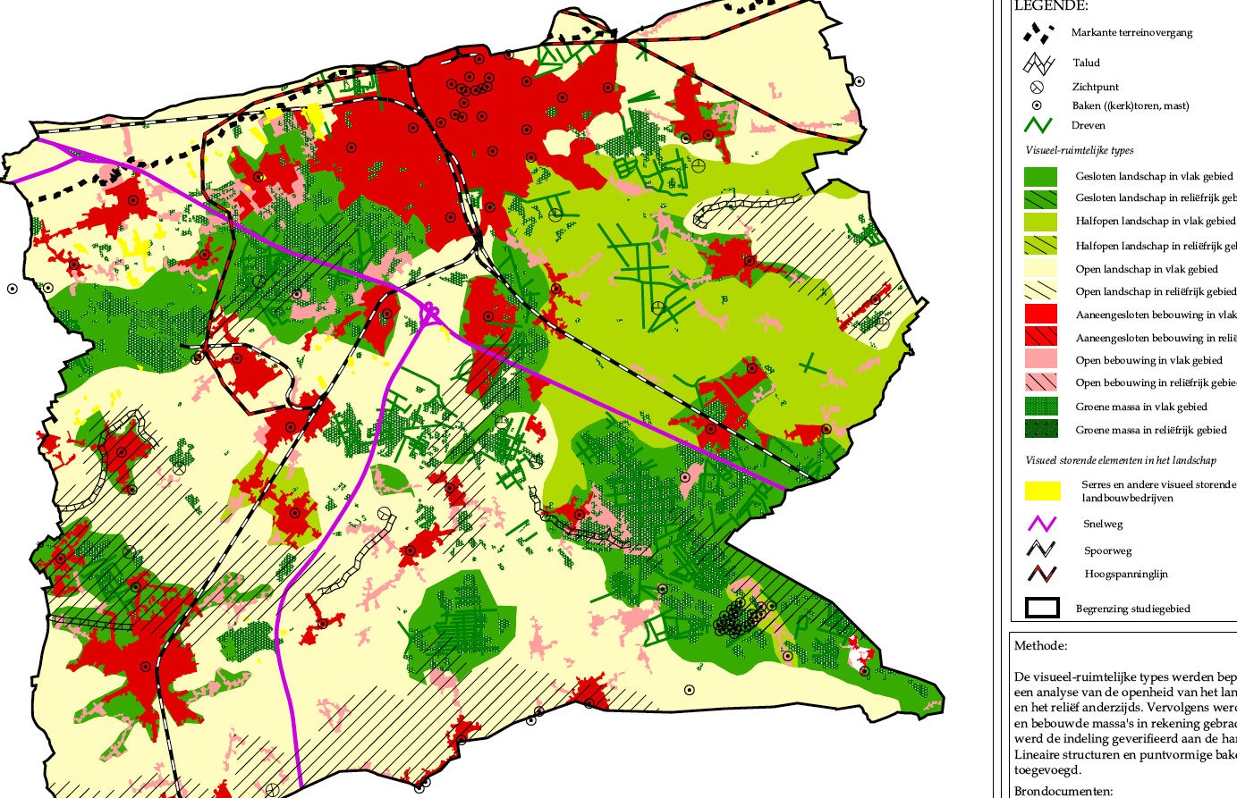
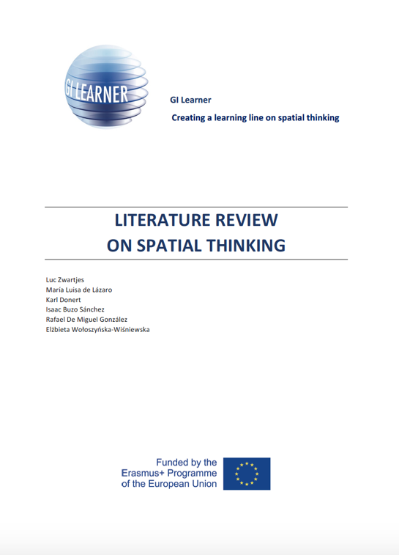
Based on the review:
10 GI-Learner geospatial thinking competences, each with a progression inside from easy (A) to advanced(C)
www.gilearner.eu

Slide 19
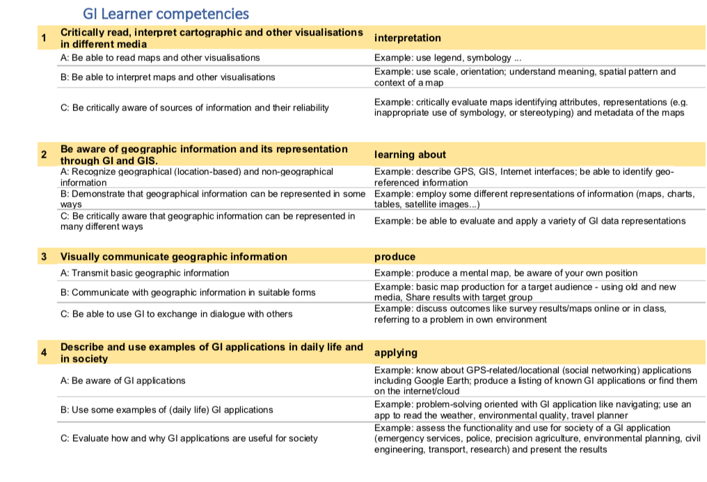

Slide 20
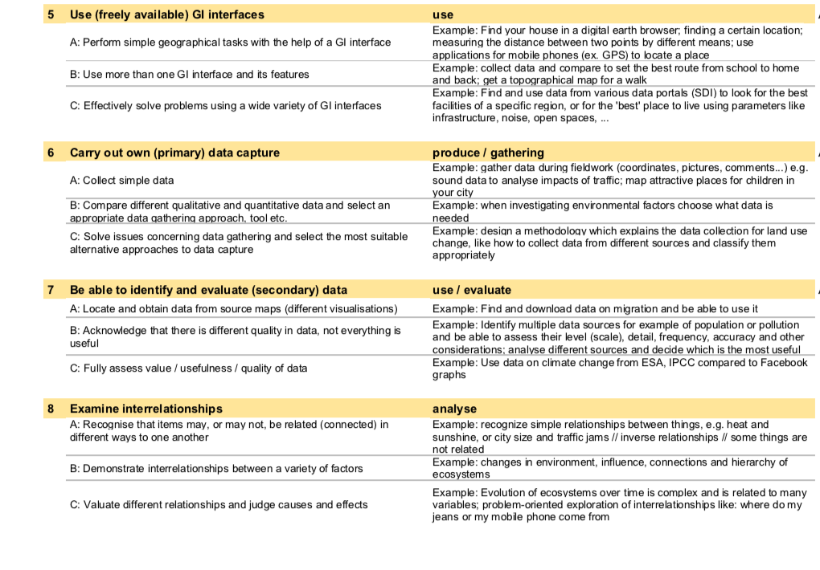

Slide 21
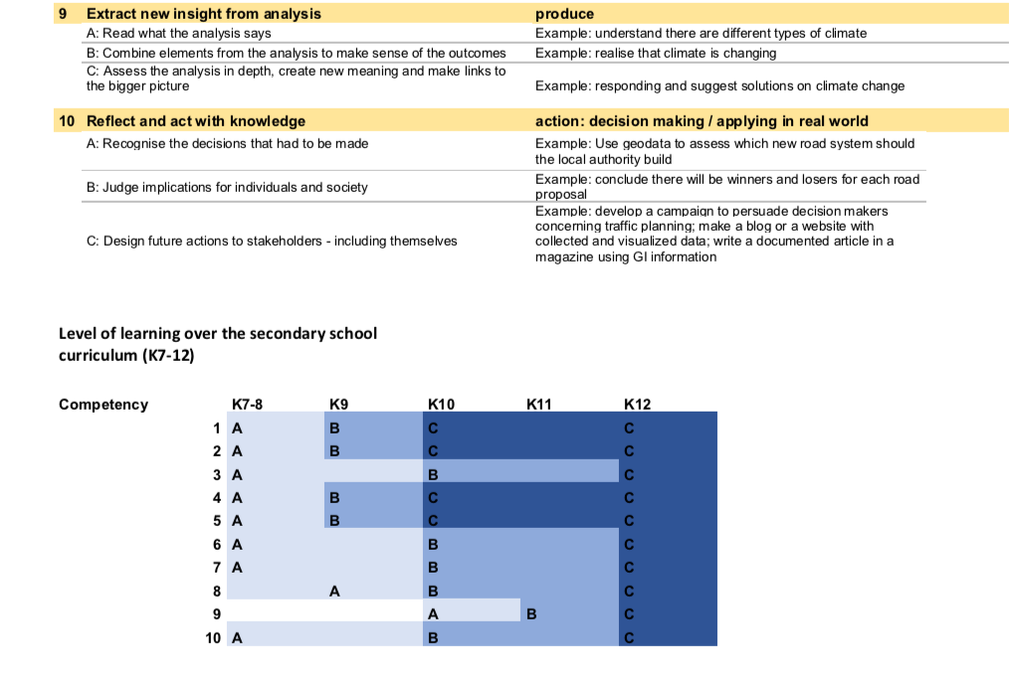

Slide 22
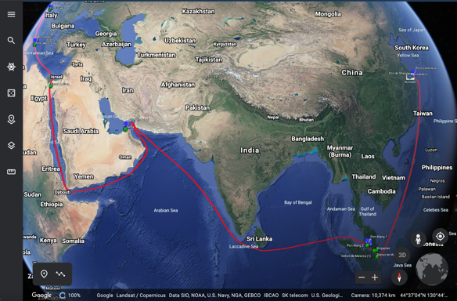
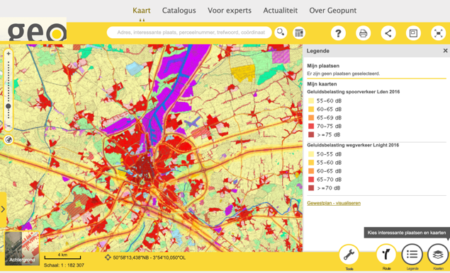
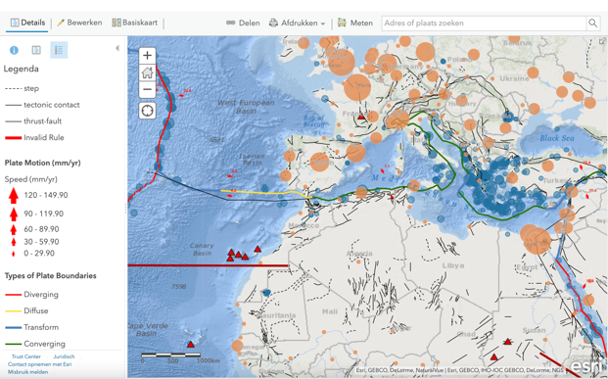
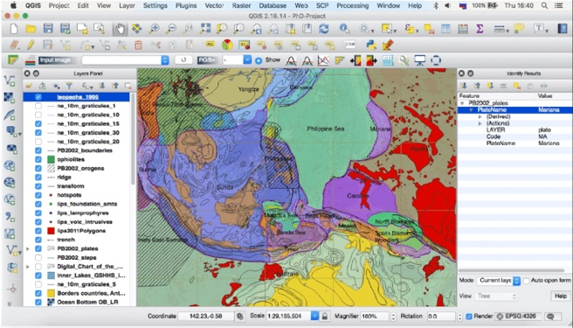
Translated into the new Flemish curriculum
Investigate relationships between landscape layers
Draw conclusions
+
Investigating spatial patterns and processes
Investigate consequences
+
Spatial problem-oriented analysis and/or synthesis of a system
Being able to query a virtual globe
Use selection of GISviewers
+
webGIS applications
+
Knowledge of GIS
Use of GIS software
K7-8
K9-10
K11-12
Notes:
Als we dat schematisch voorstellen komen we tot dit:

Slide 23
1st grade
ET 9.5 Students illustrate that landscapes evolve under the influence of physical and social-geographical changes.
- Physical-geographical changes over short or long periods of time (from one second to millions of years):
> Observable external changes of the earth's crust such as volcanic eruptions and earthquakes
Social geographical changes over short (one event) and longer time scales (since first man)
> Human interventions such as building, infrastructure and land use
ET 9.6 Students investigate spatial effects of changes in landscapes on people and their environment.
Effects of physical and social-geographical changes:
> Climate change such as sea level rise and the reduction of biodiversity due to global warming
> Changes in land use such as increasing the size of agricultural parcels, conversion of agricultural land into built-up areas, deforestation

Slide 24
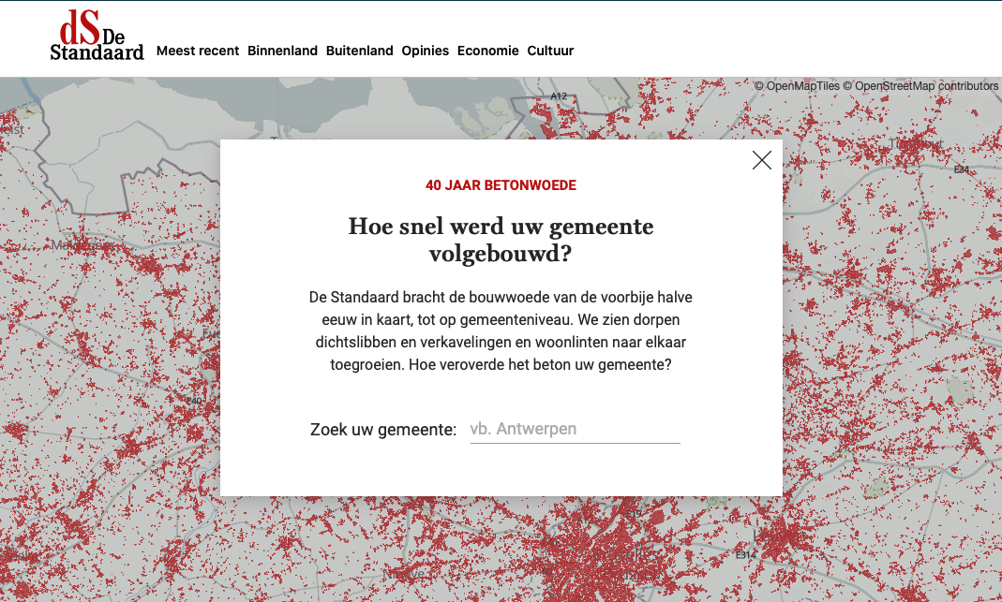
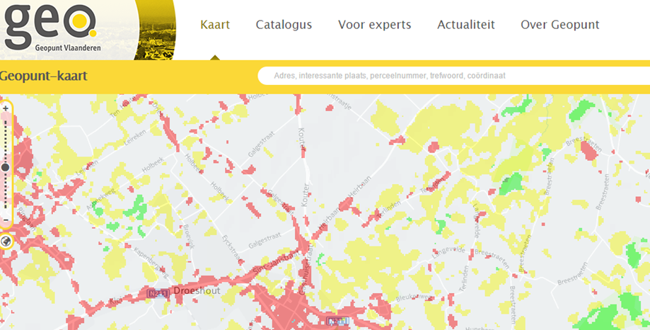
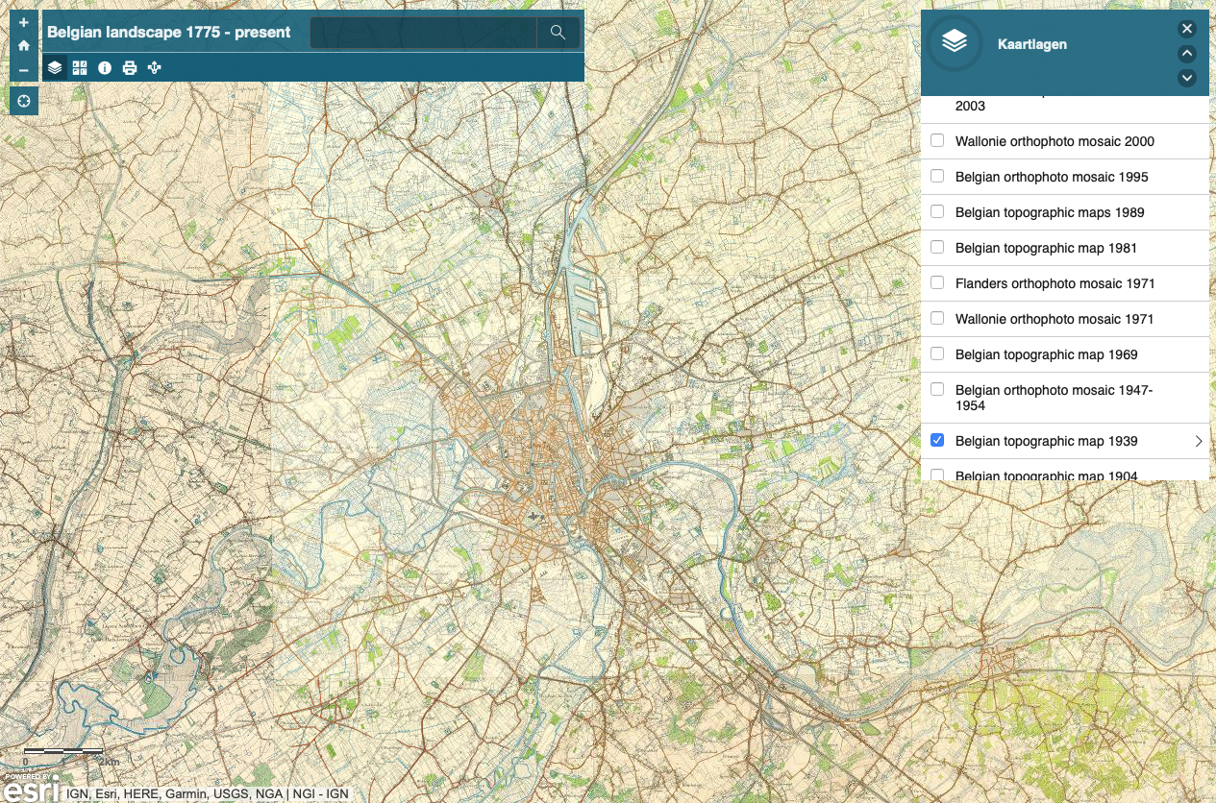
Examples 1st grade
https://www.standaard.be/betonwoede/kaart
http://www.geopunt.be
https://arcg.is/0K1He9
/
Notes:
24

Slide 25

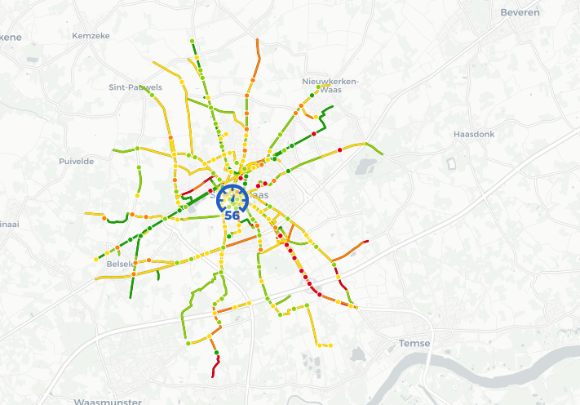
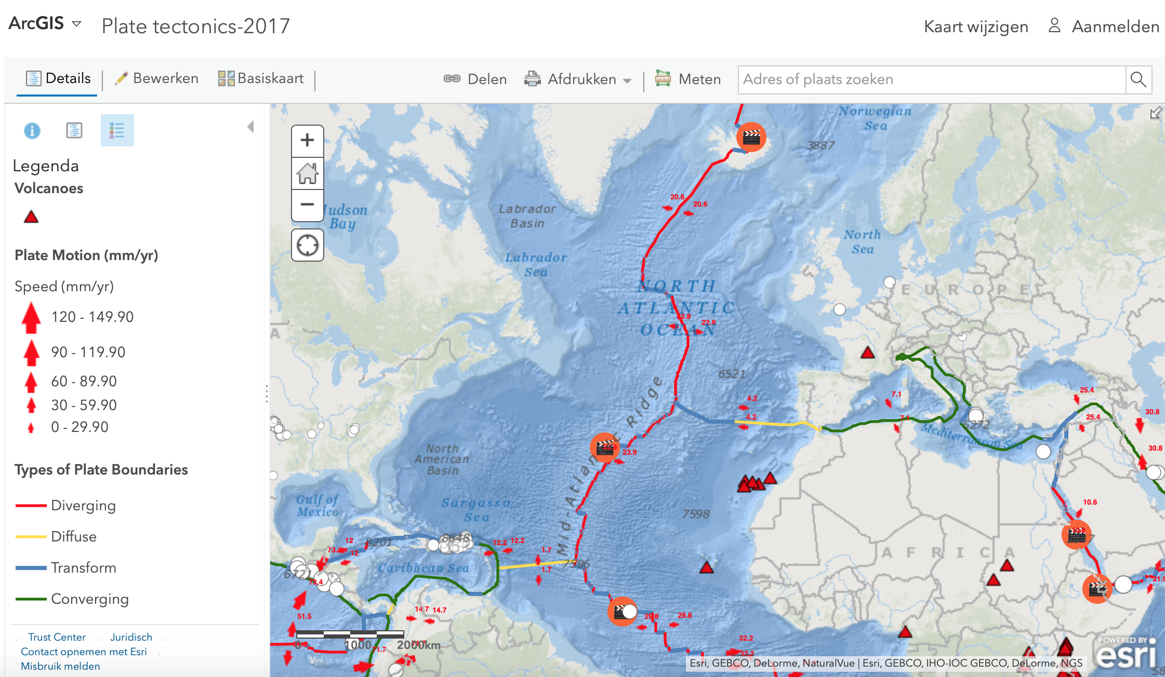
Examples 2nd and 3th grade
https://fietsbarometer.ugent.be
Using ArcGIS online
Mobility: http://arcg.is/ja09P
Habitat and flood risks: https://arcg.is/19W148
Sea level rise: https://arcg.is/1Orefe
Plate tectonics: https://arcg.is/1iiTW0

Slide 26
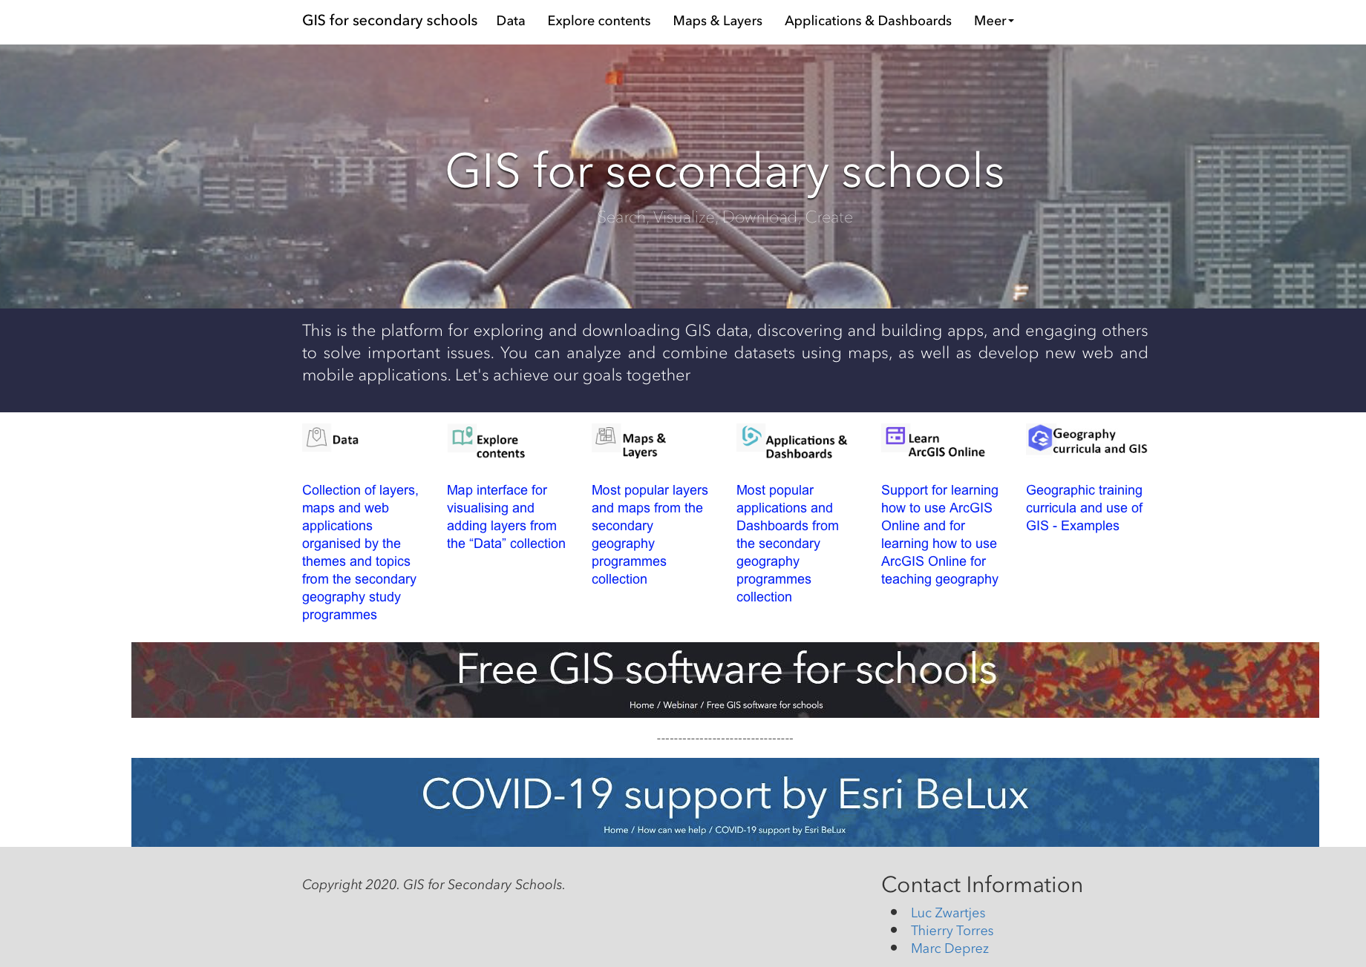
Hub for education
Platform to support use of GIS in secondary education
https://gis-for-secondary-schools-schools-be.hub.arcgis.com
Notes:
26

Slide 27

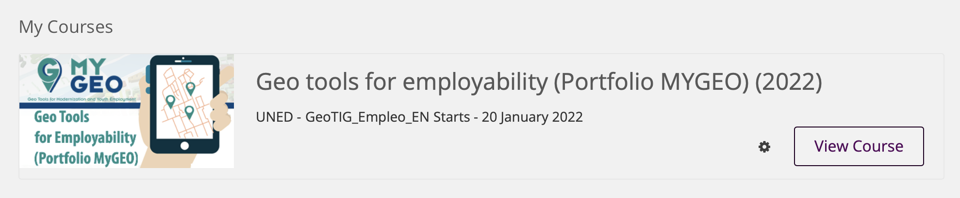

MYGEO MOOCs
MyGeo project: https://www.mygeoproject.eu
MOOCs for teachers & students

Slide 28
Interesting publications & material www.gilearner.eu www.gi-pedagogy.eu https://gis-for-secondary-schools-schools-be.hub.arcgis.com
More information?
Luc Zwartjes
Luc.zwartjes@ugent.be

