Slide 1


A project to develop geospatial thinking learning lines in secondary schools
GI-Learner
Luc Zwartjes
Teacher geography – Sint-Lodewijkscollege Brugge
Lecturer Ghent University, Geography Department
Pedagogic advisor geography West-Flanders
Luc.zwartjes@ugent.be

Slide 2
The situation
Literature Review
schools nowadays generally have better ICT equipment
Cloud-based developments
bring their own devices
more openly available data
Web-based platforms reduced / no costs
networking and communities encouraged and available

Slide 3




The situation
Literature Review
Content already exists …
  iGuess → www.iguess.eu
  I-Use → www.i-use.eu
  EduGIS → www.edugis.nl, www.edugis.pl
  PaikkaOppi learning environment → http://www.paikkaoppi.fi/
…but it is not structured or coordinated by age …

Slide 4
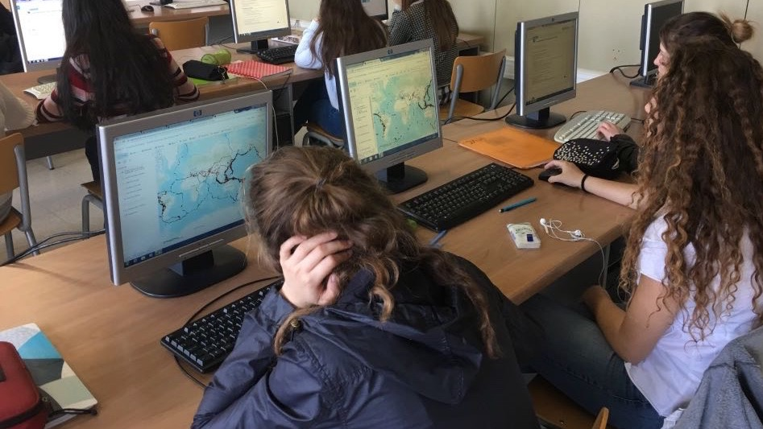
Literature Review
What is still blocking it?
Bednarz and van der Schee (2006)
GIS not a compulsory item in teacher training
Taught by non-specialists
Curriculum not include GIS
non-availability of data and easy-to-use software.
Attitudes of teachers difficult to persuade

Slide 5
Why spatial thinking?
Geo-ICT is part of the digital economy: innovation, jobs European competitiveness.
GI is part of everyday life (GPS, navigation systems, marketing…).
Spatial thinking a distinct, basic and essential skill like language, mathematics and science.
European Reference Framework: Part of the KEY COMPETENCES FOR LIFELONG LEARNING

Slide 6
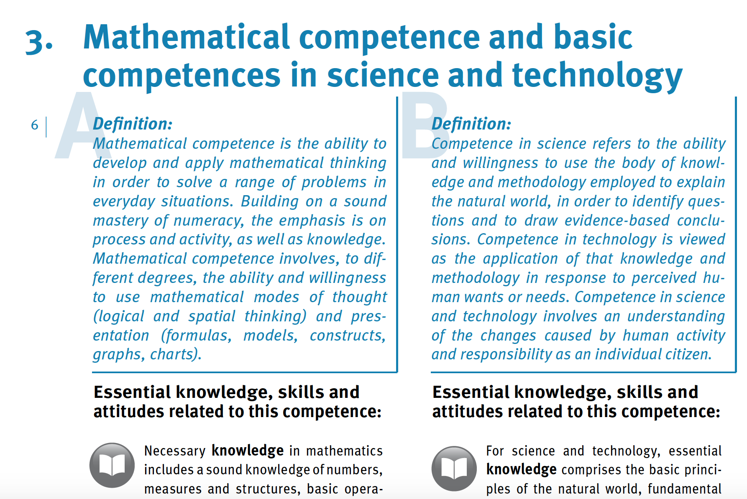

https://publications.europa.eu/en/publication-detail/-/publication/5719a044-b659-46de-b58b-606bc5b084c1/language-en/format-PDF/source-71624064

Slide 7
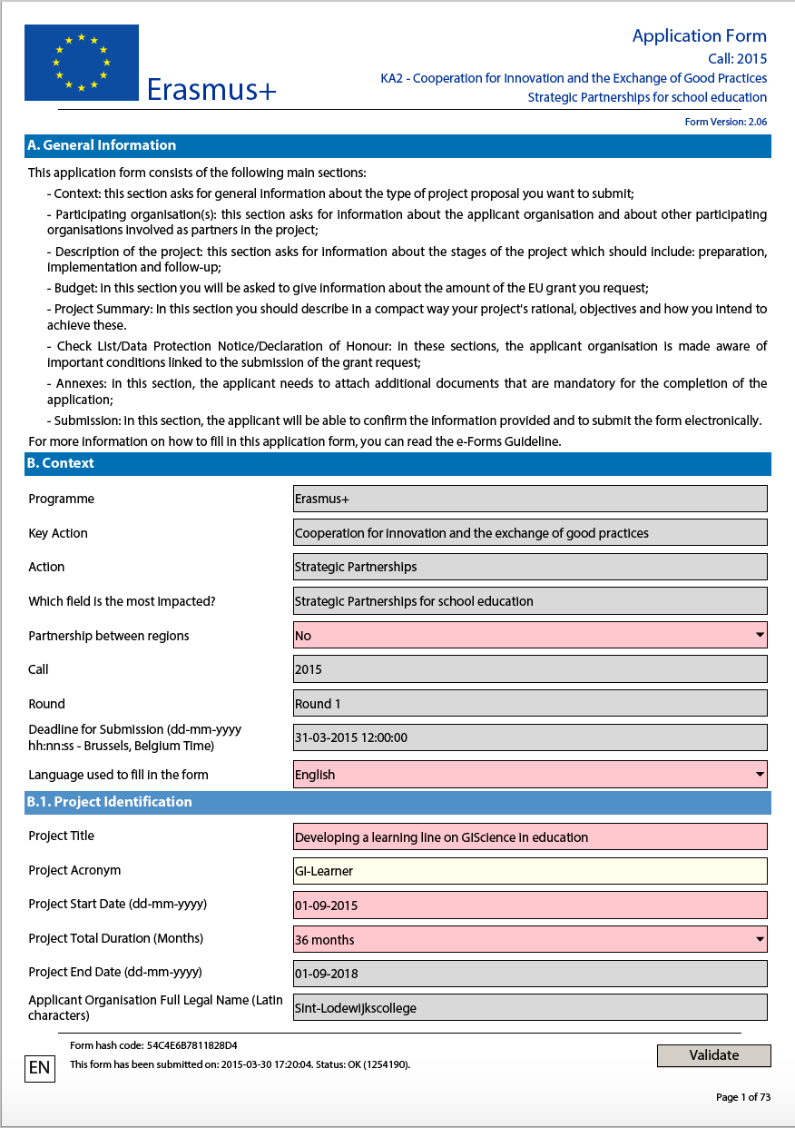






The idea

Slide 8
Aims
Need to support teachers: implement learning progression lines for spatial thinking in secondary schools, using GIScience.
https://cnr.ncsu.edu/geospatial/wp-content/uploads/sites/12/2015/08/DukeTIPCollage.png

Slide 9
Action steps
summarize literature → report
define geospatial thinking competencies
create learning lines & translating them into learning objectives, teaching and learning materials for the whole curriculum (K7 to K12)
develop an evaluative tool to analyze the impact and pupils’ feedback

Slide 10
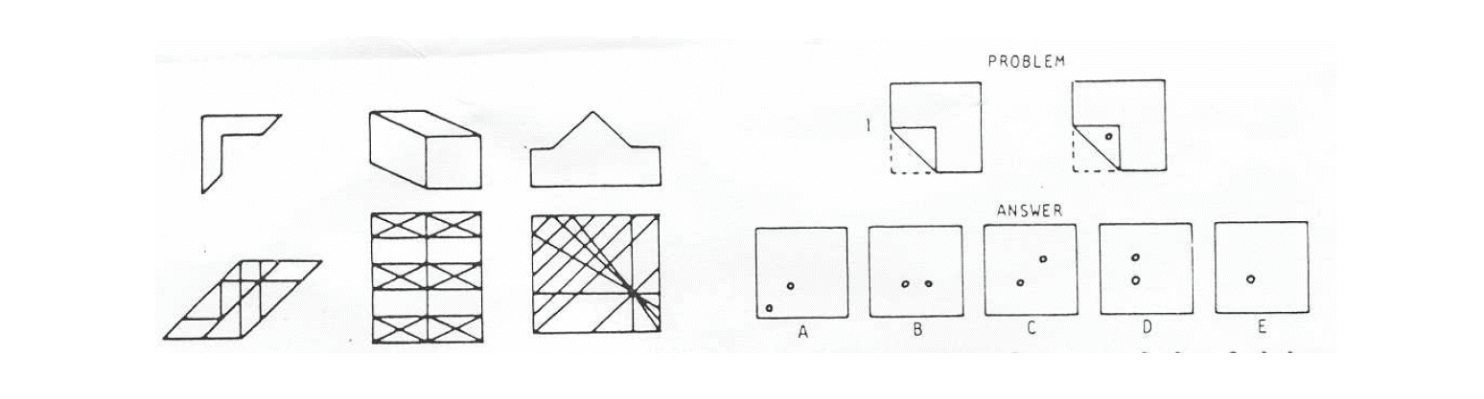
Spatial thinking is …..
Literature Review
traditionally linked to spatial visualization, orientation, spatial perception and mental rotation

Slide 11
Geospatial thinking is even more…
Literature Review
Geospatial is not simply about visualization and relationships (Wang et al. 2014), it implies
  manipulation
  interpretation and
  explanation of information (Baker et al. (2015)
.... at different geographic scales
Baker, T.R., Battersby, S., Bednarz, S.W., Bodzin, A.M., Kolvoord, B., Moore, S., Sinton, D. and Uttal, D., 2015. A research agenda for geospatial technologies and learning. Journal of Geography, 114(3), pp.118-130.
Wang, H.S., Chen, Y.T. and Lin, C.H., 2014. The learning benefits of using eye trackers to enhance the geospatial abilities of elementary school students. British Journal of Educational Technology, 45(2), pp.340-355.

Slide 12
Literature Review
Geospatial thinking is even more…
not a single ability but comprises of a collection of different skills (Bednarz & Lee, 2011)
the ability to study the characteristics and the interconnected processes of nature and human impact in time and at appropriate scale (Kerski 2008)
Bednarz, R.S. and Lee, J., 2011. The components of spatial thinking: empirical evidence. Procedia-Social and Behavioral Sciences, 21, pp.103-107.
Kerski, J.J., 2008. The role of GIS in Digital Earth education. International Journal of Digital Earth, 1(4), pp.326-346.
Notes:
Bednarz and Lee (2011) conclude in their spatial thinking ability test (STAT) that spatial thinking is not a single ability but comprised of a collection of different skills, whereby following spatial thinking components emerge: map visualization and overlay, identification and classification of map symbols (point, line, area), use of Boolean operations, map navigation and recognition of spatial correlation

Slide 13
Geospatial thinking is even more…
Literature Review
provide necessary tools and techniques to think spatially
enable students to realise and interprete patterns, associations, and spatial order (National Geography Standard, 2012)
provide students with skills to respond to crucial scientific and social questions of the 21st century (Tsou and Yanow, 2010).
Geography Education Standards Project, 2012, Geography for Life – National Geography
Standards, Second edition, National Geographic Society, Washington D.C., 272 p.
Tsou, M.H. and Yanow, K., 2010. Enhancing general education with geographic information science and spatial literacy. URISA Journal, 22(2), 45-54
Notes:
Bednarz and Lee (2011) conclude in their spatial thinking ability test (STAT) that spatial thinking is not a single ability but comprised of a collection of different skills, whereby following spatial thinking components emerge: map visualization and overlay, identification and classification of map symbols (point, line, area), use of Boolean operations, map navigation and recognition of spatial correlation

Slide 14
GI Science ← Spatial Thinking
Literature Review
Key Literature
Michel, E. & Hof, A., 2013, Promoting Spatial Thinking and Learning with Mobile Field Trips and eGeo-Riddles, Jekel, T., Car, A., Strobl, J., Griesebner, G. (eds.), GI_Forum 2013: Creating the GISociety, 378-387. Berlin, Wichmann Verlag
Notes:
enables knowing about
- Space – e.g. different ways of calculating distance, coordinate system
- Representation – e.g. effect of projections, principles of graphic design (semiology)
- Reasoning – e.g. different ways of thinking about shortest distances, estimate the slope of a hill fom a map of contour lines

Slide 15
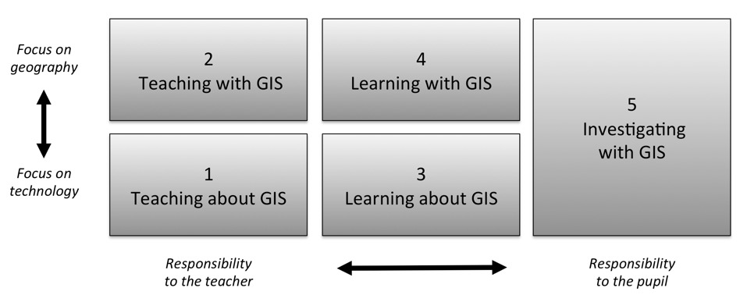
How to implement this?
Literature Review
Five ways of integrating GIS in geography education (Favier, 2013)
Favier, T.M., 2011, Geographic Information Systems in inquiry-based secondary geography education, Vrije Universiteit Amsterdam, 287 pp.
Notes:
Favier (2013) describes five ways on how GIS can be integrated in secondary education (Figure 8). Teaching and learning about GIS focuses more on the theoretical aspects of GIS (knowledge of GIS, structure of the technology), where the three other ways use the technology to develop and use spatial thinking skills

Slide 16
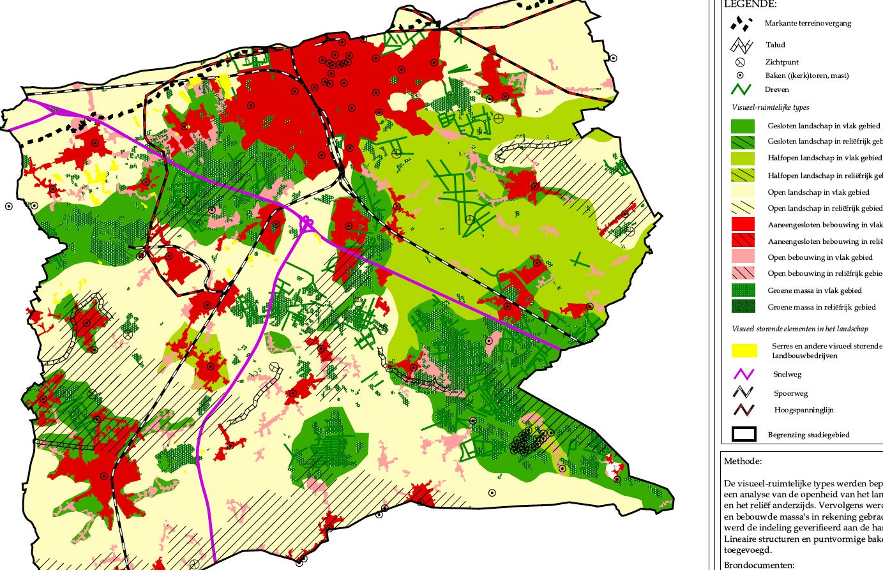
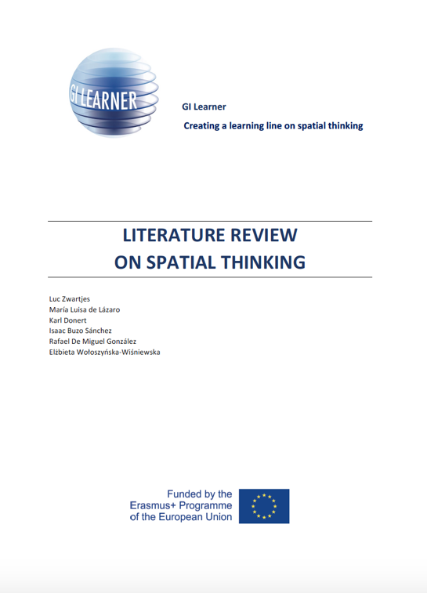
Literature Review
Literature Review on spatial thinking
Based on the review:
10 GI-Learner geospatial thinking competences, each with a progression inside from easy (A) to advanced(C)

Slide 17
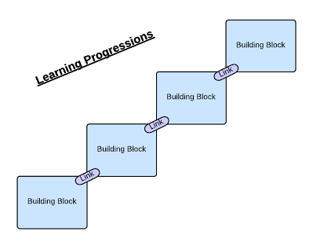
Learning progression line
construction of knowledge and skills throughout the whole curriculum
reflect a growing level of complexity, ranging from easy to difficult
Notes:
broad thematic topics that are evidently thaught in partner countries (research by GI-Learner!)
selected competencies and topics per class (K7-K12)

Slide 18
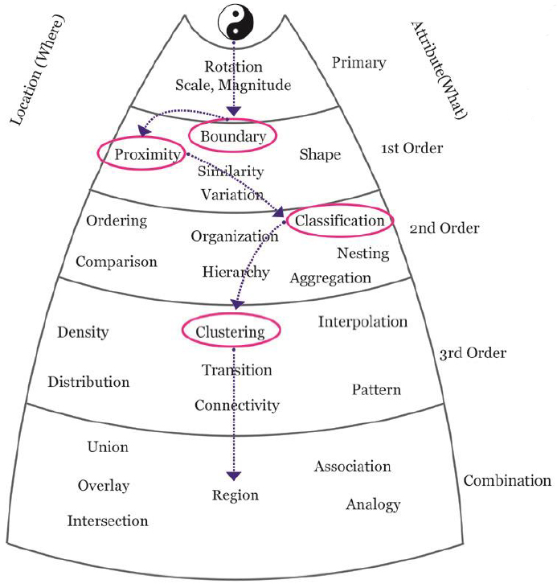
Learning progression line
Certain spatial thinking skills are higher order than others and build upon previous, less complex skills

Slide 19
Action steps
summarize literature → report
define geospatial thinking competencies
create learning lines & translating them into learning objectives, teaching and learning materials for the whole curriculum (K7 to K12)
develop an evaluative tool to analyze the impact and pupils’ feedback

Slide 20
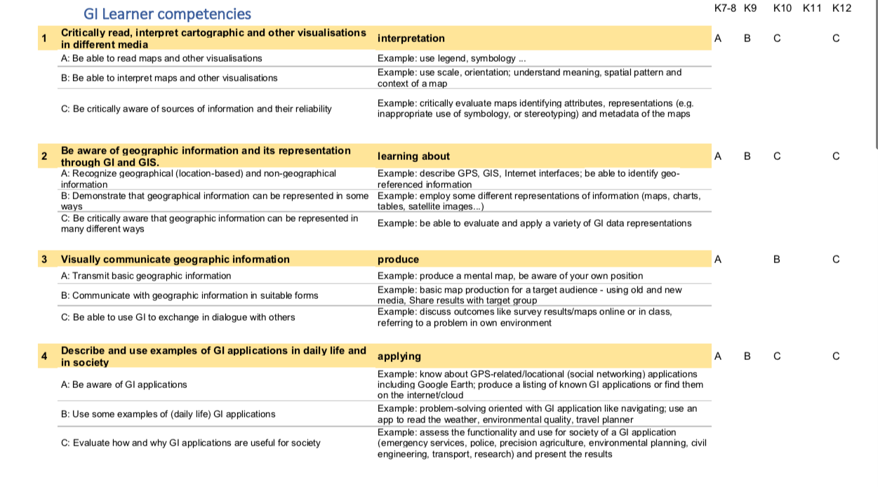
Based on the review, ten geospatial thinking competences are proposed

Slide 21
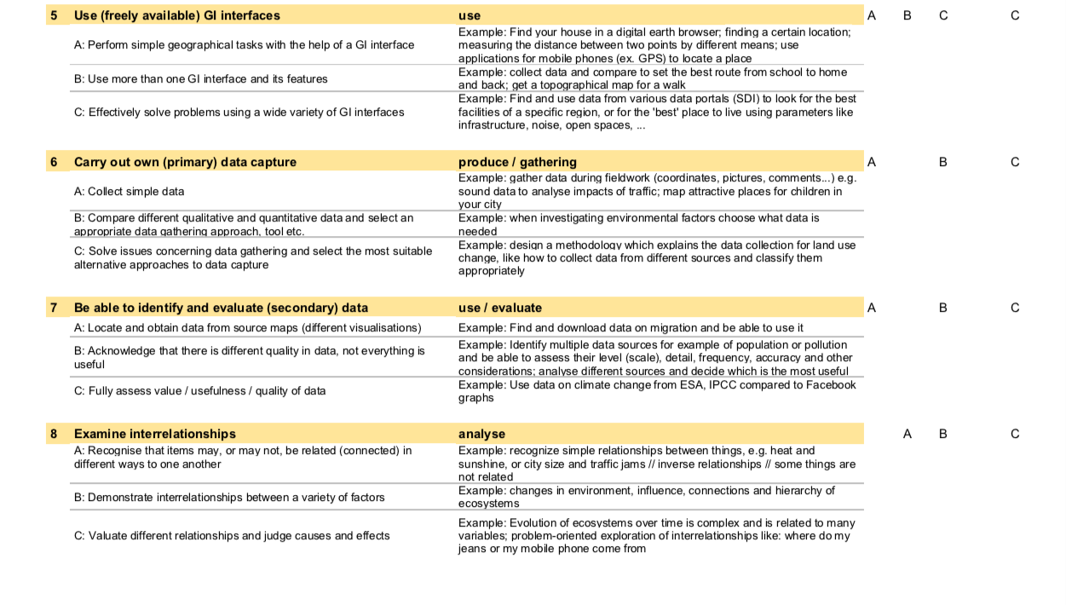

Slide 22
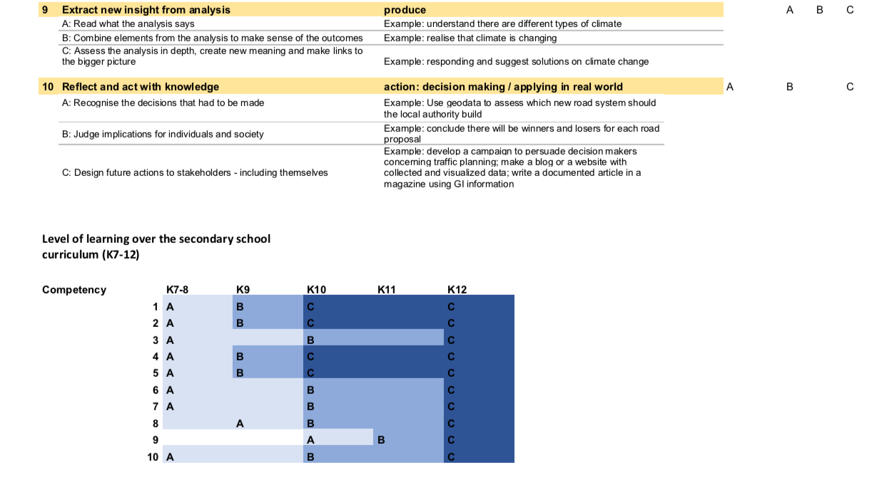

Slide 23
Action steps
summarize literature → report
define geospatial thinking competencies
create learning lines & translating them into learning objectives, teaching and learning materials for the whole curriculum (K7 to K12)
develop an evaluative tool to analyze the impact and pupils’ feedback

Slide 24
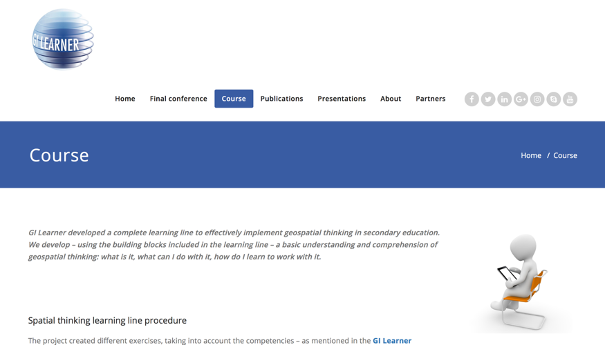
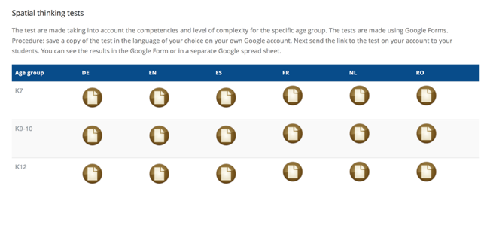
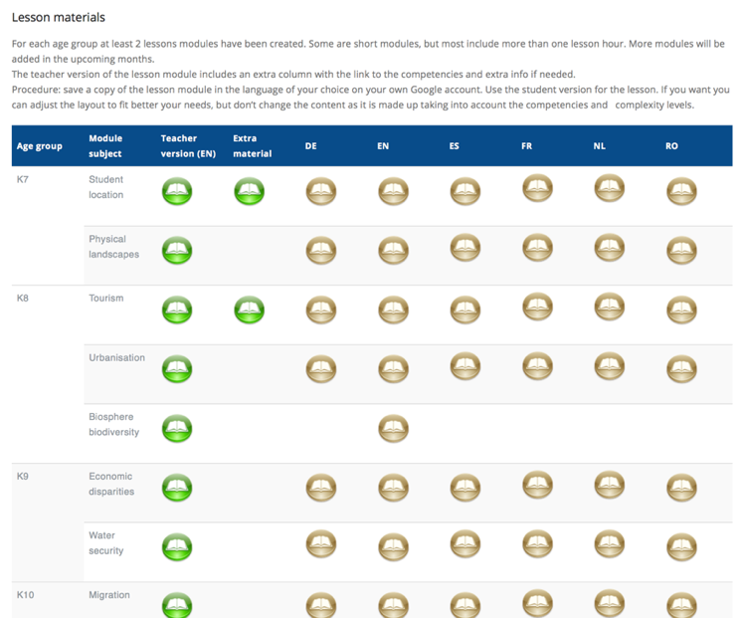
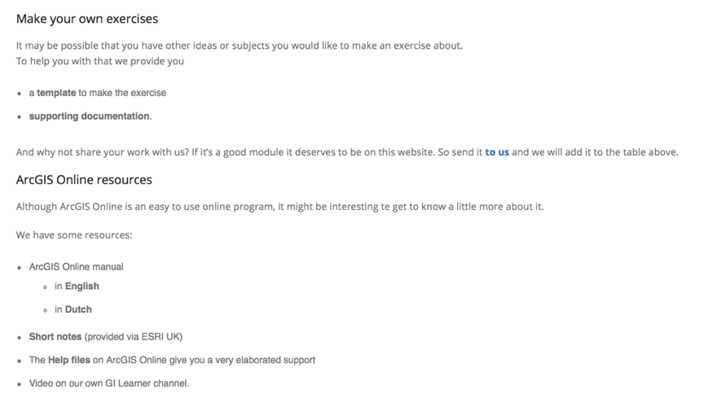
Learning outcomes
Course materials on
www.gilearner.eu

Slide 25
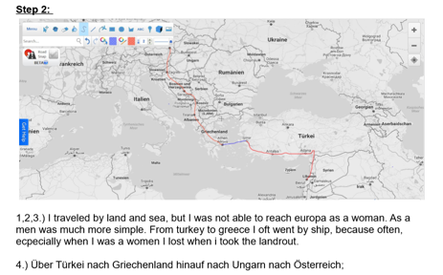
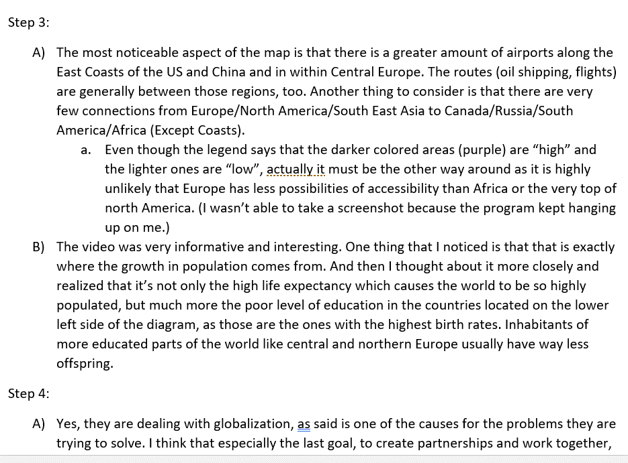
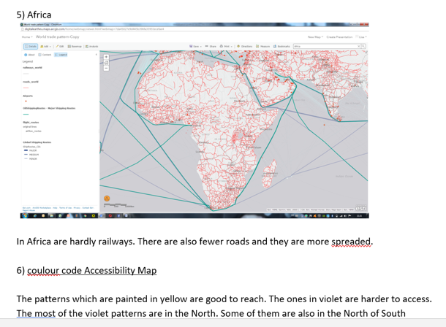
Learning outcomes
Descriptions, interpretations, articles, essays, posters, presentations based on online news, data, mapping-services

Slide 26
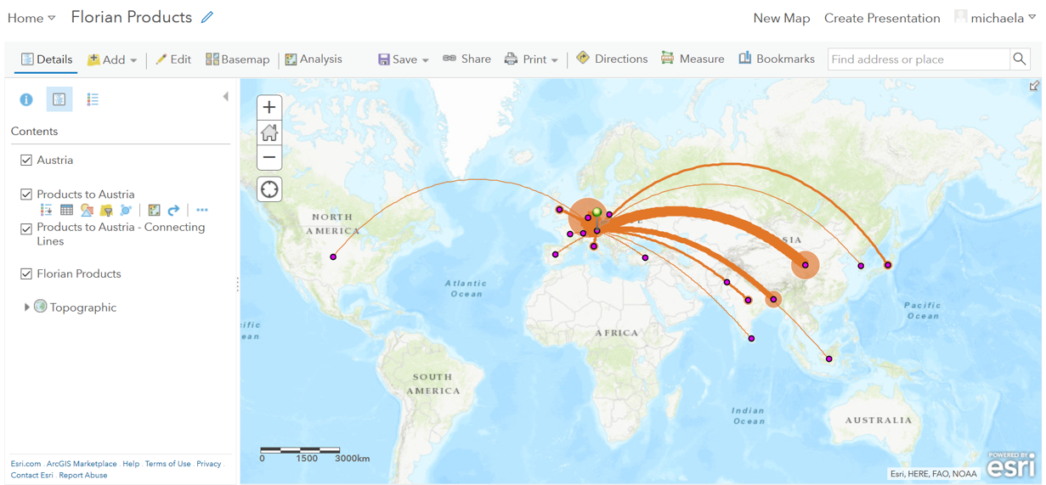
Learning outcomes
Online-maps using primary and secondary data

Slide 27
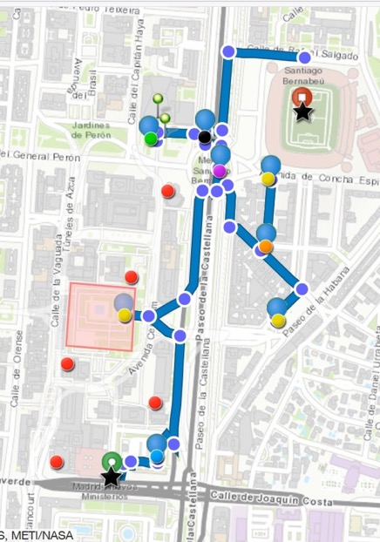
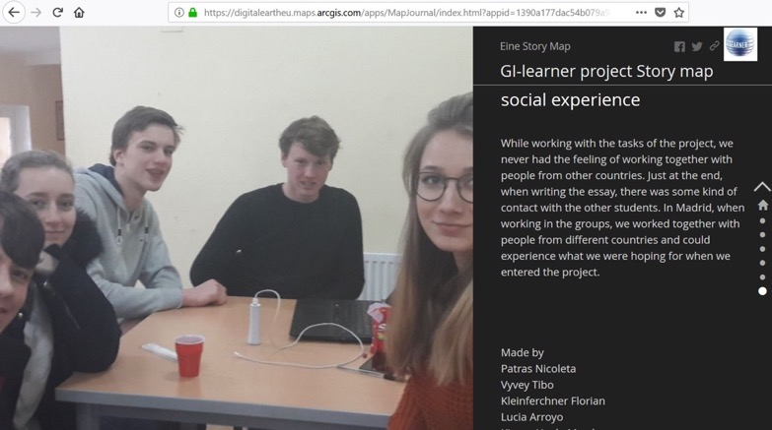
Learning outcomes ...
City tours using online-mapping
Story-maps on project work & outcomes

Slide 28
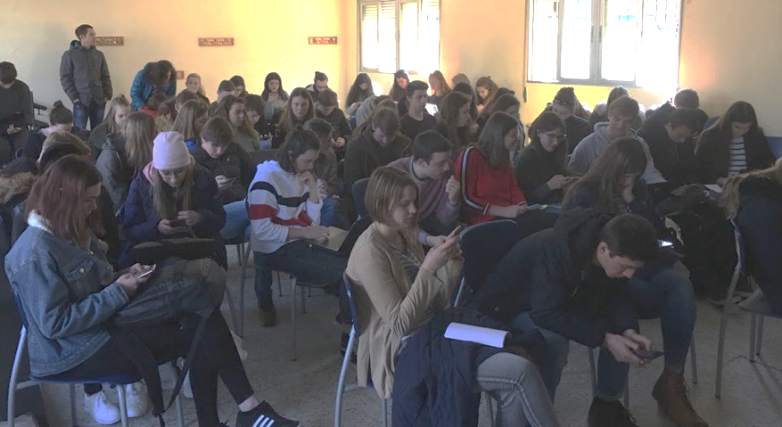
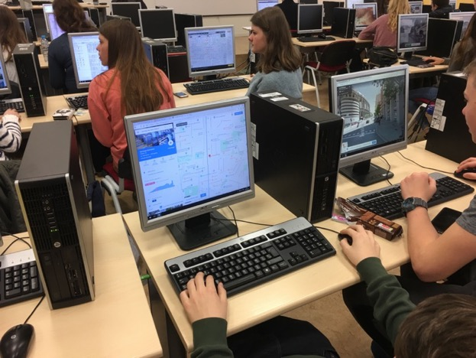
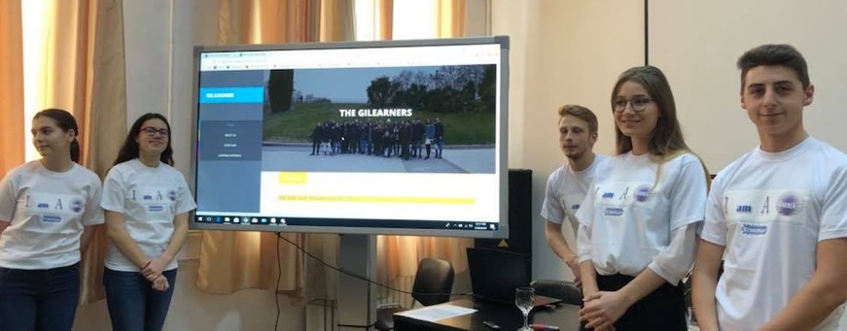
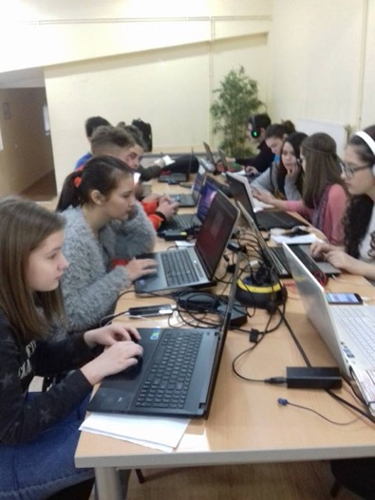
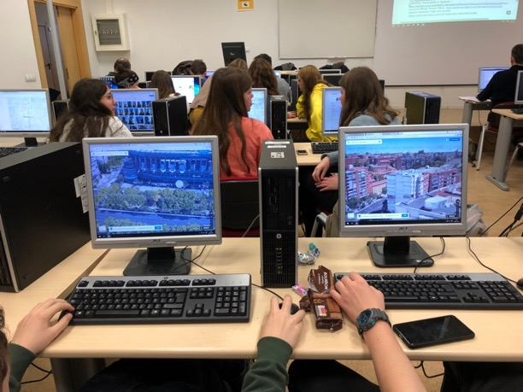
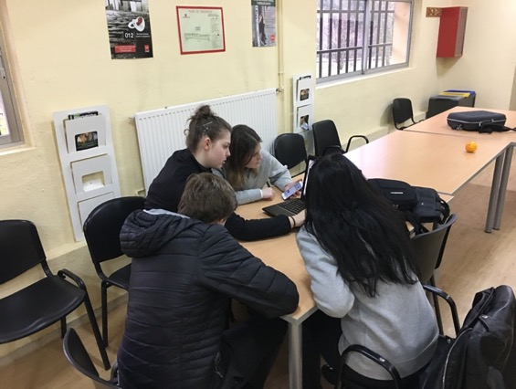
… supported by pupils

Slide 29
Action steps
summarize literature → report
define geospatial thinking competencies
create learning lines & translating them into learning objectives, teaching and learning materials for the whole curriculum (K7 to K12)
develop an evaluative tool to analyze the impact & pupils’ feedback

Slide 30
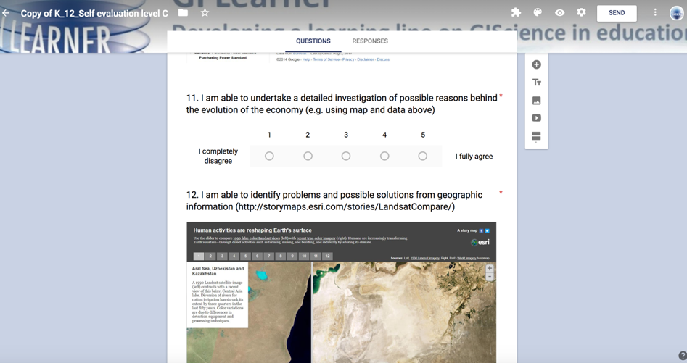
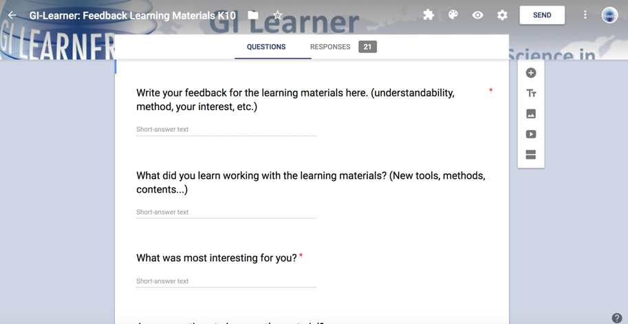
Pupils feedback & self evaluation
Evaluation tool

Slide 31
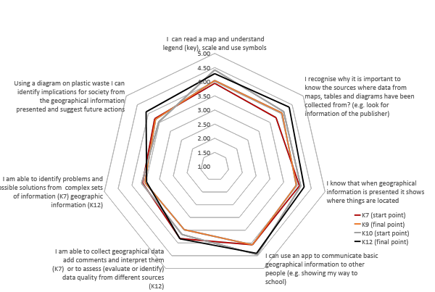
Learning success
All participants (5 countries)

Slide 32
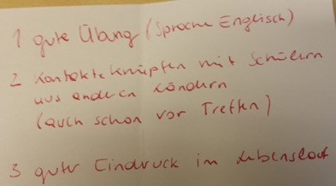
What did I learn?
The project gave me the opportunity to get in contact with peers from other countries, which I liked a lot!
It was new to me to test learning materials - a very interesting way of learning!
We did not only discover Madrid in our final meeting, we also met people from all over Europe. This was a very important experience for me and made me more open towards other people.

Slide 33

What did I learn?
The project was important for my personal development - from active learning to getting into contact with other nationalities.
A perfect opportunity to practice my English skills!
I gained not only GI-skills, but also my (spatial!) thinking improved. I think it is important that other pupils have the opportunity to participate in projects like this!

Slide 34
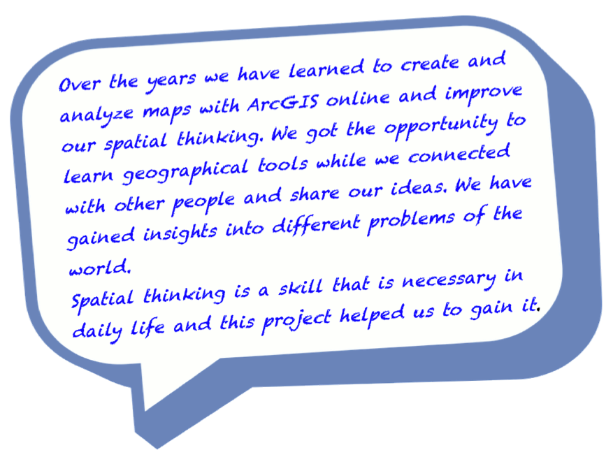
What did I learn?

Slide 35
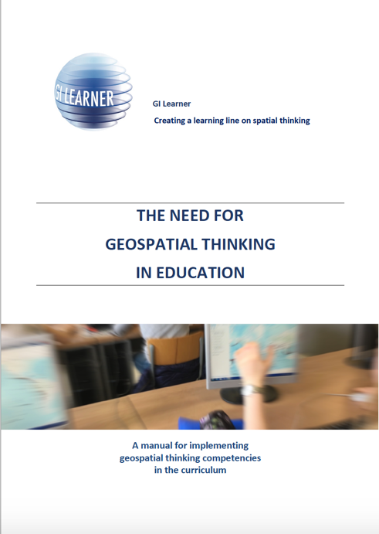

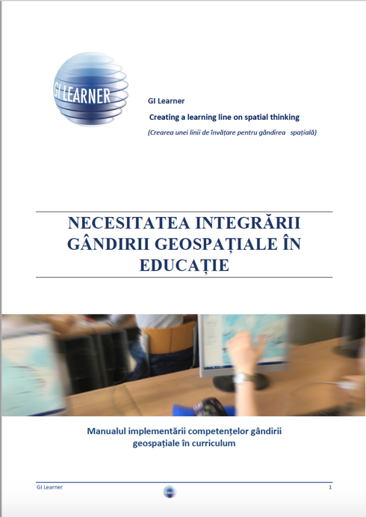
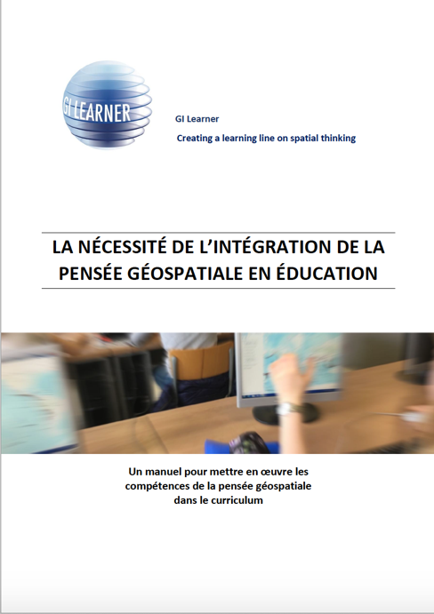
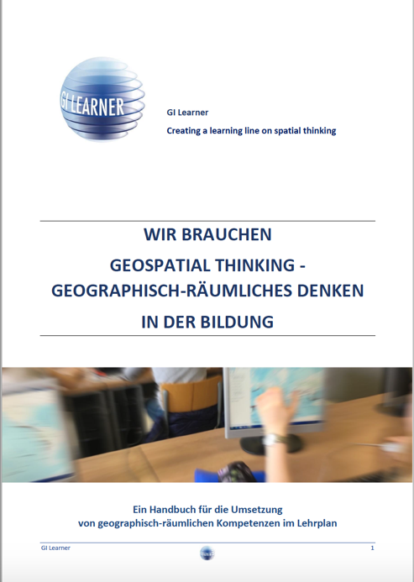
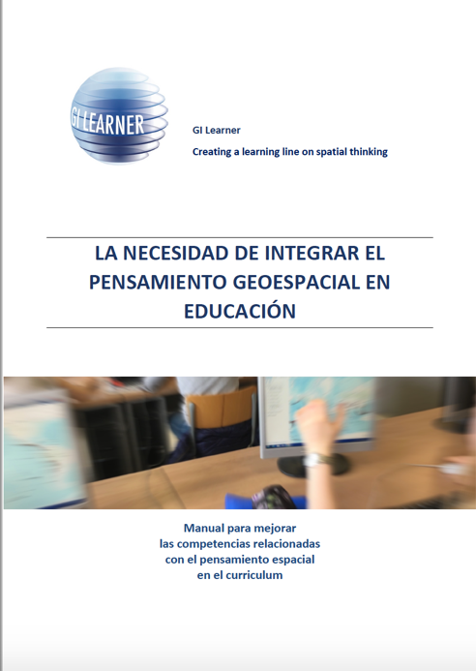
Final publication for the wider public, decision makers, government …
Available in 7 languages
on the website

Slide 36
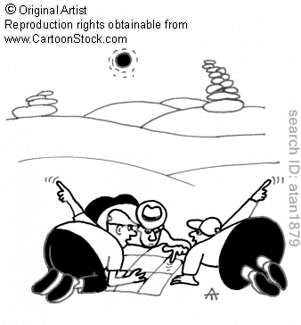
Project Timeframe:
September 2015 – August 2018
More info : www.gilearner.eu
Twitter: @GILearner
Project coordinator: luc.zwartjes@ugent.be

