Slide 1



A project to develop geospatial thinking learning lines in secondary schools
GI-Learner
Luc Zwartjes

Slide 2
The situation
Literature Review
schools nowadays generally have better ICT equipment
Cloud-based developments
bring their own devices
more openly available data
Web-based platforms reduced / no costs
networking and communities encouraged and available

Slide 3




The situation
Literature Review
Content already exists …
iGuess → www.iguess.eu
I-Use → www.i-use.eu
EduGIS → www.edugis.nl, www.edugis.pl
PaikkaOppi learning environment → http://www.paikkaoppi.fi/
…but it is not structured or coordinated by age …

Slide 4
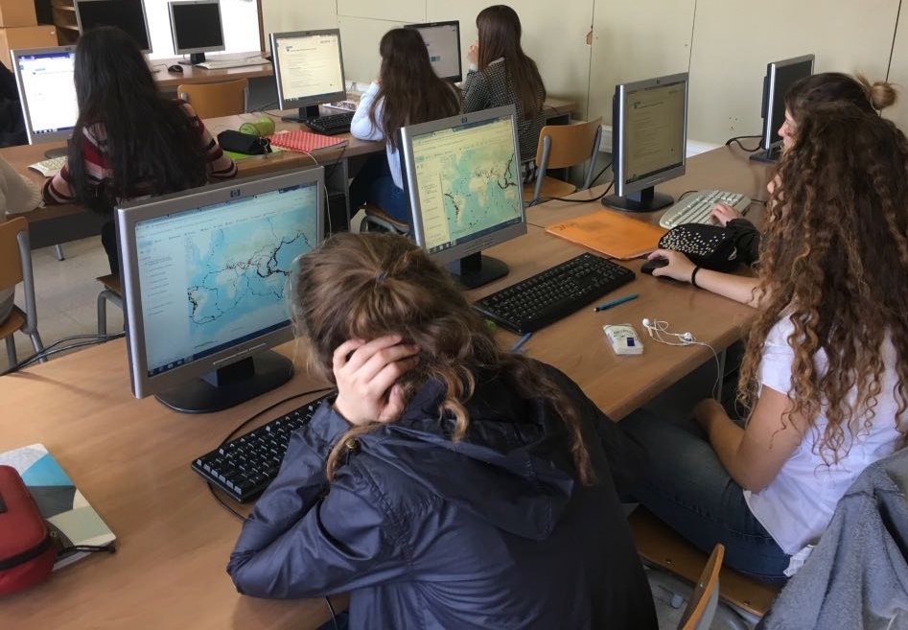
Literature Review
What is still blocking it?
Bednarz and van der Schee (2006)
GIS not a compulsory item in teacher training
Taught by non-specialists
Curriculum not include GIS
non-availability of data and easy-to-use software.
Attitudes of teachers difficult to persuade

Slide 5
Literature Review
What is still blocking it?
Bednarz and van der Schee (2006)
GIS not a compulsory item in teacher training
Taught by non-specialists
Curriculum not include GIS
non-availability of data and easy-to-use software.
Attitudes of teachers difficult to persuade

Slide 6
Recommendations
Literature Review
Bednarz and van der Schee (2006)
address key issues related to GIS implementation:
teacher training,
availability of user friendly software,
ICT equipment in schools.
use a community of learners approach
institutionalize GIScience into curricula

Slide 7
Recommendations
Literature Review
Bednarz and van der Schee (2006)
address key issues related to GIS implementation:
teacher training,
availability of user friendly software,
ICT equipment in schools.
use a community of learners approach
institutionalize GIScience into curricula

Slide 8






GI-Learner partners

Slide 9
Aim
help teachers implement learning progression lines for spatial thinking in secondary schools, using GIScience.
https://cnr.ncsu.edu/geospatial/wp-content/uploads/sites/12/2015/08/DukeTIPCollage.png

Slide 10
Action steps
summarize literature → report
define geospatial thinking competencies
develop an evaluative tool to analyze the impact
create learning lines translating them into learning objectives, teaching and learning materials for the whole curriculum (K7 to K12)

Slide 11
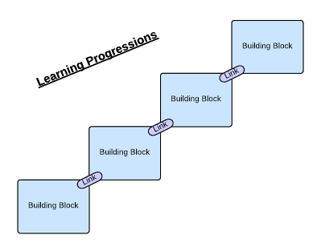
Learning progression line
construction of knowledge and skills throughout the whole curriculum
reflect a growing level of complexity, ranging from easy to difficult

Slide 12
Learning progression line example
Learning lines | Field-work | Working with images | Working with maps | Working with statistics | Creation of knowledge
Level 1 | Perception – knowledge of facts
Level 2 | Analysis – selection of relevant geographic information
Level 3 | Structure – look for complex connections and relationships
Level 4 | Application – thinking problem solving

Slide 13
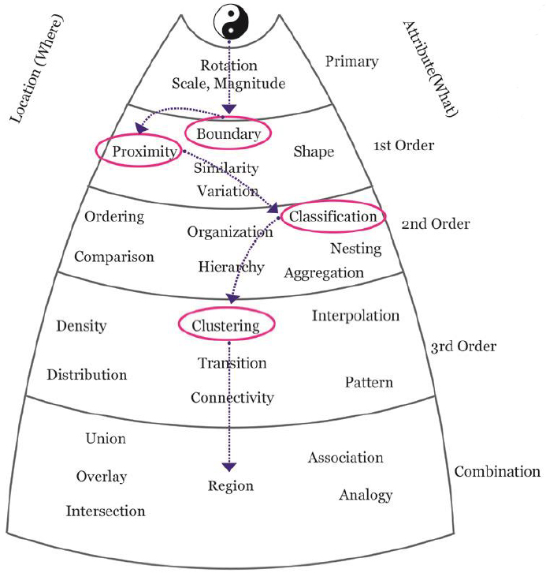
Learning progression line
certain spatial thinking skills are higher order than others and build upon previous, less complex skills

Slide 14
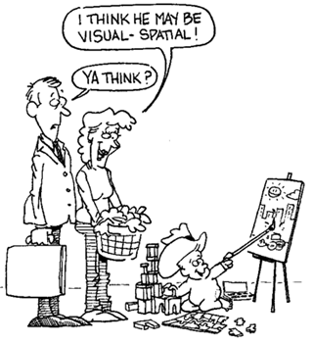
GI Spatial Thinking
Key Literature
Literature Review
a distinct form of thinking, which helps people to visualize relationships between and among spatial phenomena
(NRC, 2006) “a collection of cognitive skills comprised of knowing concepts of space, using tools of representation and reasoning processes”
Notes:
enables knowing about
- Space – e.g. different ways of calculating distance, coordinate system
- Representation – e.g. effect of projections, principles of graphic design (semiology)
- Reasoning – e.g. different ways of thinking about shortest distances, estimate the slope of a hill fom a map of contour lines

Slide 15
GI Science ← Spatial Thinking
Literature Review
Key Literature
Michel, E. & Hof, A., 2013, Promoting Spatial Thinking and Learning with Mobile Field Trips and eGeo-Riddles, Jekel, T., Car, A., Strobl, J., Griesebner, G. (eds.), GI_Forum 2013: Creating the GISociety, 378-387. Berlin, Wichmann Verlag
Notes:
enables knowing about
- Space – e.g. different ways of calculating distance, coordinate system
- Representation – e.g. effect of projections, principles of graphic design (semiology)
- Reasoning – e.g. different ways of thinking about shortest distances, estimate the slope of a hill fom a map of contour lines

Slide 16
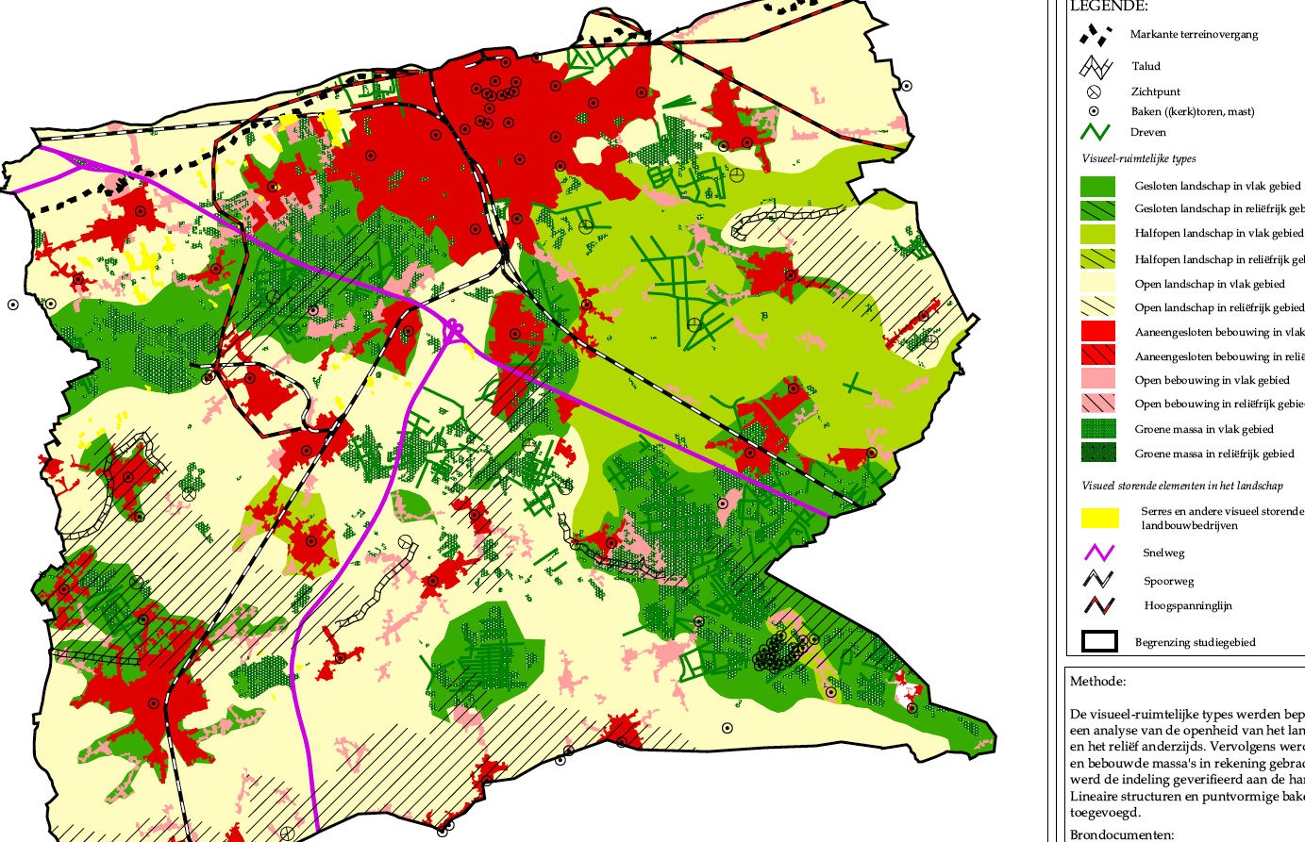
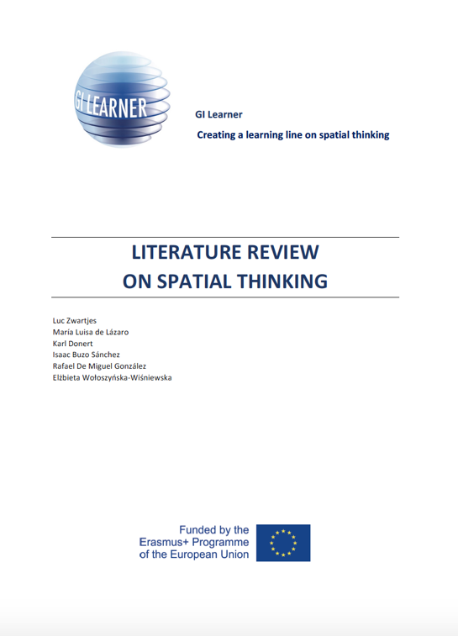
Literature Review
Key Literature
Based on the review: 10 GI-Learner geospatial thinking competences, each with a progression inside from easy (A) to more elaborated (C)

Slide 17
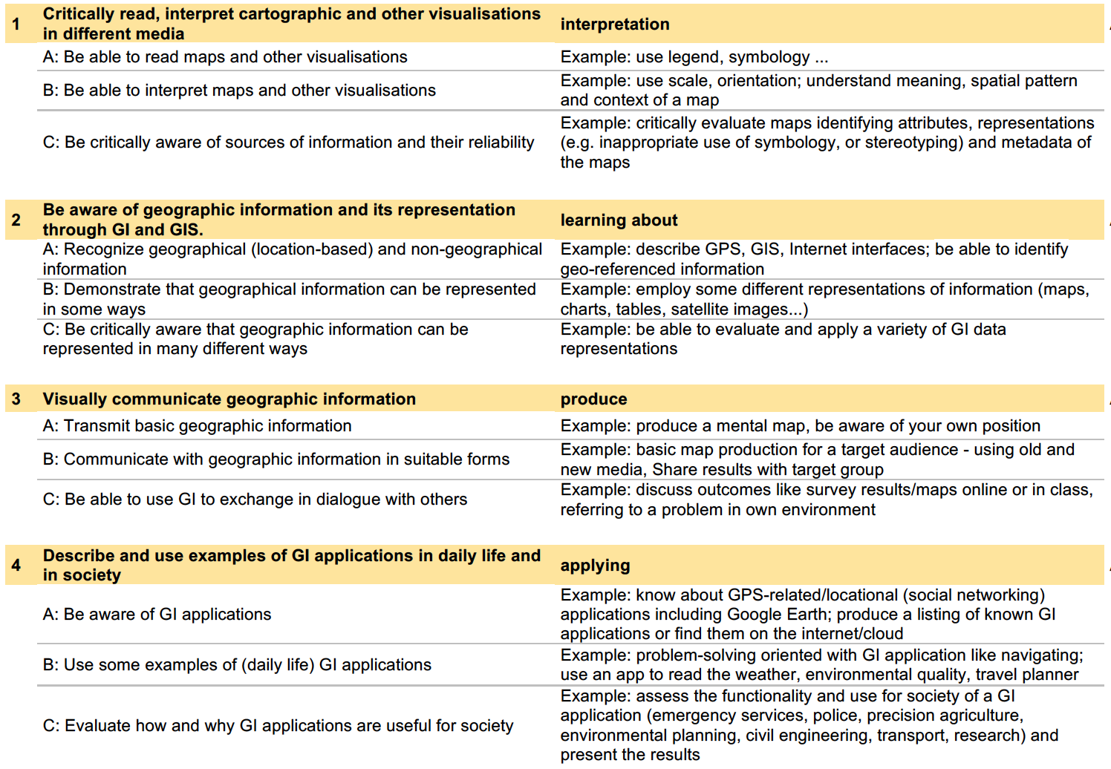
Based on the review, ten geospatial thinking competences are proposed

Slide 18
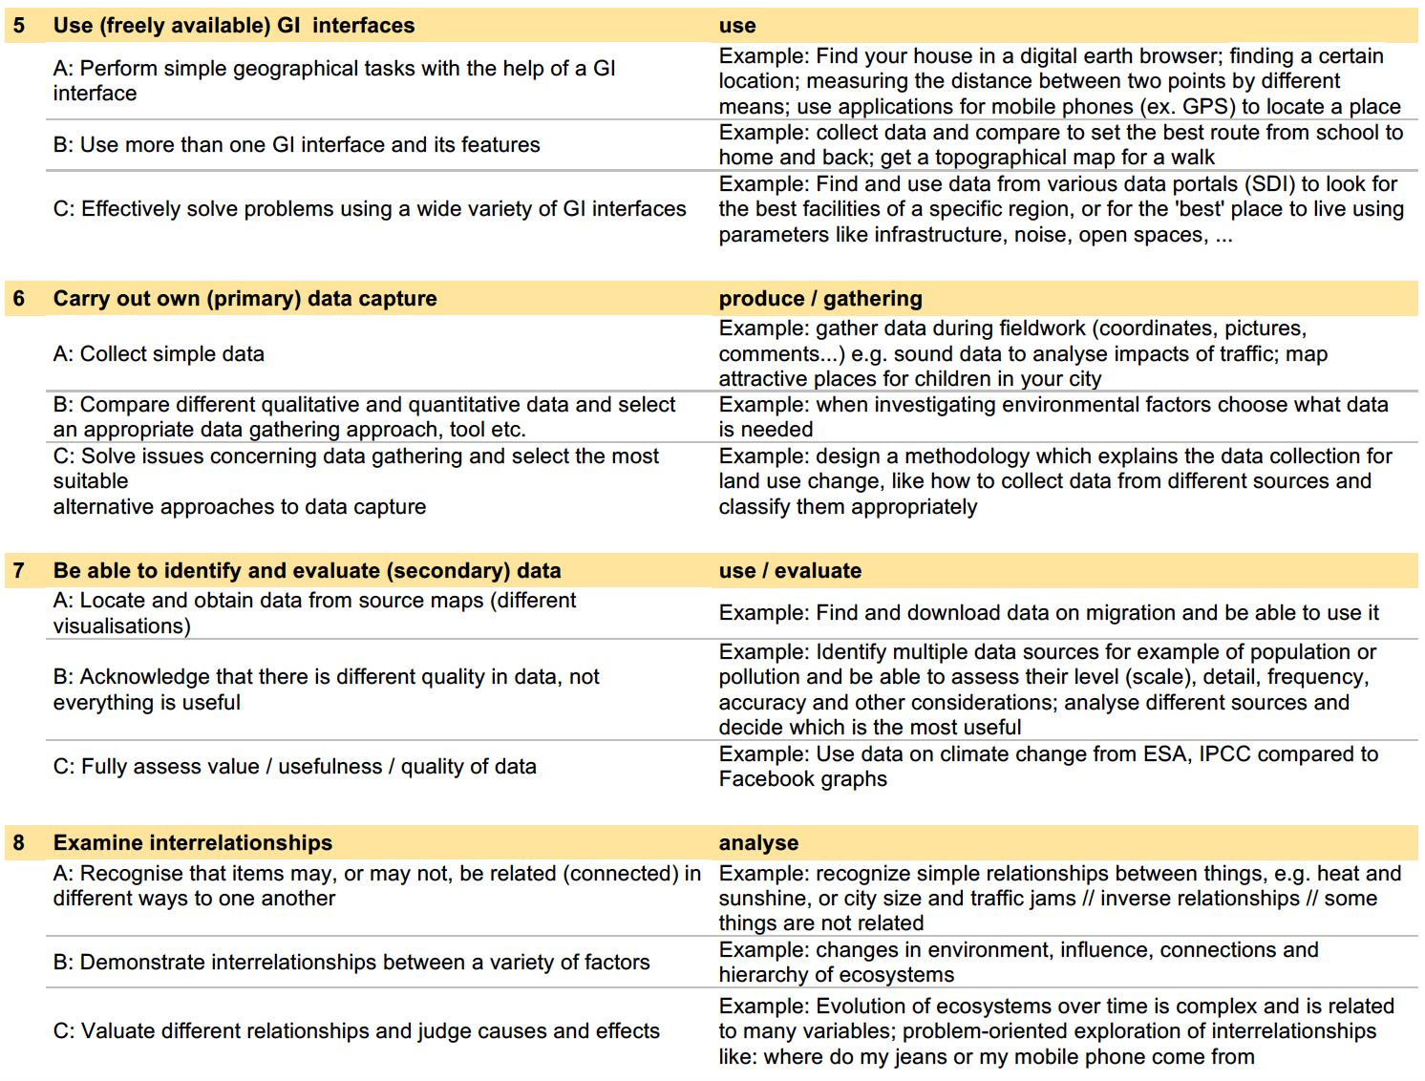
Based on the review, ten geospatial thinking competences are proposed

Slide 19
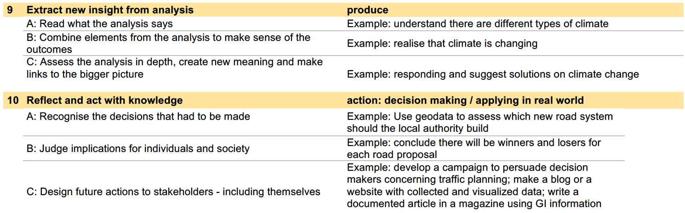
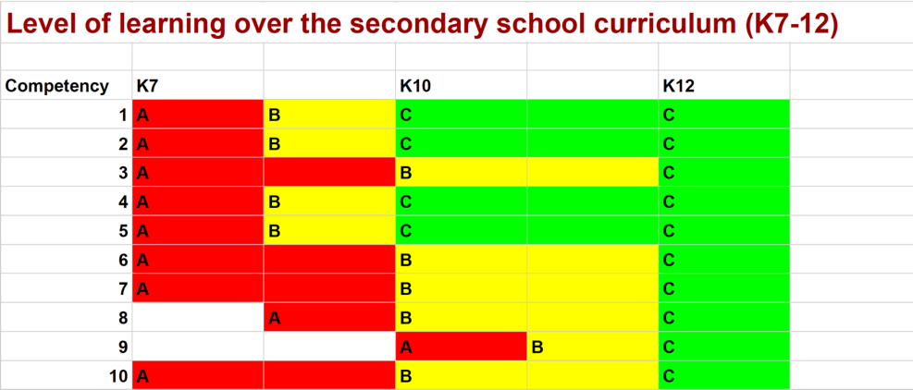

Slide 20
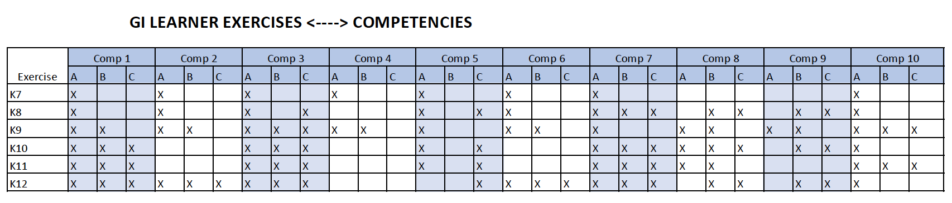
K7: local area
K8: tourism
K9: economic disparities
K10: refugees, migration
K11: plate tectonics, tsunami risk
K12: globalisation
+ for each year extra exercises to come

Slide 21

Literature Review
Linking geospatial thinking to GIS
More than mapping

Slide 22
Examples working with GIS
New football stadium FC Bruges – alternative:
https://arcg.is/SazXb
Plate tectonics:
https://arcg.is/1X0zqX

Slide 23
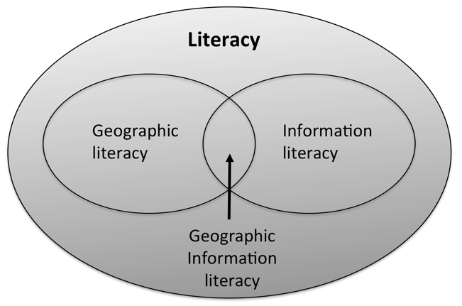
Literature Review
Linking geospatial thinking to GIS
More than mapping
Contextual diagram for geographic information literacy (Miller et.al., 2005)

Slide 24
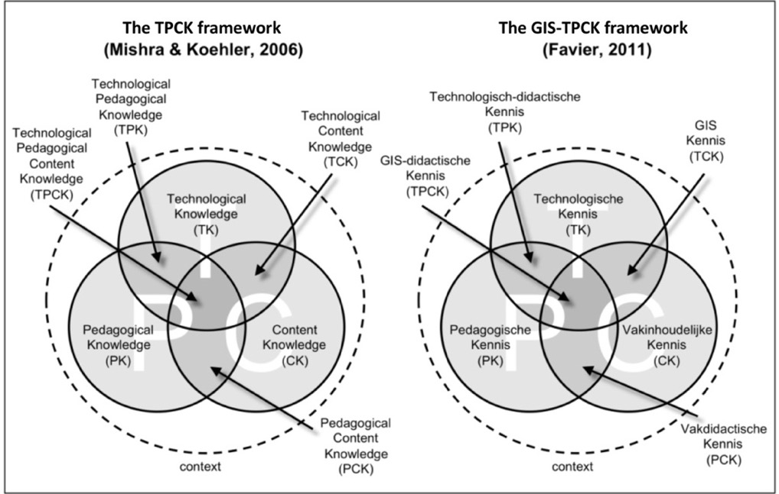
Literature Review
Linking geospatial thinking to GIS
TPCK: the knowledge a teacher should have about how to use technology in instruction in such a way that students develop knowledge and skills in a certain domain’.
Contextual diagram for geographic information literacy (Miller et.al., 2005)
Notes:
TPCK: the knowledge a teacher should have about how to use technology in instruction in such a way that students develop knowledge and skills in a certain domain’.

Slide 25
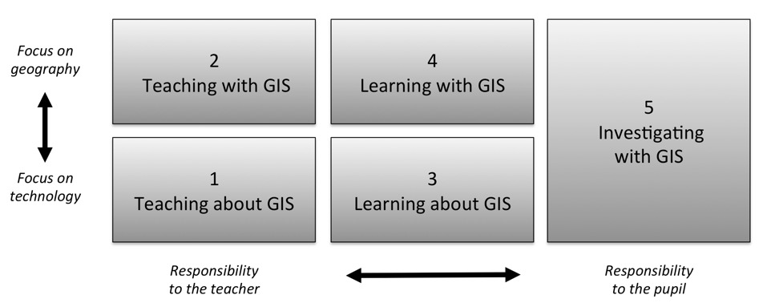
How to implement this?
Literature Review
Five ways of integrating GIS in geography education (Favier, 2013)
Favier, T.M., 2011, Geographic Information Systems in inquiry-based secondary geography education, Vrije Universiteit Amsterdam, 287 pp.
Notes:
Favier (2013) describes five ways on how GIS can be integrated in secondary education (Figure 8). Teaching and learning about GIS focuses more on the theoretical aspects of GIS (knowledge of GIS, structure of the technology), where the three other ways use the technology to develop and use spatial thinking skills

Slide 26
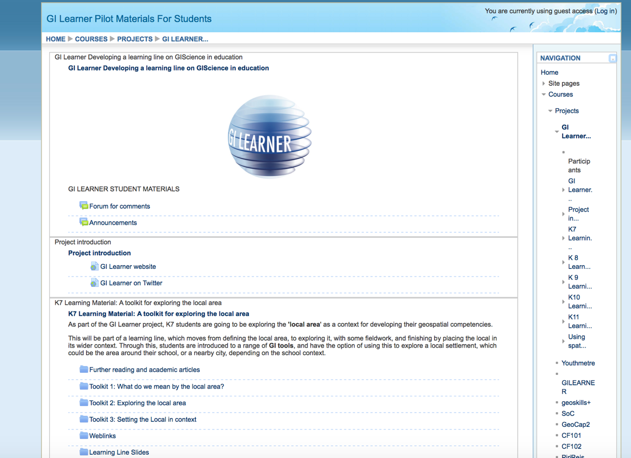
GI Learner material
Go to www.gilearner.eu → Course → Acces to pilot materials of the course

Slide 27
GI Learner material
Material course: http://moodle.eurogeography.eu/course/view.php?id=47
example
K12 exercise globalization https://arcg.is/SC0vy
Task paper: https://tinyurl.com/ybhxfufv

Slide 28
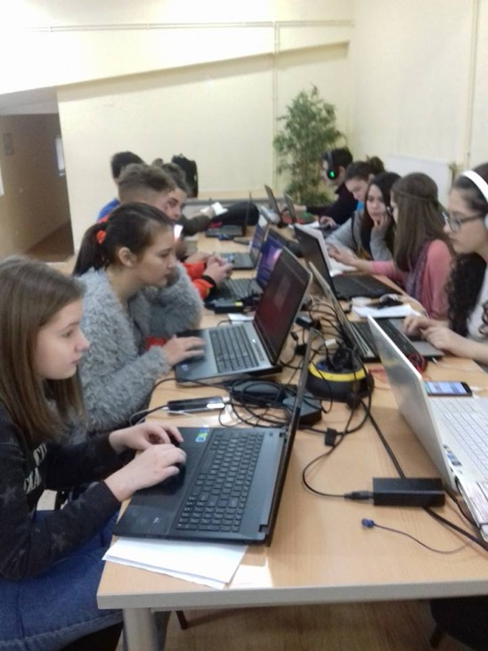
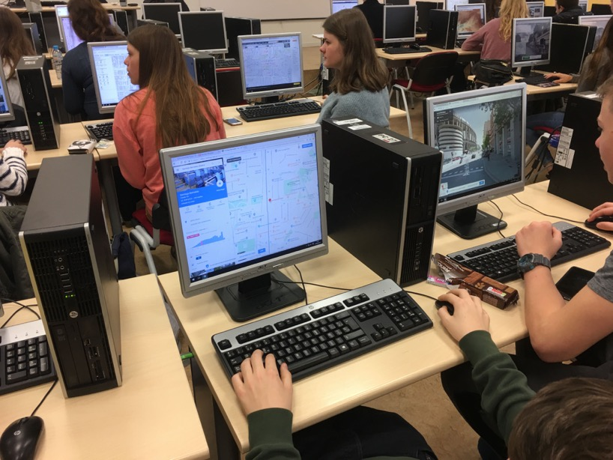
Pupils at work during mobility week Madrid, March 2018
Creating city tour for younger group (K12)
Evaluating the project (K9, K12)
Evaluation Test C (K12)
Presenting Madrid (K9)

Slide 29
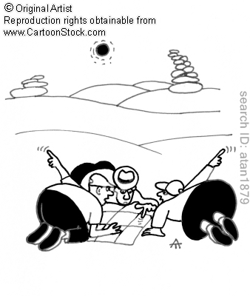
Project Timeframe: September 2015 – August 2018 More info : www.gi-learner.eu Twitter: @GILearner Project coordinator: luc.zwartjes@ugent.be

