Slide 1

A project to develop geospatial thinking learning lines in secondary schools
GI-Learner
Luc Zwartjes
Teacher geography – Sint-Lodewijkscollege Brugge
Lecturer Ghent University, Geography Department
Pedagogic advisor geography West-Flanders
Luc.zwartjes@ugent.be

Slide 2
The situation
Literature Review
schools nowadays generally have better ICT equipment
Cloud-based developments
bring their own devices
more openly available data
Web-based platforms reduced / no costs
networking and communities encouraged and available

Slide 3




The situation
Literature Review
Content already exists …
  iGuess → www.iguess.eu
  I-Use → www.i-use.eu
  EduGIS → www.edugis.nl, www.edugis.pl
  PaikkaOppi learning environment → http://www.paikkaoppi.fi/
…but it is not structured or coordinated by age …

Slide 4
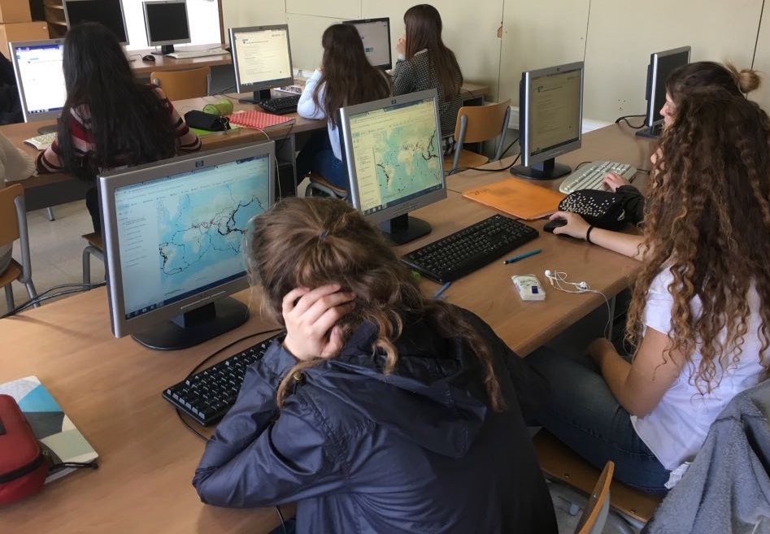
Literature Review
What is still blocking it?
Bednarz and van der Schee (2006)
GIS not a compulsory item in teacher training
Taught by non-specialists
Curriculum not include GIS
non-availability of data and easy-to-use software.
Attitudes of teachers difficult to persuade

Slide 5
Recommendations
Literature Review
Bednarz and van der Schee (2006)
address key issues related to GIS implementation:
  teacher training,
  availability of user friendly software,
  ICT equipment in schools.
use a community of learners approach
institutionalize GIScience into curricula

Slide 6
Why spatial thinking?
Geo-ICT is part of the digital economy identified by the European Commission as being vital for innovation, growth, jobs and European competitiveness.
The use of GI tools to support spatial thinking has become integral to everyday life (GPS and car navigation systems are just one example).
Space and location make spatial thinking a distinct, basic and essential skill that can and should be learned in school education, alongside other skills like language, mathematics and science.
Part of the KEY COMPETENCES FOR LIFELONG LEARNING European Reference Framework

Slide 7
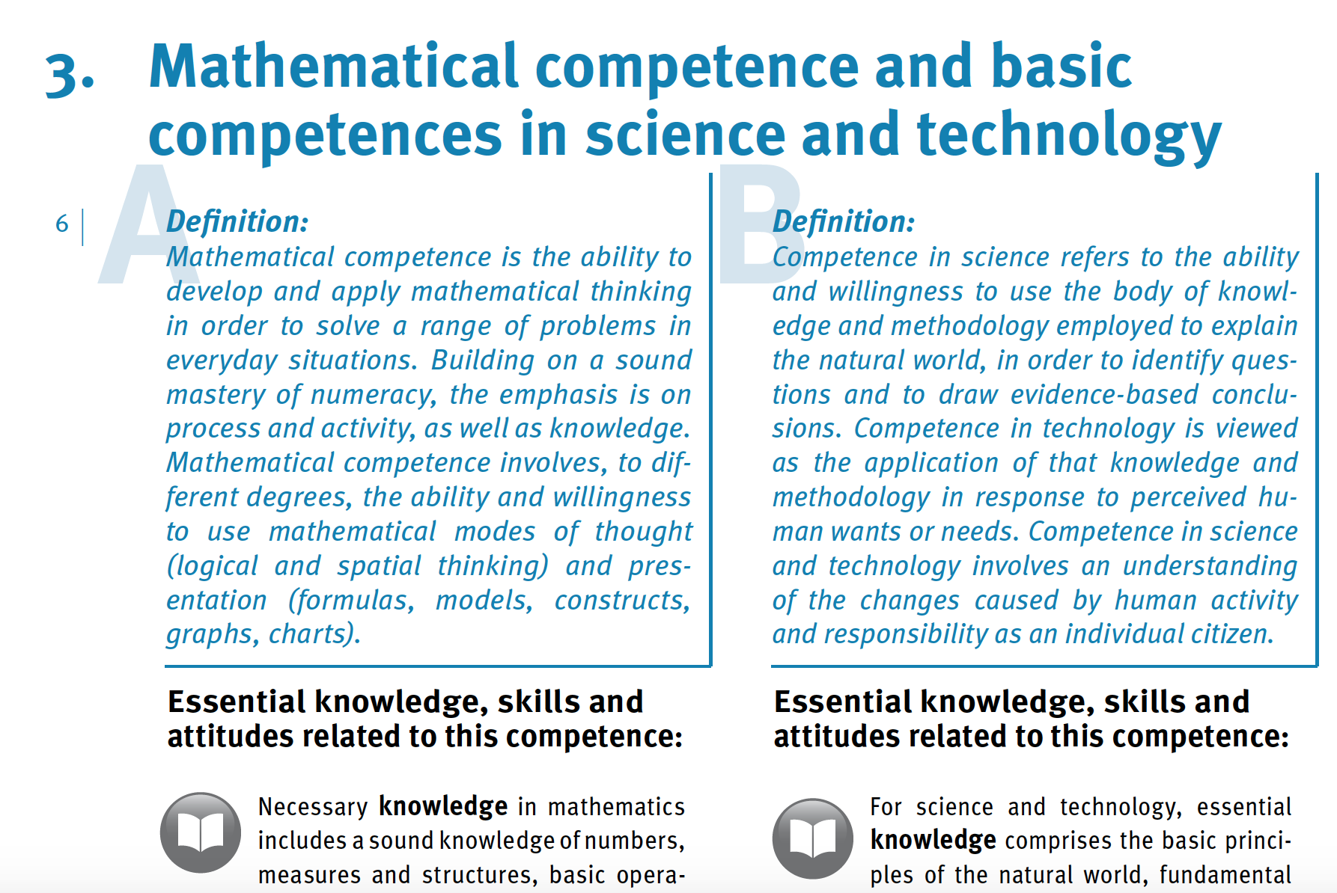

https://publications.europa.eu/en/publication-detail/-/publication/5719a044-b659-46de-b58b-606bc5b084c1/language-en/format-PDF/source-71624064

Slide 8
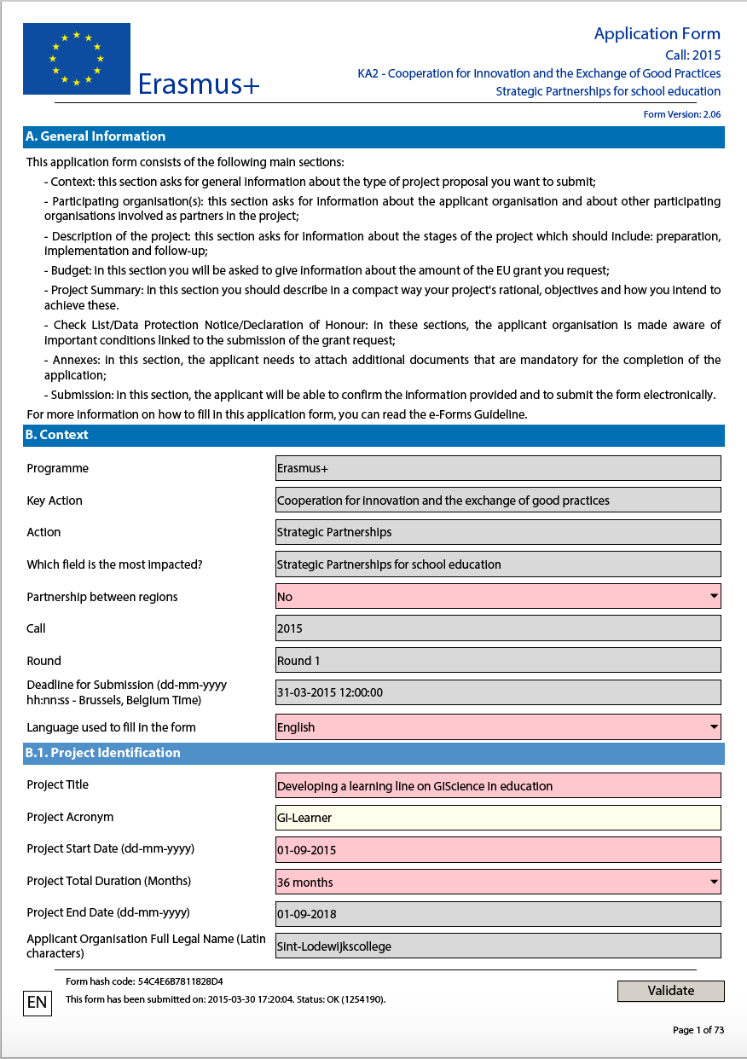






The idea

Slide 9
Aim
help teachers implement learning progression lines for spatial thinking in secondary schools, using GIScience.
https://cnr.ncsu.edu/geospatial/wp-content/uploads/sites/12/2015/08/DukeTIPCollage.png

Slide 10
Action steps
summarize literature → report
define geospatial thinking competencies
develop an evaluative tool to analyze the impact
create learning lines translating them into learning objectives, teaching and learning materials for the whole curriculum (K7 to K12)

Slide 11

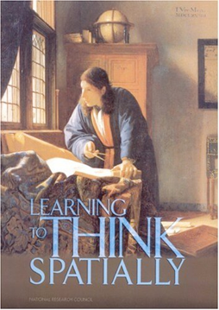
A spatially literate student …
1 Literature Review
…. has the following characteristics
Habit of mind of thinking spatially – knows where, when, how and why to think spatially
Practices spatial thinking in an informal way
– deep and broad knowledge of spatial
concepts and representation…
Adopts a critical stance to spatial thinking –
evaluates the quality of spatial data,
uses spatial data to construct …
National Research Council, 2006, Learning to think spatially: GIS as a Support System in the K-12 Curriculum, Washington DC, National Academy Press

Slide 12
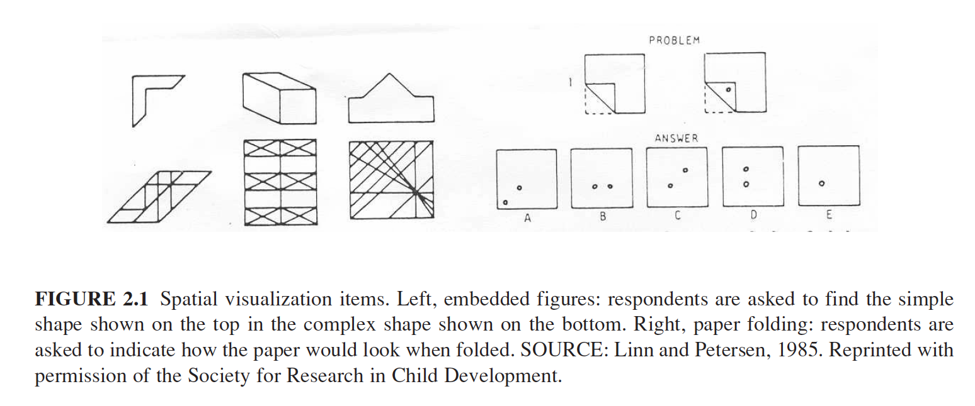
Spatial thinking is …..
Literature Review
traditionally linked to spatial visualization, orientation, spatial perception and mental rotation

Slide 13
Geospatial thinking is even more …
Literature Review
Geospatial is not simply about visualization and relationships (Wang et al. 2014), it implies
  manipulation
  interpretation and
  explanation of information (Baker et al. (2015)
.... at different geographic scales
Baker, T.R., Battersby, S., Bednarz, S.W., Bodzin, A.M., Kolvoord, B., Moore, S., Sinton, D. and Uttal, D., 2015. A research agenda for geospatial technologies and learning. Journal of Geography, 114(3), pp.118-130.
Wang, H.S., Chen, Y.T. and Lin, C.H., 2014. The learning benefits of using eye trackers to enhance the geospatial abilities of elementary school students. British Journal of Educational Technology, 45(2), pp.340-355.

Slide 14
Geospatial thinking is even more …
Literature Review
not a single ability but comprised of a collection of different skills (Bednarz & Lee, 2011)
the ability to study the characteristics and the interconnected processes of nature and human impact in time and at appropriate scale (Kerski 2008)
Bednarz, R.S. and Lee, J., 2011. The components of spatial thinking: empirical evidence. Procedia-Social and Behavioral Sciences, 21, pp.103-107.
Kerski, J.J., 2008. The role of GIS in Digital Earth education. International Journal of Digital Earth, 1(4), pp.326-346.
Notes:
Bednarz and Lee (2011) conclude in their spatial thinking ability test (STAT) that spatial thinking is not a single ability but comprised of a collection of different skills, whereby following spatial thinking components emerge: map visualization and overlay, identification and classification of map symbols (point, line, area), use of Boolean operations, map navigation and recognition of spatial correlation

Slide 15
Geospatial thinking is even more …
Literature Review
geographic skills provide necessary tools and techniques to think spatially
they enable patterns, associations, and spatial order to be observed (National Geography Standard, 2012)
provide students with skills to respond to crucial scientific and social questions of the 21st century (Tsou and Yanow, 2010).
Geography Education Standards Project, 2012, Geography for Life – National Geography
Standards, Second edition, National Geographic Society, Washington D.C., 272 p.
Tsou, M.H. and Yanow, K., 2010. Enhancing general education with geographic information science and spatial literacy. URISA Journal, 22(2), 45-54
Notes:
Bednarz and Lee (2011) conclude in their spatial thinking ability test (STAT) that spatial thinking is not a single ability but comprised of a collection of different skills, whereby following spatial thinking components emerge: map visualization and overlay, identification and classification of map symbols (point, line, area), use of Boolean operations, map navigation and recognition of spatial correlation

Slide 16
GI Science ← Spatial Thinking
Literature Review
Key Literature
Michel, E. & Hof, A., 2013, Promoting Spatial Thinking and Learning with Mobile Field Trips and eGeo-Riddles, Jekel, T., Car, A., Strobl, J., Griesebner, G. (eds.), GI_Forum 2013: Creating the GISociety, 378-387. Berlin, Wichmann Verlag
Notes:
enables knowing about
- Space – e.g. different ways of calculating distance, coordinate system
- Representation – e.g. effect of projections, principles of graphic design (semiology)
- Reasoning – e.g. different ways of thinking about shortest distances, estimate the slope of a hill fom a map of contour lines

Slide 17
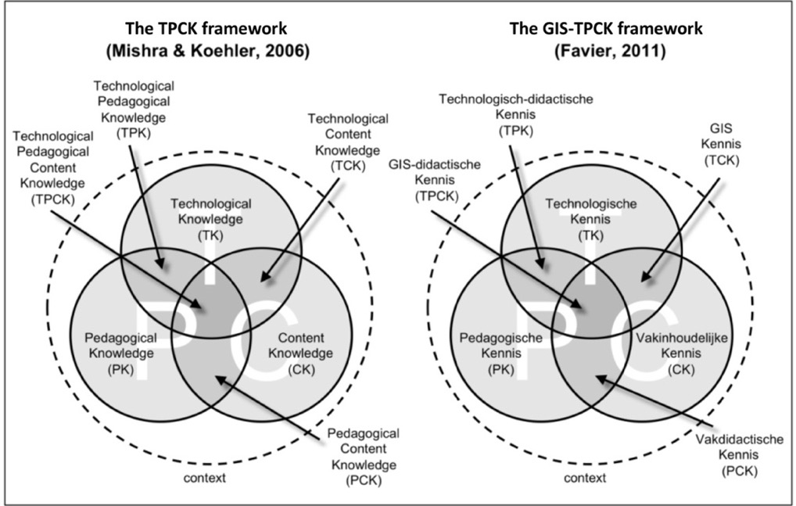
Literature Review
Linking geospatial thinking to GIS
TPCK: the knowledge a teacher should have about how to use technology in instruction in such a way that students develop knowledge and skills in a certain domain’.
Contextual diagram for geographic information literacy (Miller et.al., 2005)
Notes:
TPCK: the knowledge a teacher should have about how to use technology in instruction in such a way that students develop knowledge and skills in a certain domain’.

Slide 18
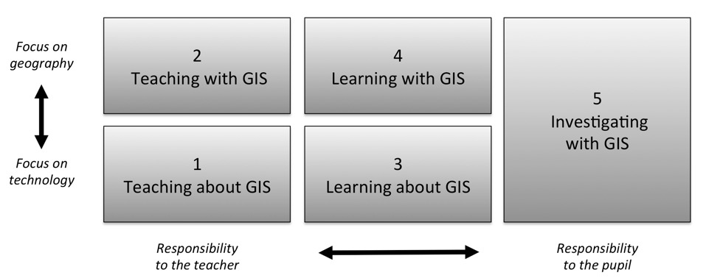
How to implement this?
Literature Review
Five ways of integrating GIS in geography education (Favier, 2013)
Favier, T.M., 2011, Geographic Information Systems in inquiry-based secondary geography education, Vrije Universiteit Amsterdam, 287 pp.
Notes:
Favier (2013) describes five ways on how GIS can be integrated in secondary education (Figure 8). Teaching and learning about GIS focuses more on the theoretical aspects of GIS (knowledge of GIS, structure of the technology), where the three other ways use the technology to develop and use spatial thinking skills

Slide 19
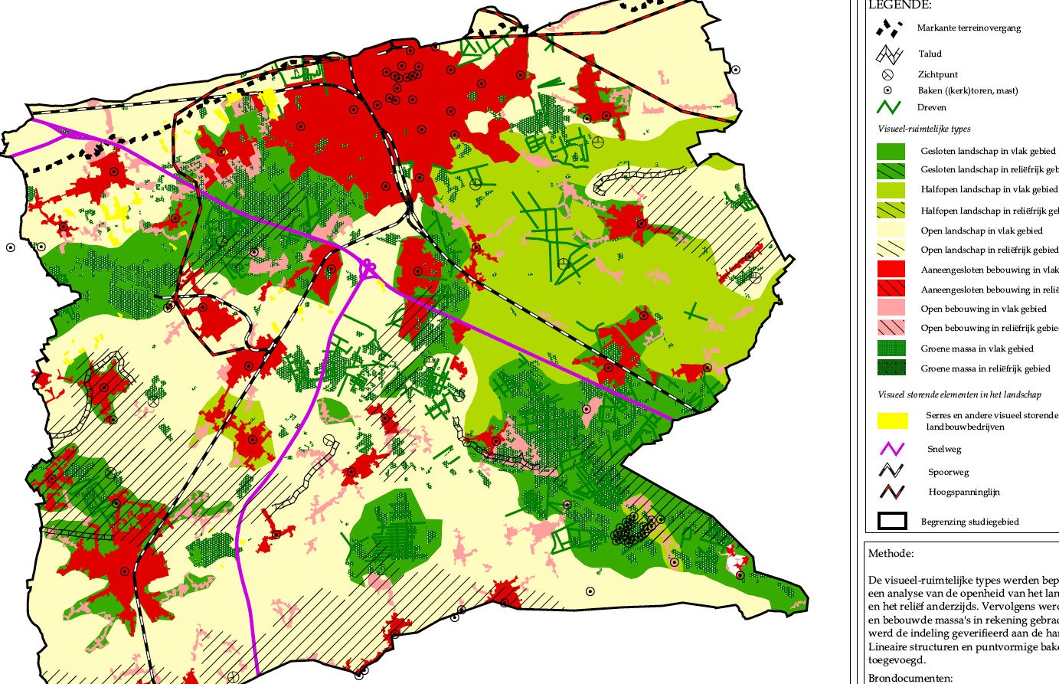
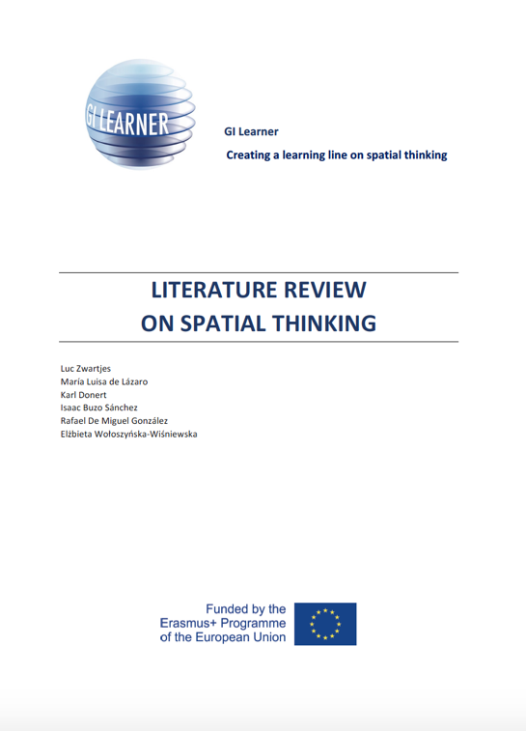
Literature Review
Key Literature
Based on the review: 10 GI-Learner geospatial thinking competences, each with a progression inside from easy (A) to more elaborated (C)

Slide 20
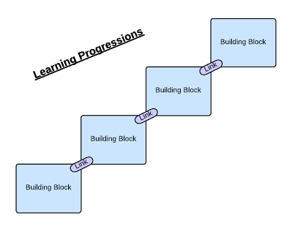
Learning progression line
construction of knowledge and skills throughout the whole curriculum
reflect a growing level of complexity, ranging from easy to difficult

Slide 21
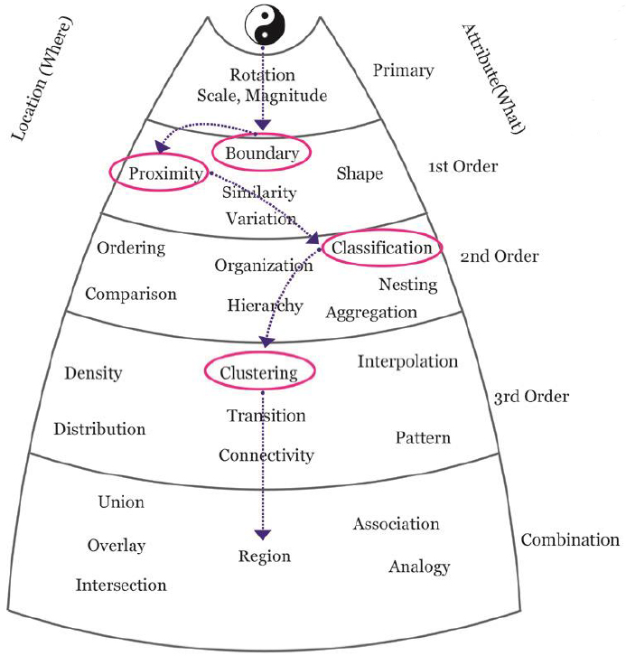
Learning progression line
certain spatial thinking skills are higher order than others and build upon previous, less complex skills

Slide 22
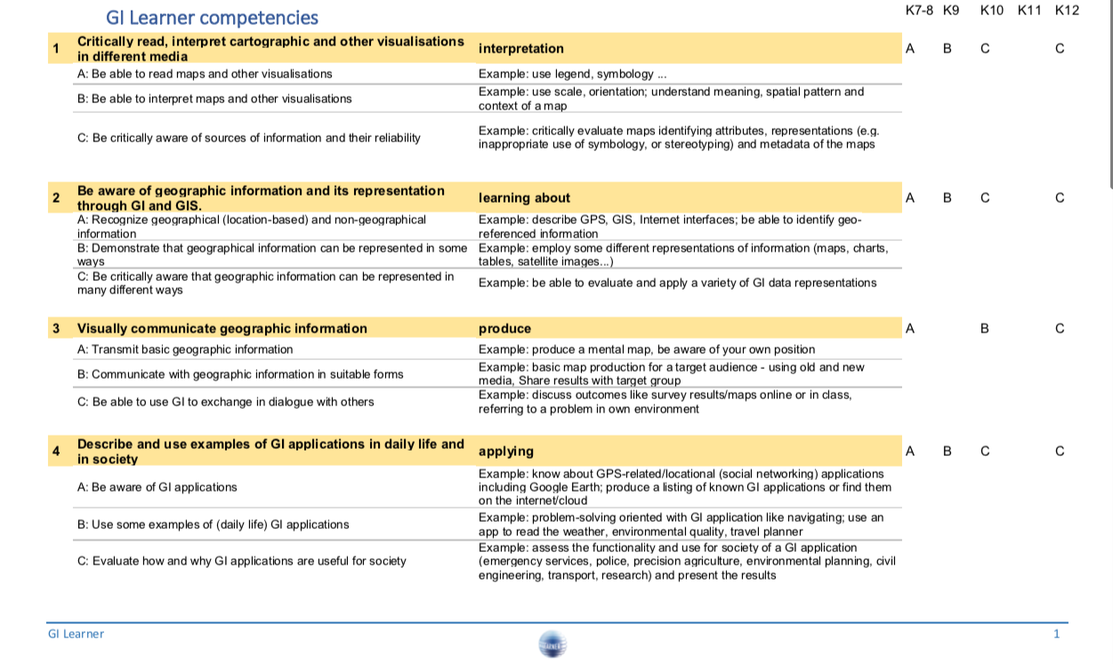
2 Based on the review, ten geospatial thinking competences are proposed

Slide 23
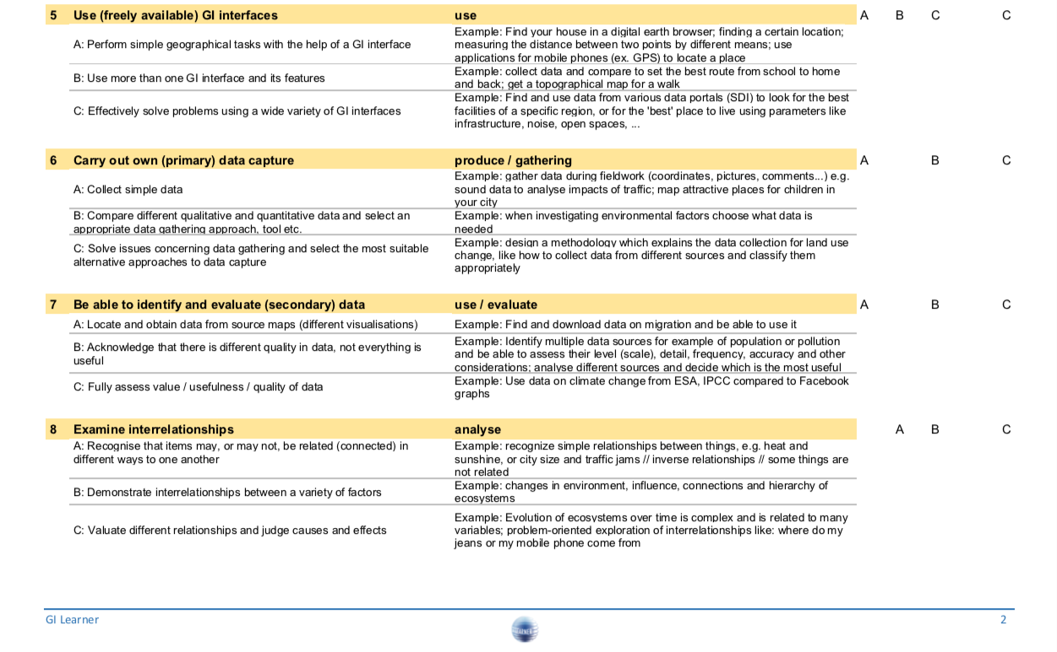

Slide 24
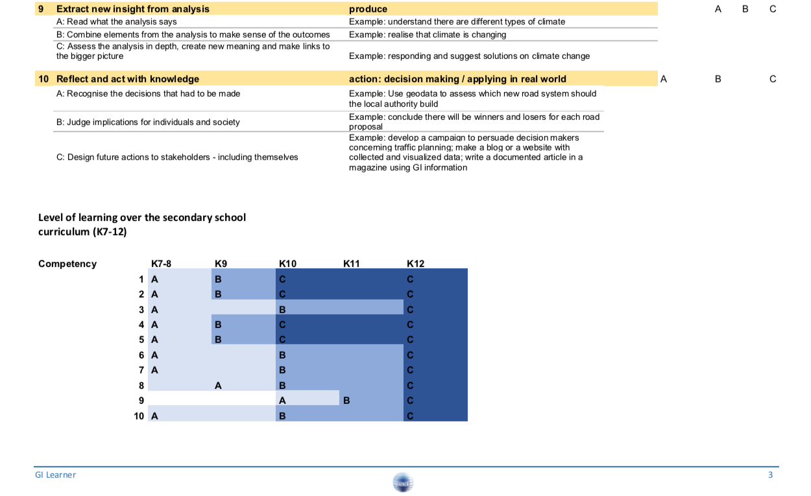

Slide 25
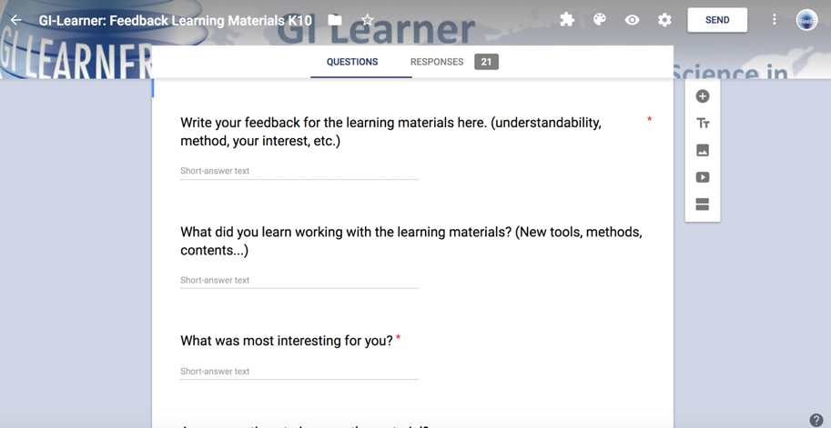
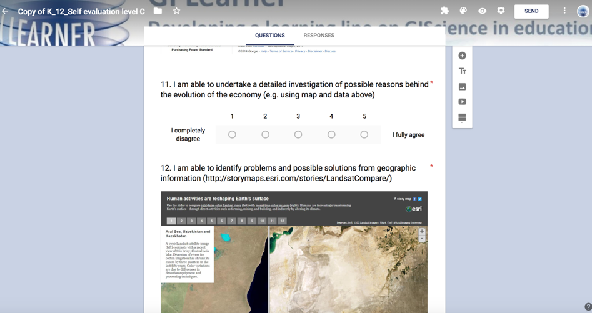
With the help of pupils
3 Evaluative tool

Slide 26
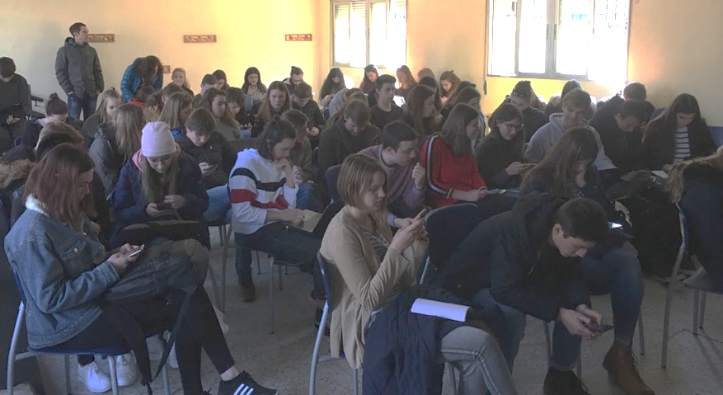
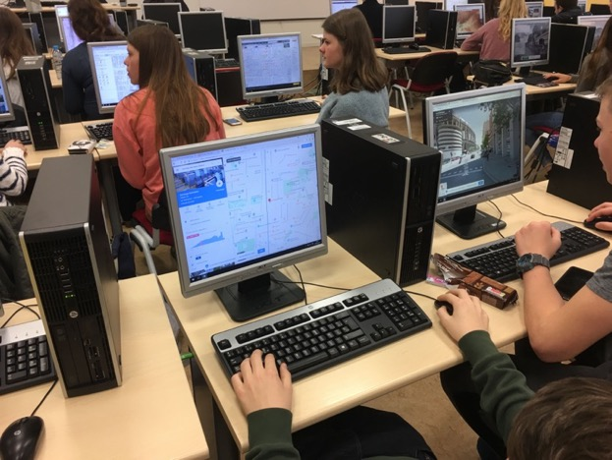
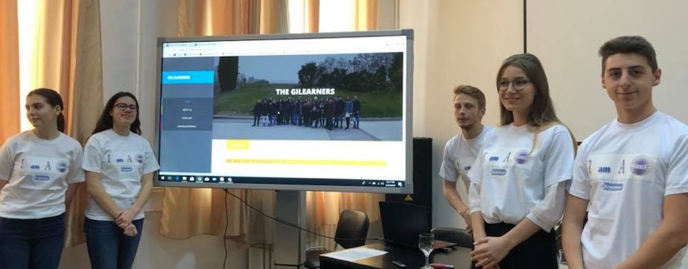
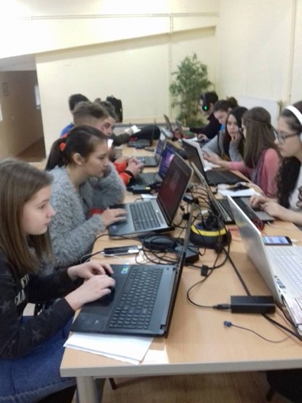
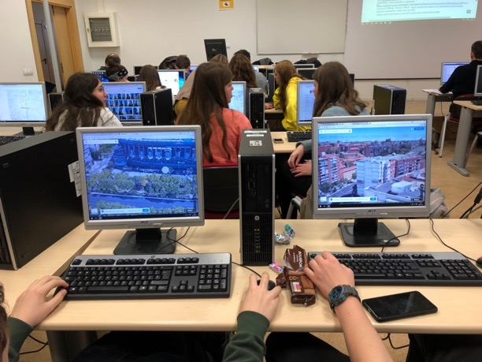
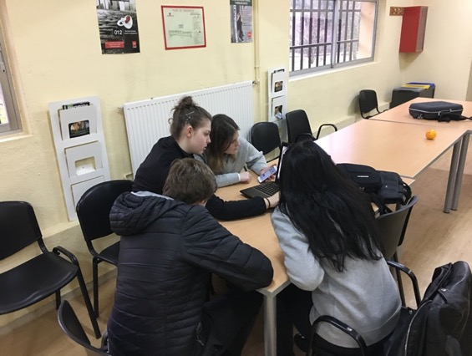
With the help of pupils

Slide 27
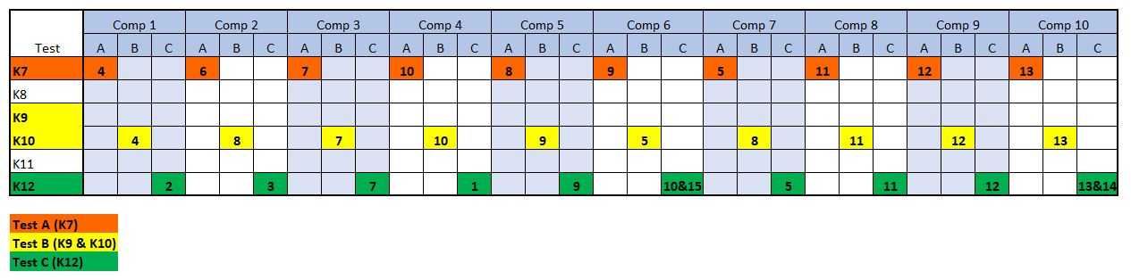

Slide 28
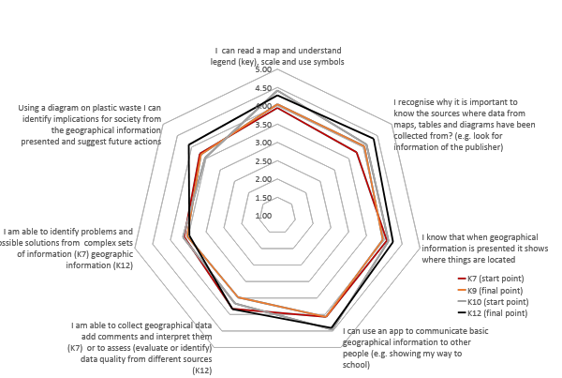
All participants (5 countries)

Slide 29
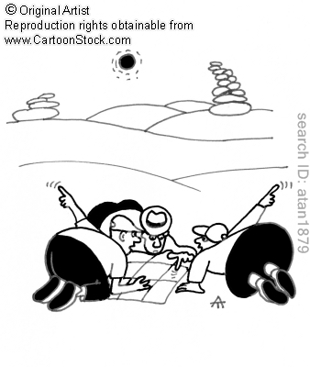
Project Timeframe:
September 2015 – August 2018
More info : www.gilearner.eu
Twitter: @GILearner
Project coordinator: luc.zwartjes@ugent.be

