Slide 1


A project to develop geospatial thinking learning lines in secondary schools
GI-Learner
Luc Zwartjes
Luc.zwartjes@ugent.be

Slide 2
GI-Learner in figures
Seven partners
Five high schools (including coordinating organisation)
Five countries: Belgium, Austria, Romania, Spain, UK
Three year, EU funded Erasmus+ project
Two universities
One international association, EUROGEO

Slide 3





GI-Learner partners

Slide 4

http://www.gilearner.eu

Slide 5
GI Learner Context
To help meet mismatch between workforce demand and labour supply in GI occupation sector.
Due to students leaving high school or university without necessary skills and knowledge.
Big problem for companies, also for society where students finish their studies but don’t find a job.

Slide 6
GI Learner Project Goals
Aim to increase education activities in the field for future workforce needs.
To be achieved by integrating spatial literacy, spatial thinking and GIScience into schools
Help teachers implement learning lines for spatial thinking in secondary schools, using GIScience

Slide 7
GI Learner Action Plan
Summarize most important literature on learning lines and spatial thinking - project foundation.
Scan school curricula to identify opportunities to introduce GIScience → used to develop materials.
Create a test to analyse impact of learning lines on spatial thinking
  at the start of the project to establish the zero level, baseline value of their spatial thinking capability.
  At the end of each year the test will be done, thus measuring the impact of the learning line and to adjust it if needed.

Slide 8
GI Learner Action Plan
Create first learning lines, translate them into real learning objectives, taking into account curricula opportunities in partner countries
  each year one-third of the total learning line will be elaborated (Includes necessary classroom materials)
In Year 1, pupils of different ages (K7 and K10) in partner schools will trial materials, schools give feedback and where appropriate suggest amendments
Final versions of learning outcomes for year 1 lines

Slide 9
GI Learner Action Plan
In year 2, second stage learning lines are developed and used by the pilot groups i.e. in K8, K11
In year 3, third stage learning lines are developed and used by the pilot groups i.e. in K9, K12
Final learning lines are published, with the essential classroom materials, thus facilitating introduction and implementation
A publication with suggestions for inclusion into the national curricula and disseminated among different National Ministries of Education …

Slide 10
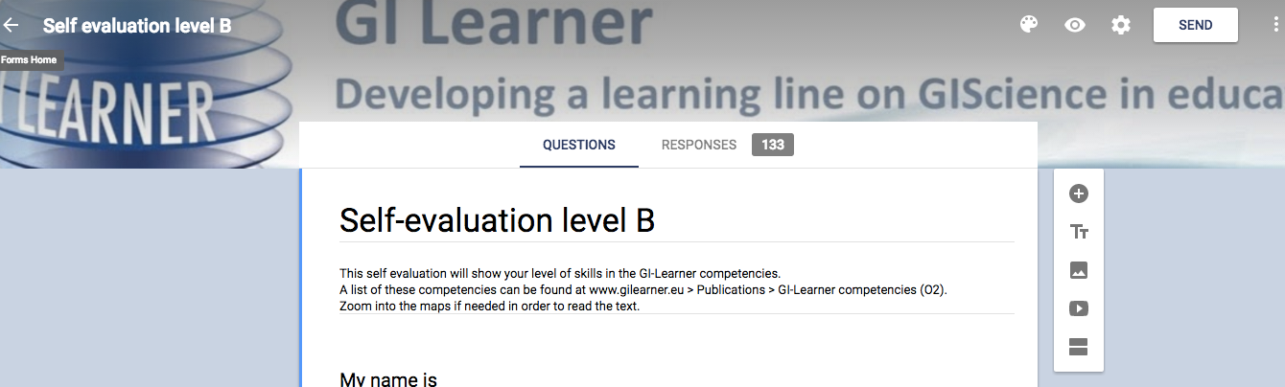
GI Learner Evaluation
Two evaluation surveys have been created (for pupils) to self-assess their confidence in the awareness and understanding of the Spatial Thinking competences – Basic – More Advanced

Slide 11


A spatially literate student …
Literature Review
…. has the following characteristics
Habit of mind of thinking spatially – knows where, when, how and why to think spatially
Practices spatial thinking in an informal way
– deep and broad knowledge of spatial
concepts and representation…
Adopts a critical stance to spatial thinking –
evaluates the quality of spatial data,
uses spatial data to construct …
National Research Council, 2006, Learning to think spatially: GIS as a Support System in the K-12 Curriculum, Washington DC, National Academy Press

Slide 12
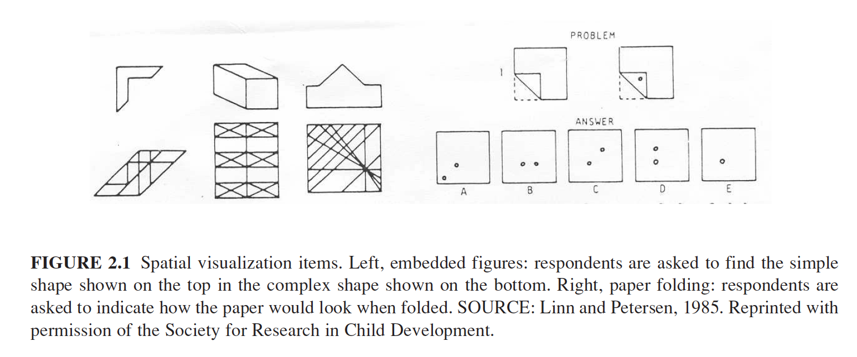
Spatial thinking is …..
Literature Review
traditionally linked to spatial visualization, orientation, spatial perception and mental rotation

Slide 13
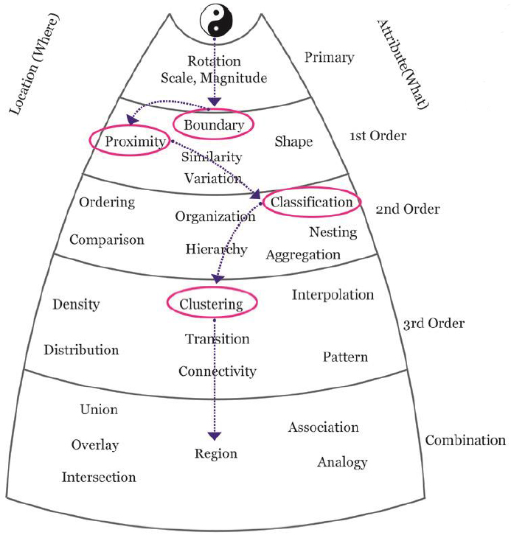
Literature Review
Spatial thinking framework (Perdue and Lobben, 2013)
Perdue, N. and Lobben, A., 2013. The Challenges of Testing Spatial Thinking Skills with Participants who are Blind or Partially Sighted. Sharing knowledge, p.107.

Slide 14
Geospatial thinking is even more …
Literature Review
Geospatial is not simply about visualization and relationships (Wang et al. 2014), it implies
  manipulation
  interpretation and
  explanation of information (Baker et al. (2015)
.... at different geographic scales
Baker, T.R., Battersby, S., Bednarz, S.W., Bodzin, A.M., Kolvoord, B., Moore, S., Sinton, D. and Uttal, D., 2015. A research agenda for geospatial technologies and learning. Journal of Geography, 114(3), pp.118-130.
Wang, H.S., Chen, Y.T. and Lin, C.H., 2014. The learning benefits of using eye trackers to enhance the geospatial abilities of elementary school students. British Journal of Educational Technology, 45(2), pp.340-355.

Slide 15
Geospatial thinking is even more …
Literature Review
not a single ability but comprised of a collection of different skills (Bednarz & Lee, 2011)
the ability to study the characteristics and the interconnected processes of nature and human impact in time and at appropriate scale (Kerski 2008)
Bednarz, R.S. and Lee, J., 2011. The components of spatial thinking: empirical evidence. Procedia-Social and Behavioral Sciences, 21, pp.103-107.
Kerski, J.J., 2008. The role of GIS in Digital Earth education. International Journal of Digital Earth, 1(4), pp.326-346.
Notes:
Bednarz and Lee (2011) conclude in their spatial thinking ability test (STAT) that spatial thinking is not a single ability but comprised of a collection of different skills, whereby following spatial thinking components emerge: map visualization and overlay, identification and classification of map symbols (point, line, area), use of Boolean operations, map navigation and recognition of spatial correlation

Slide 16
Geospatial thinking is even more …
Literature Review
geographic skills provide necessary tools and techniques to think spatially
they enable patterns, associations, and spatial order to be observed (National Geography Standard, 2012)
provide students with skills to respond to crucial scientific and social questions of the 21st century (Tsou and Yanow, 2010).
Geography Education Standards Project, 2012, Geography for Life – National Geography
Standards, Second edition, National Geographic Society, Washington D.C., 272 p.
Tsou, M.H. and Yanow, K., 2010. Enhancing general education with geographic information science and spatial literacy. URISA Journal, 22(2), 45-54
Notes:
Bednarz and Lee (2011) conclude in their spatial thinking ability test (STAT) that spatial thinking is not a single ability but comprised of a collection of different skills, whereby following spatial thinking components emerge: map visualization and overlay, identification and classification of map symbols (point, line, area), use of Boolean operations, map navigation and recognition of spatial correlation

Slide 17
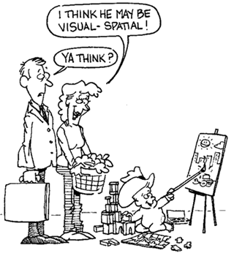
GI Science ← Spatial Thinking
Key Literature
Literature Review
Spatial Thinking dimensions and related terms (Michel & Hof, 2013)
Michel, E. & Hof, A., 2013, Promoting Spatial Thinking and Learning with Mobile Field Trips and eGeo-Riddles, Jekel, T., Car, A., Strobl, J., Griesebner, G. (eds.), GI_Forum 2013: Creating the GISociety, 378-387. Berlin, Wichmann Verlag
Notes:
enables knowing about
- Space – e.g. different ways of calculating distance, coordinate system
- Representation – e.g. effect of projections, principles of graphic design (semiology)
- Reasoning – e.g. different ways of thinking about shortest distances, estimate the slope of a hill fom a map of contour lines

Slide 18
Linking geospatial thinking to GIS
Literature Review
a new geotechnological paradigm (Kerski, 2015)
defined as a new way of doing science
derived from technological advances
the huge increase in availability of spatial data (big data, mining data, crowdsourcing etc.)
tools and data available to citizens
awareness of data quality now essential
Kerski, J.J., 2015. Opportunities and Challenges in Using Geospatial Technologies for Education. In Geospatial Technologies and Geography Education in a Changing World (pp.183-194). Springer Japan.

Slide 19
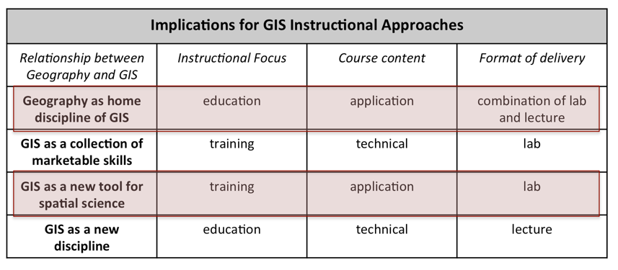
How to implement this?
Literature Review
Four schools of thought on the relationship between Geography & GIS (Sui, 1995)
Sui, D.Z., 1995. A pedagogic framework to link GIS to the intellectual core of geography. Journal of Geography, 94(6), pp.578-591.
Notes:
Two of the four schools describe the ideal vision for secondary education:
The first schools stating that Geography is uniquely suited as the home discipline of GIS. It simply automates the tasks geographers have been doing for several thousands of years, and aims at a full integration of GIS into all aspects of geography curriculum.
The third school seeing GIS as the tool to support scientific inquiry as ultimate goal in a variety of disciplines, thus GIS as enabling tool for science.
Both put the emphasis of the course content on application – GIS as a tool, whereas the two other schools are focusing on the technical aspects of GIS.

Slide 20
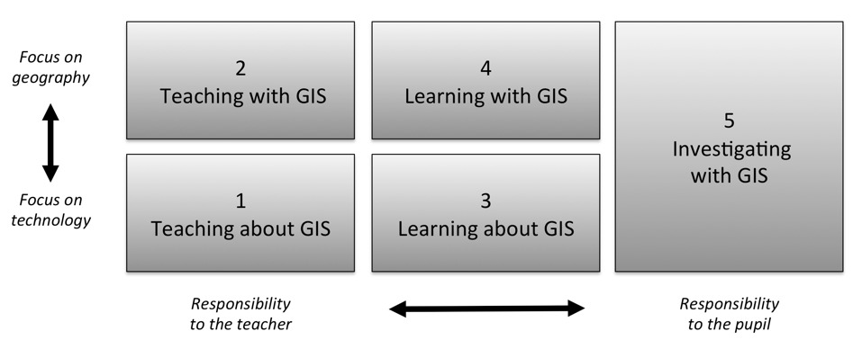
How to implement this?
Literature Review
Five ways of integrating GIS in geography education (Favier, 2013)
Favier, T.M., 2011, Geographic Information Systems in inquiry-based secondary geography education, Vrije Universiteit Amsterdam, 287 pp.
Notes:
Favier (2013) describes five ways on how GIS can be integrated in secondary education (Figure 8). Teaching and learning about GIS focuses more on the theoretical aspects of GIS (knowledge of GIS, structure of the technology), where the three other ways use the technology to develop and use spatial thinking skills

Slide 21
Why GIS is not used more?
Literature Review
GIS is not a compulsory item in teacher training.
Taught by non-specialists, leading to teachers with limited pedagogical content knowledge, resulting in fewer teachers recognizing the potential opportunities GIS offers to teach geography content and skills, teach more and more geography.
Curriculum not included or impedes adoption to include GIS.
The non-availability of data and easy-to-use software.
Attitudes of teachers It seems difficult to persuade teachers to use new technologies, if they are highly demanding technically and if teachers are not fully convinced of the effectiveness and added value.
Bednarz and van der Schee (2006)
Bednarz, S.W. and Schee, J.V.D., 2006. Europe and the United States: The implementation of geographic information systems in secondary education in two contexts. Technology, Pedagogy and Education, 15(2),191-205.

Slide 22
Recommendations for successful introduction and integration
Literature Review
address key issues related to GIS implementation: teacher training, availability of user friendly software, ICT equipment in schools.
use a community of learners approach and
institutionalize GIScience into curricula, making sure that it is aligned with significant general learning goals like graphicacy, critical thinking and citizenship skills.
Bednarz, S. W. & van der Schee, J. 2006. Europe and the United States: the implementation of geographic information systems in secondary education in two contexts, Technology, Pedagogy and Education. 15 (2), 191-205

Slide 23
Why GIS is not used more?
Literature Review
schools in Europe nowadays generally have better ICT equipment
Cloud-based developments
pupils increasingly asked bring their own devices
more openly available data
Web-based platforms have reduced / no costs
networking and communities encouraged and available – social media (digital-earth, eduGIS)

Slide 24




Content already exists
Literature Review
iGuess → www.iguess.eu
I-Use → www.i-use.eu
EduGIS → www.edugis.nl, www.edugis.pl
PaikkaOppi learning environment → http://www.paikkaoppi.fi/
But it is not structured or coordinated by age …

Slide 25
Why GIS is not used more?
Literature Review
GIS is not a compulsory item in teacher training.
Taught by non-specialists, leading to teachers with limited pedagogical content knowledge, resulting in fewer teachers recognizing the potential opportunities GIS offers to teach geography content and skills, teach more and more geography.
Curriculum not included or impedes adoption to include GIS.
The non-availability of data and easy-to-use software.
Attitudes of teachers It seems difficult to persuade teachers to use new technologies, if they are highly demanding technically and if teachers are not fully convinced of the effectiveness and added value.
Bednarz and van der Schee (2006)
Bednarz, S.W. and Schee, J.V.D., 2006. Europe and the United States: The implementation of geographic information systems in secondary education in two contexts. Technology, Pedagogy and Education, 15(2), pp.191-205.

Slide 26
Recommendations for successful introduction and integration
Literature Review
institutionalization of geo-technology and geo-media into curricula remains a goal in almost all European countries … despite:
  benchmarks, intended to give a rationale and recommendations on the implementation to teacher trainers, teachers and headmasters, but also to policy and decision makers
  competence models
  teacher guidance, whereby teachers can select suitable tools to use, based on curricula, abilities of their students and their own capabilities and
  content from innovative projects: iGuess, SPACIT, EduGIS Academy, I-Use etc.

Slide 27

Literature Review
What is a learning line?
A learning line is an educational term that refers to the construction of knowledge and skills throughout the whole curriculum.
This learning line reflects an increasing level of complexity, ranging from easy (more basic skills and knowledge) to difficult.
Zwartjes, L., 2014. The need for a learning line for spatial thinking using GIS in education. Innovative Learning Geography in Europe: New Challenge for the 21st Century, pp.39-62.

Slide 28
Learning Lines
Literature Review
based on the Flemish National curriculum
an overall framework for education and training
reflect a growing level of complexity
range from easy (more basic skills and knowledge) to difficult
distinguish several “learning steps” – beginners to experts
Bloemen, H. and Naaijkens, A., 2014, January. Designing a (Continuous) Learning Line for Literary Translation. In Second international conference on research into the didactics of translation: book of abstracts (pp. 36-36). PACTE group, https://lirias.kuleuven.be/handle/123456789/489288 .

Slide 29
Learning Lines
Literature Review
Three possible approaches from the literature:
analytical, competence-based (Bloemen & Naaijkens, 2014)
problem setting - concept-context approach for selecting learning goals (Van Moolenbroek & Boersma, 2013)
spatial thinking framework (Perdue & Lobben, 2013) - certain spatial thinking skills are higher order than others and build upon previous, less complex skills
Van Moolenbroek, A., & Boersma, K. 2013. Behavioural biology: Developing a learning and teaching strategy in upper secondary education. In T. Plomp, & N. Nieveen (eds.), Educational design research, 601-617. Enschede, the Netherlands: SLO, http://www.vanmoolenbroek.nl/wp-content/uploads/2015/01/Ch29.pdf
Perdue, N. and Lobben, A., 2013. The Challenges of Testing Spatial Thinking Skills with Participants who are Blind or Partially Sighted. Sharing knowledge, In: Reyes Nuñez J. J.. Sharing knowledge. Joint ICA Symposium, http://lazarus.elte.hu/ccc/2013icc/skproceedings.pdf#page=112

Slide 30

Literature Review
Learning Line examples
learning lines: | Fieldwork | Working with images | Working with maps | Working with statistical material | Creation of knowledge
Level 1 | Perception – knowledge of facts
Level 2 | Analysis – selection of relevant geographic information
Level 3 | Structure – look for complex connections and relationships
Level 4 | Application – thinking problem solving

Slide 31
Geospatial thinking
Based on the review, ten geospatial thinking competences are proposed for GI-Learner:
Critically read, interpret cartographic and other visualisations in different media
Be aware of geographic information and its representation through GI and GIS.
Visually communicate geographic information
Describe and use examples of GI applications in daily life and in society
Use (freely available) GI interfaces

Slide 32
Geospatial thinking
Based on this review, ten geospatial thinking competences are proposed for GI-Learner:
Carry out own (primary) data capture
Be able to identify and evaluate (secondary) data
Examine interrelationships
Synthesise meaning from analysis
Reflect and act with knowledge

Slide 33
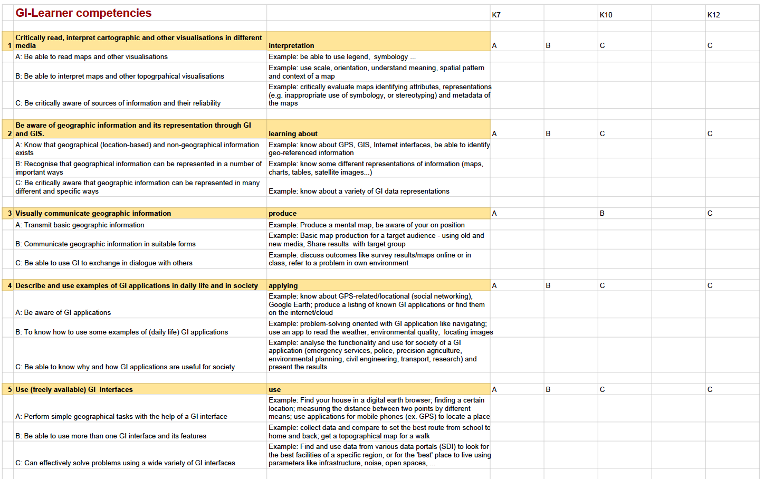
Geospatial thinking

Slide 34
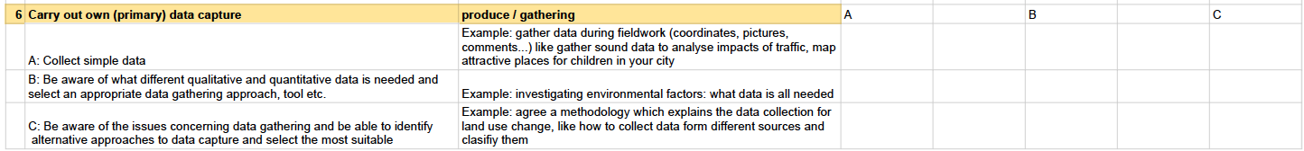
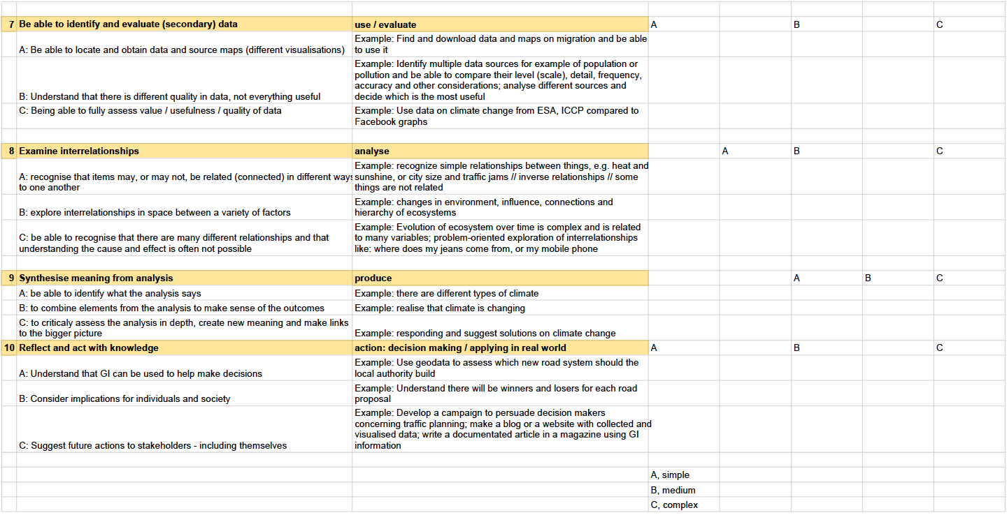
Geospatial thinking

Slide 35
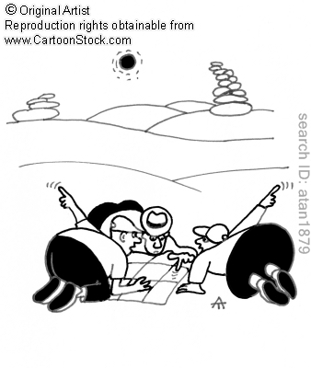
Project Timeframe:
September 2015 – August 2018
More info : www.gi-learner.eu
Twitter: @GILearner
Project coordinator: luc.zwartjes@ugent.be

