Slide 1


A project to develop geospatial thinking learning lines in secondary schools
GI-Learner
Luc Zwartjes
Ghent University Geography Department
Sint-Lodewijkscollege Brugge

Slide 2
GI-Learner in figures
Seven partners
Five high schools (including coordinating organisation)
Five countries: Belgium, Austria, Romania, Spain, UK
Three year, EU funded Erasmus+ project
Two universities
One international association, EUROGEO

Slide 3







GI-Learner partners

Slide 4
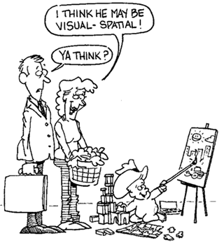
GI Science ← Spatial Thinking
Key Literature
Literature Review
Spatial Thinking dimensions and related terms (Michel & Hof, 2013)
Michel, E. & Hof, A., 2013, Promoting Spatial Thinking and Learning with Mobile Field Trips and eGeo-Riddles, Jekel, T., Car, A., Strobl, J., Griesebner, G. (eds.), GI_Forum 2013: Creating the GISociety, 378-387. Berlin, Wichmann Verlag
Notes:
enables knowing about
- Space – e.g. different ways of calculating distance, coordinate system
- Representation – e.g. effect of projections, principles of graphic design (semiology)
- Reasoning – e.g. different ways of thinking about shortest distances, estimate the slope of a hill fom a map of contour lines

Slide 5
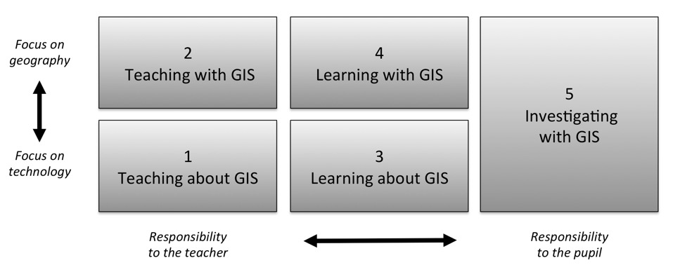
How to implement this?
Literature Review
Five ways of integrating GIS in geography education (Favier, 2013)
Favier, T.M., 2011, Geographic Information Systems in inquiry-based secondary geography education, Vrije Universiteit Amsterdam, 287 pp.
Notes:
Favier (2013) describes five ways on how GIS can be integrated in secondary education (Figure 8). Teaching and learning about GIS focuses more on the theoretical aspects of GIS (knowledge of GIS, structure of the technology), where the three other ways use the technology to develop and use spatial thinking skills

Slide 6




Content already exists
Literature Review
iGuess → www.iguess.eu
I-Use → www.i-use.eu
EduGIS → www.edugis.nl, www.edugis.pl
PaikkaOppi learning environment → http://www.paikkaoppi.fi/
But it is not structured or coordinated by age …

Slide 7
Why GIS is not used more?
Literature Review
GIS is not a compulsory item in teacher training.
Taught by non-specialists, leading to teachers with limited pedagogical content knowledge, resulting in fewer teachers recognizing the potential opportunities GIS offers to teach geography content and skills, teach more and more geography.
Curriculum not included or impedes adoption to include GIS.
The non-availability of data and easy-to-use software.
Attitudes of teachers It seems difficult to persuade teachers to use new technologies, if they are highly demanding technically and if teachers are not fully convinced of the effectiveness and added value.
Bednarz and van der Schee (2006)
Bednarz, S.W. and Schee, J.V.D., 2006. Europe and the United States: The implementation of geographic information systems in secondary education in two contexts. Technology, Pedagogy and Education, 15(2), pp.191-205.

Slide 8

Literature Review
What is a learning line?
A learning line is an educational term that refers to the construction of knowledge and skills throughout the whole curriculum.
This learning line reflects an increasing level of complexity, ranging from easy (more basic skills and knowledge) to difficult.
Zwartjes, L., 2014. The need for a learning line for spatial thinking using GIS in education. Innovative Learning Geography in Europe: New Challenge for the 21st Century, pp.39-62.

Slide 9
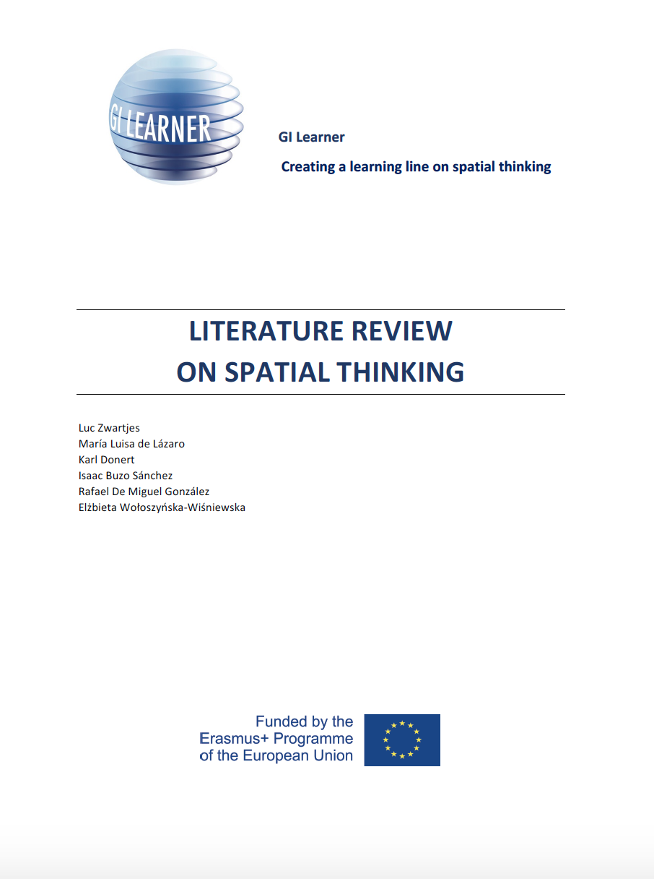
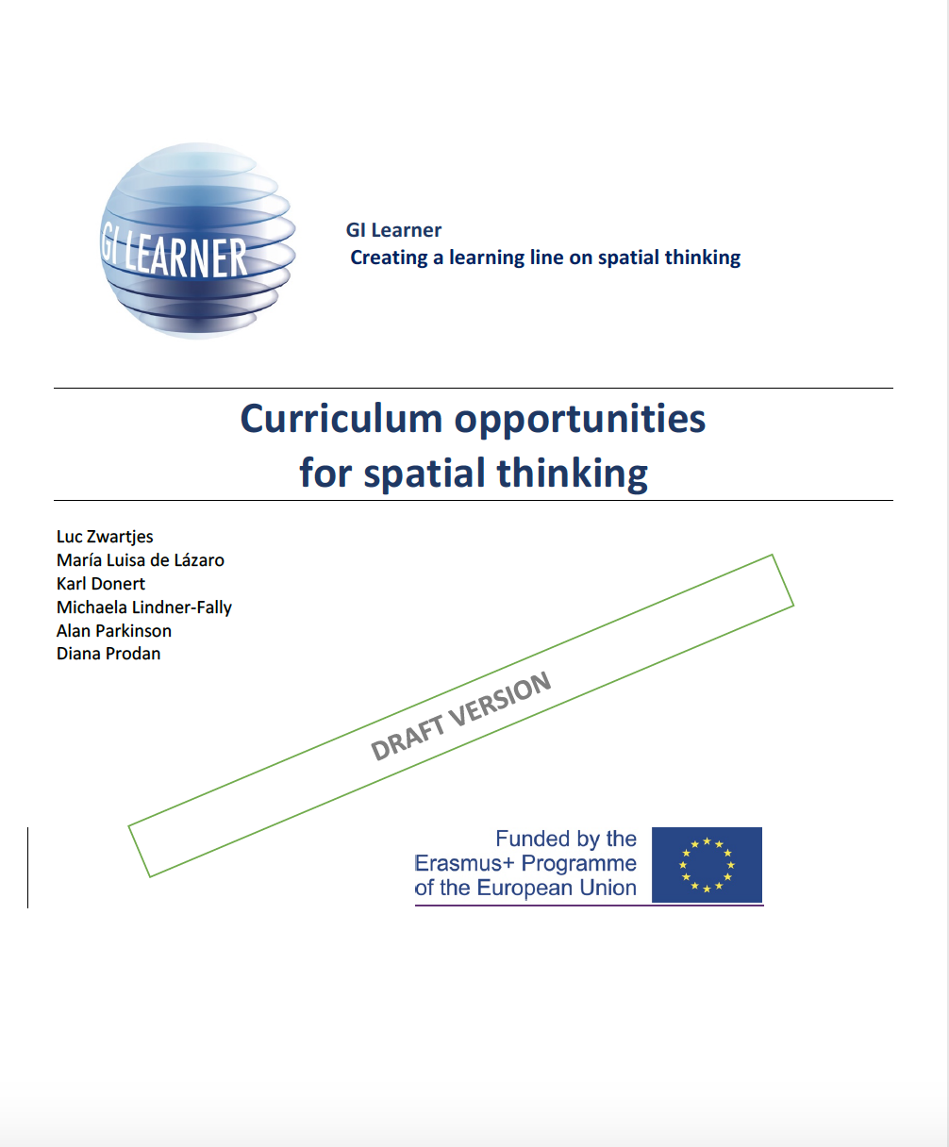
GI Learner Action Plan
Summarize most important literature on learning lines and spatial thinking - project foundation.
→ publication
Scan school curricula to identify opportunities to introduce GIScience → used to develop materials.
→ publication
Create first learning lines, translate them into real learning objectives, taking into account curricula opportunities in partner countries

Slide 10
GI Learner Action Plan
Create a test to analyse impact of learning lines on spatial thinking
  at the start of the project to establish the zero level,
  At the end of each year thus measuring the impact
In Year 1, pupils of different ages (K7 and K10) in partner schools will trial materials, schools give feedback and where appropriate suggest amendments
Final versions of learning outcomes for year 1 lines

Slide 11
GI Learner Action Plan
In year 2, second stage learning lines are developed and used by the pilot groups i.e. in K8, K11
In year 3, third stage learning lines are developed and used by the pilot groups i.e. in K9, K12
Final learning lines are published, with the essential classroom materials, thus facilitating introduction and implementation
A publication with suggestions for inclusion into the national curricula and disseminated among different National Ministries of Education …

Slide 12
Geospatial thinking competences
Based on the review, ten geospatial thinking competences are proposed for GI-Learner:
Critically read, interpret cartographic and other visualisations in different media
Be aware of geographic information and its representation through GI and GIS.
Visually communicate geographic information
Describe and use examples of GI applications in daily life and in society
Use (freely available) GI interfaces

Slide 13
Geospatial thinking competences
Based on this review, ten geospatial thinking competences are proposed for GI-Learner:
Carry out own (primary) data capture
Be able to identify and evaluate (secondary) data
Examine interrelationships
Synthesise meaning from analysis
Reflect and act with knowledge

Slide 14
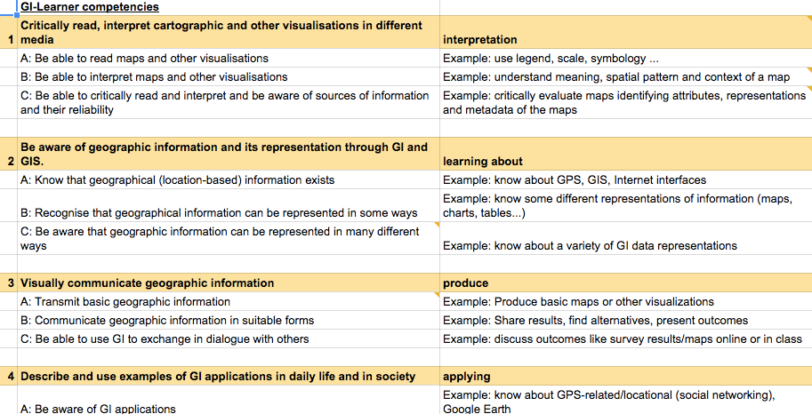
Geospatial thinking competences

Slide 15

http://www.gilearner.eu

Slide 16
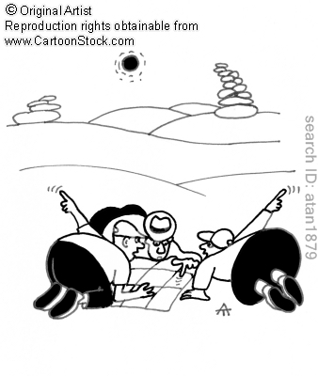
Project Timeframe:
September 2015 – August 2018
More info : www.gilearner.eu
Twitter: @GILearner
Project coordinator: luc.zwartjes@ugent.be

