Slide 1

GI Learner:
Developing a learning line on GIScience in education
Luc Zwartjes
Ghent University, geography department
Sint-Lodewijkscollege Brugge
EUROGEO

Slide 2
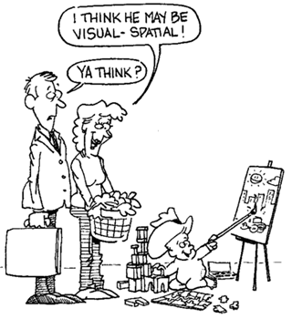
GI Science ← spatial thinking
Notes:
enables knowing about
- Space – e.g. different ways of calculating distance, coordinate system
- Representation – e.g. effect of projections, principles of graphic design (semiology)
- Reasoning – e.g. different ways of thinking about shortest distances, estimate the slope of a hill fom a map of contour lines

Slide 3

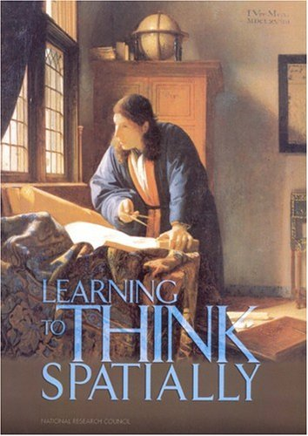
A spatially literate student
has following characteristics
Habbit of mind of thinking spatially – knows where, when, how and why to think spatially
Practice spatial thinking in an informal way
– deep and broad knowledge of spatial
concepts and representation…
Adopt critical stance to spatial thinking –
evaluate quality of spatial data,
use spatial data to construct …
http://www.nap.edu/catalog.php?record_id=11019

Slide 4
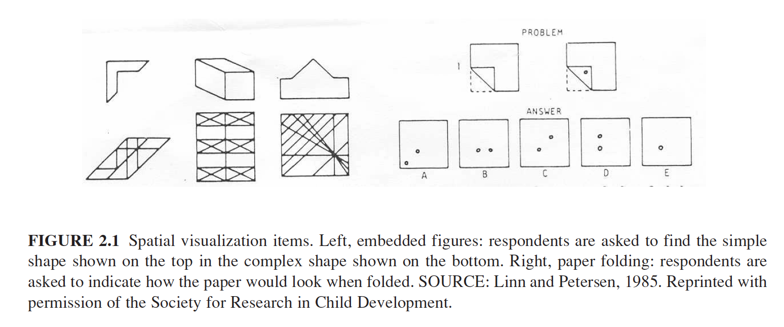
Spatial thinking is even more … geospatial thinking
Spatial thinking traditionally linked to spatial visualization and orientation, to spatial perception and mental rotation as integration in spatial visualization

Slide 5
Spatial thinking is even more … geospatial thinking
Spatial thinking traditionally linked to spatial visualization and orientation, to spatial perception and mental rotation as integration in spatial visualization
Geospatial: not only to do with visualization and relationships, it means to manipulate (e.g. using simulations), interpret and explain information at different geographic scales connected to Earth.

Slide 6
Spatial thinking is even more … geospatial thinking
The ability to study the characteristics and the interconnected processes of nature and human impact in time and at appropriate scale (Kerski 2008)
not a single ability but comprised of a collection of different skills (Bednarz & Lee, 2011)
Geographic skills provide necessary tools and techniques to think spatially. They enable to observe patterns, associations, and spatial order (National geography standard, 2012)
A solid foundation in spatial literacy will provide students with the crucial scientific and social questions of the 21st century (Tsou and Yanow, 2010).
Notes:
Bednarz and Lee (2011) conclude in their spatial thinking ability test (STAT) that spatial thinking is not a single ability but comprised of a collection of different skills, whereby following spatial thinking components emerge: map visualization and overlay, identification and classification of map symbols (point, line, area), use of Boolean operations, map navigation and recognition of spatial correlation

Slide 7
Linking geospatial thinking to the use of GIS
There is an epistemological change in Geographical discipline into a new scientific praxis:
a geotechnological paradigm defined as a new way of doing science possible not only derived from the technological advance, but also because of the huge increased in spatial data (big data, mining data and crowdsourcing data, among others) available to citizens whose knowledge on quality data now appears as essential (Kerski, 2015).

Slide 8
Linking geospatial thinking to the use of GIS
geotechnological paradigm
a proper use of technologies, which in Geography can be translated into using technologies and GIS as a science not only as a tool (teaching GIS) but for learning, teaching and researching: teaching with GIS (Koutsopoulos, 2010).

Slide 9
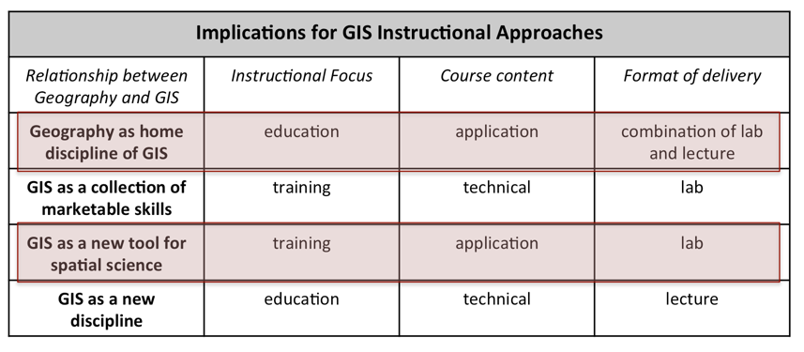
But how to implement?
Four schools of thought about the relationship between geography & GIS (Kemp. et al, mentioned by Sui, 1995
Notes:
Two of the four schools describe the ideal vision for secondary education:
The first schools stating that Geography is uniquely suited as the home discipline of GIS. It simply automates the tasks geographers have been doing for several thousands of years, and aims at a full integration of GIS into all aspects of geography curriculum.
The third school seeing GIS as the tool to support scientific inquiry as ultimate goal in a variety of disciplines, thus GIS as enabling tool for science.
Both put the emphasis of the course content on application – GIS as a tool, whereas the two other schools are focusing on the technical aspects of GIS.

Slide 10
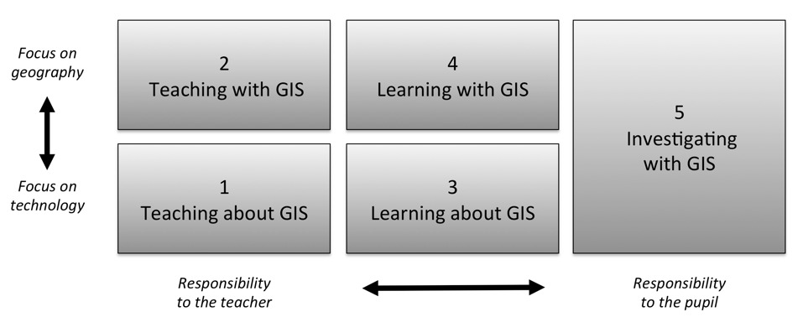
But how to implement?
Five ways of integrating GIS in geography education (Favier, 2013)
Notes:
Favier (2013) describes five ways on how GIS can be integrated in secondary education (Figure 8). Teaching and learning about GIS focuses more on the theoretical aspects of GIS (knowledge of GIS, structure of the technology), where the three other ways use the technology to develop and use spatial thinking skills

Slide 11
Why not used more / better?
In teacher training GIS is not a core item.
Non-geographers, leading to teachers with limited pedagogical content knowledge, resulting in fewer teachers recognizing the potential opportunities GIS offers to teach geography content and skills, teach more and more geography.
Curriculum doesn’t include or impede adoption to include GIS.
The non-availability of free data and easy-to-use software.
The attitude of teachers. It seems difficult to persuade teachers to use new technologies, certainly if they are highly technical demanding and if teachers are not fully convinced of the effectiveness and added value.
Bednarz and van der Schee (2006)

Slide 12
Why not used more / better?
In teacher training GIS is not a core item.
Non-geographers, leading to teachers with limited pedagogical content knowledge, resulting in fewer teachers recognizing the potential opportunities GIS offers to teach geography content and skills, teach more and more geography.
Curriculum doesn’t include or impede adoption to include GIS.
The non-availability of free data and easy-to-use software.
The attitude of teachers. It seems difficult to persuade teachers to use new technologies, certainly if they are highly technical demanding and if teachers are not fully convinced of the effectiveness and added value.
Bednarz and van der Schee (2006)

Slide 13


Already many ideas/materials
iGuess → www.iguess.eu
I-Use → www.i-use.eu
EduGIS → www.edugis.nl, www.edugis.pl
Geospatial Semester → http://www.isat.jmu.edu/geospatialsemester
PaikkaOppi learning environment → http://www.paikkaoppi.fi/
But not structured

Slide 14




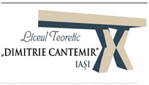



Slide 15
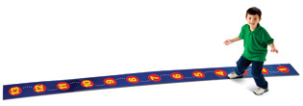
Aim
Creating a learning line
“educational term that refers to the construction of knowledge and skills throughout the whole curriculum. This learning line reflects an increasing level of complexity, ranging from easy (more basic skills and knowledge) to difficult.”

Slide 16
Aim
5 learning lines: | Fieldwork | Working with images | Working with maps | Working with statistical material | Creation of knowledg
Level 1 | Perception – knowledge of facts
Level 2 | Analysis – selection of relevant geographic information
Level 3 | Structure – look for complex connections and relationships
Level 4 | Apply – thinking problem solving

Slide 17
Different steps
Summarize the most important literature on learning lines and spatial thinking - thus being the basis for the next steps.
Scan the curricula to identify opportunities to introduce GIScience → will be used to develop all materials
Test to analyse the impact of the learning lines on spatial thinking
  at the start of the project to establish the zero level, baseline value of their spatial thinking capability.
  At the end of each year the test will be done again, thus offering the opportunity to measure the impact of the developing learning line and to adjust if needed.

Slide 18
Different steps
create the first drafts of learning line, translating them into real learning objectives for selected years (K7 and K10) - taking into account the subjects of the curricual in their country
  each year a part of the total learning line will be elaborated.
  Include necessary classroom materials,
In the first year of the project, pupils of different ages (K7 and K10) of the partner schools will test the materials and give their feedback and if appropriate their amendements.
The teachers and researchers will rewrite the learning outcomes into a final version .

Slide 19
Different steps
In the second and third year of the project the same activities will be done for year groups K8-K11 and K9-K12.- same group of pupils will be testing the materials for three years in a row
The final learning lines will be published.
along with the essential classroom materials, thus facilitating the introduction and implementation.
A publication with amendments for inclusion into the national curricula will be produced and disseminated among the different national ministries of education..

Slide 20
Timeframe:
September 2015 – August 2018 more info : www.gi-learner.eu (soon) join us at the next EUROGEO conference: September 2016 luc.zwartjes@ugent.be

Slide 21

www.eurogeography.eu/

Slide 22

www.eurogeography.eu/

Slide 23
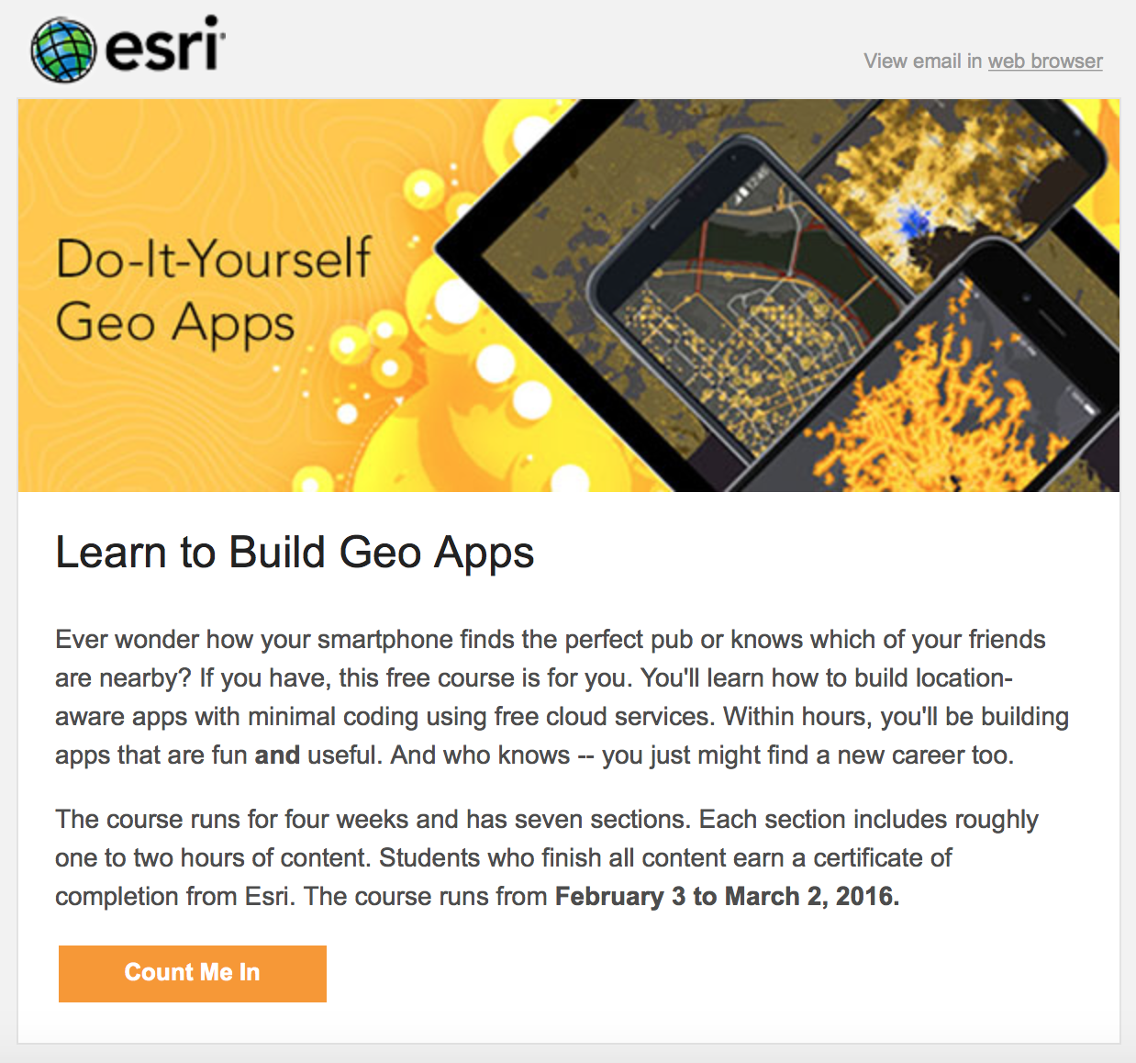
http://tinyurl.com/zjh2fmo
www.eurogeography.eu/

Slide 24
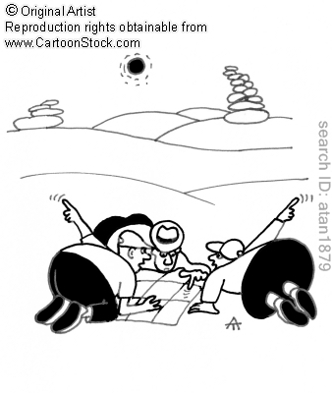
Timeframe:
September 2015 – August 2018 more info : www.gi-learner.eu (soon) join us at the next EUROGEO conference: September 2016 http://www.eurogeography.eu/conference-2016-malaga/ luc.zwartjes@ugent.be

